Slide 1
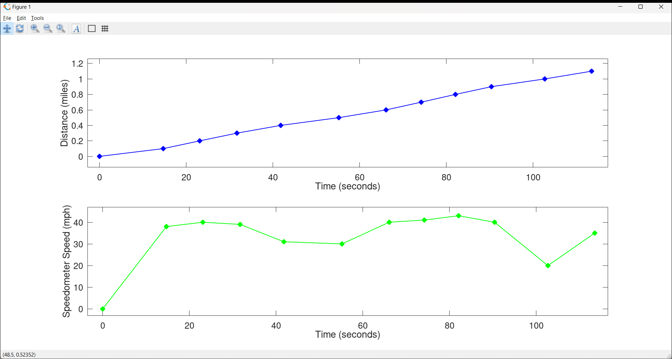

Slide 2
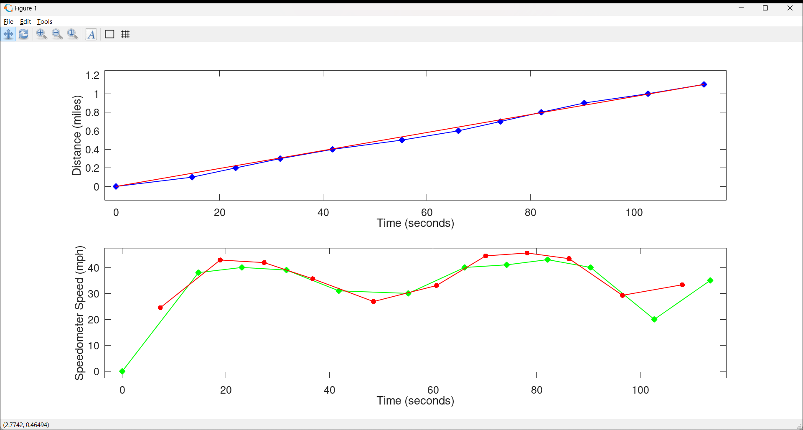
Distance = (35 mph)*time=(1.1 miles)/(113.5s)*t

Slide 3
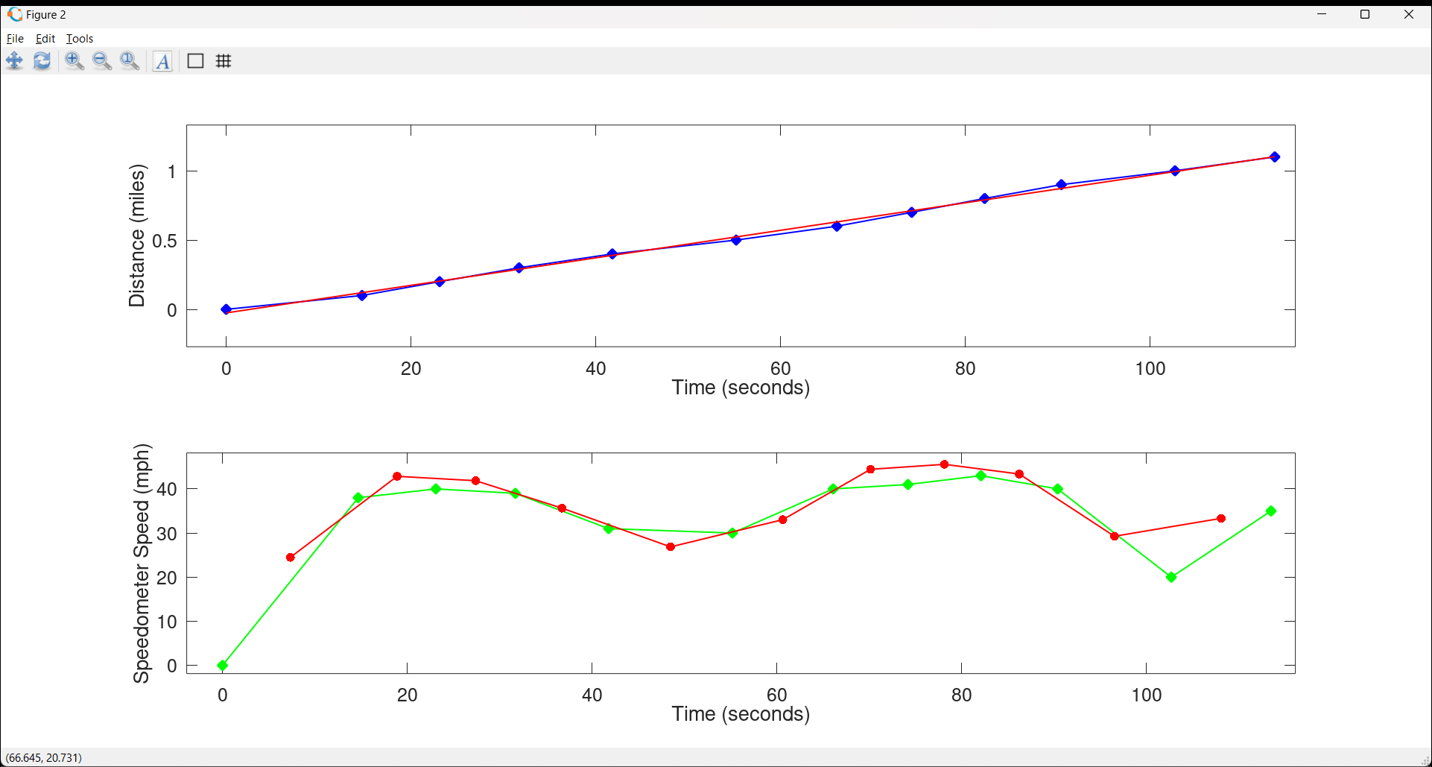
Distance = (36 mph)*time-(0.2 miles)

Slide 7
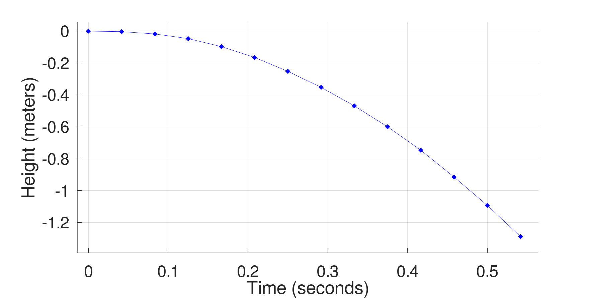

Slide 8
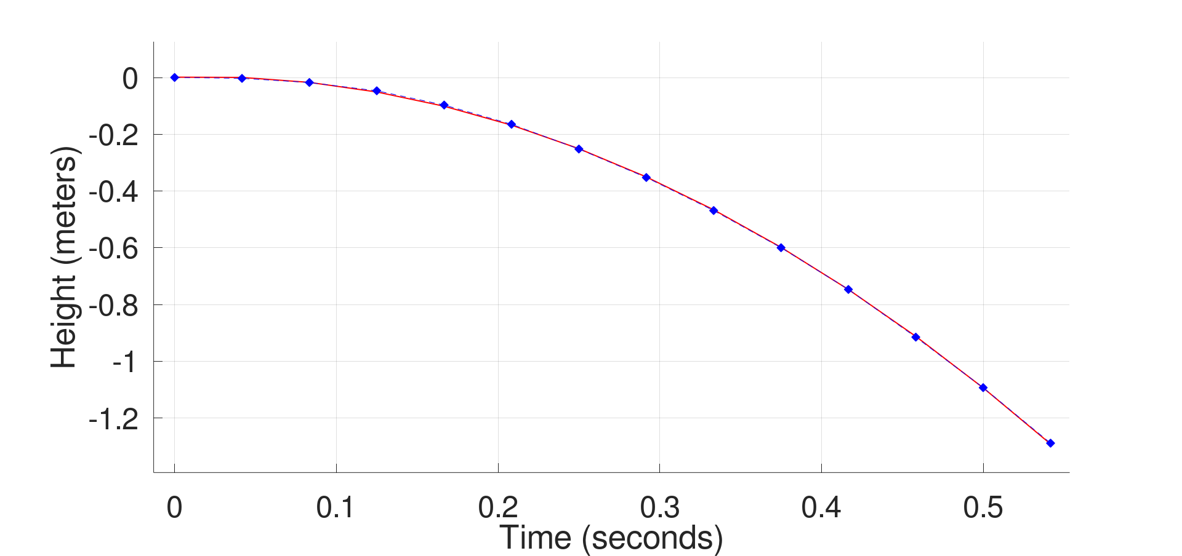
Distance = -(4.7m/s^2)*time^2
+(0.17 m/s)*time
+(.001 m)

Slide 9
Distance = -(4.7m/s^2)*time^2

Slide 10
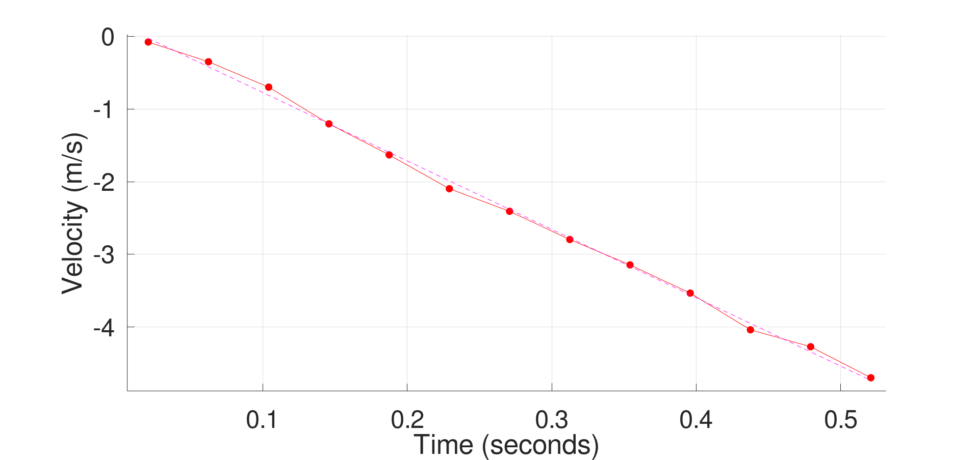
Velocity ~= -(9.4 m/s^2)*time

Slide 11
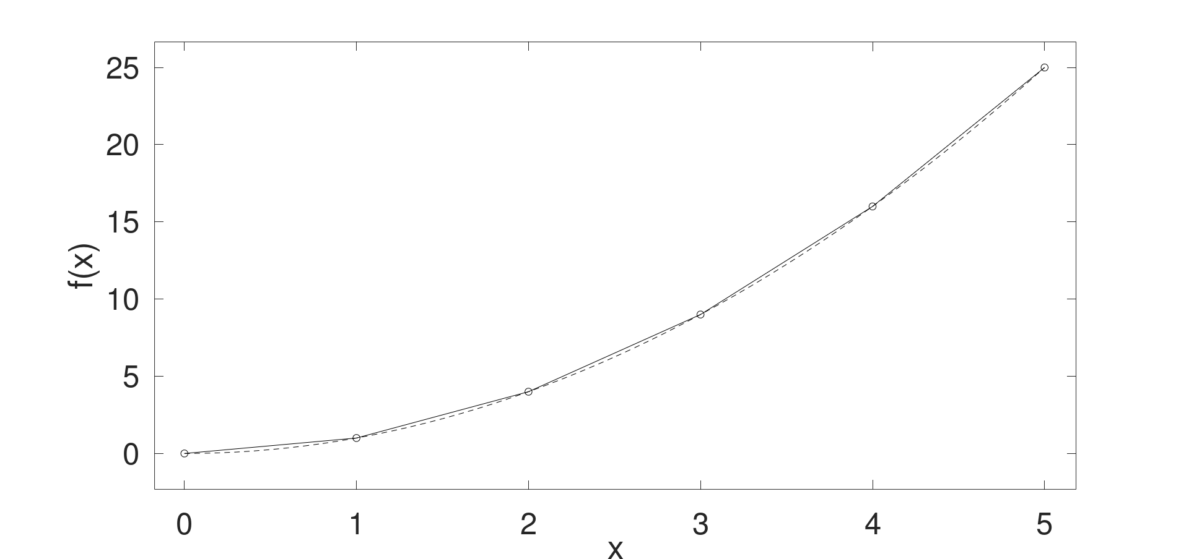





$$\frac{5^{2}−42}{1}=9$$
$$\frac{4^{2}−32}{1}=7$$
$$\frac{3^{2}−22}{1}=5$$
$$\frac{2^{2}−12}{1}=3$$
$$\frac{1^{2}}{1}=1$$

Slide 12





$$\frac{5^{2}−42}{1}=9$$
$$\frac{4^{2}−32}{1}=7$$
$$\frac{3^{2}−22}{1}=5$$
$$\frac{2^{2}−12}{1}=3$$
$$\frac{1^{2}}{1}=1$$
$$0.5$$
$$1.5$$
$$2.5$$
$$3.5$$
$$4.5$$

Slide 13

$$\frac{5^{2}−42}{1}=9$$
$$\frac{d}{∂x}x^{2}=2⋅x$$
$$\frac{4^{2}−32}{1}=7$$
$$\frac{3^{2}−22}{1}=5$$
$$\frac{2^{2}−12}{1}=3$$
$$\frac{1^{2}}{1}=1$$
$$0.5$$
$$1.5$$
$$2.5$$
$$3.5$$
$$4.5$$

Slide 14
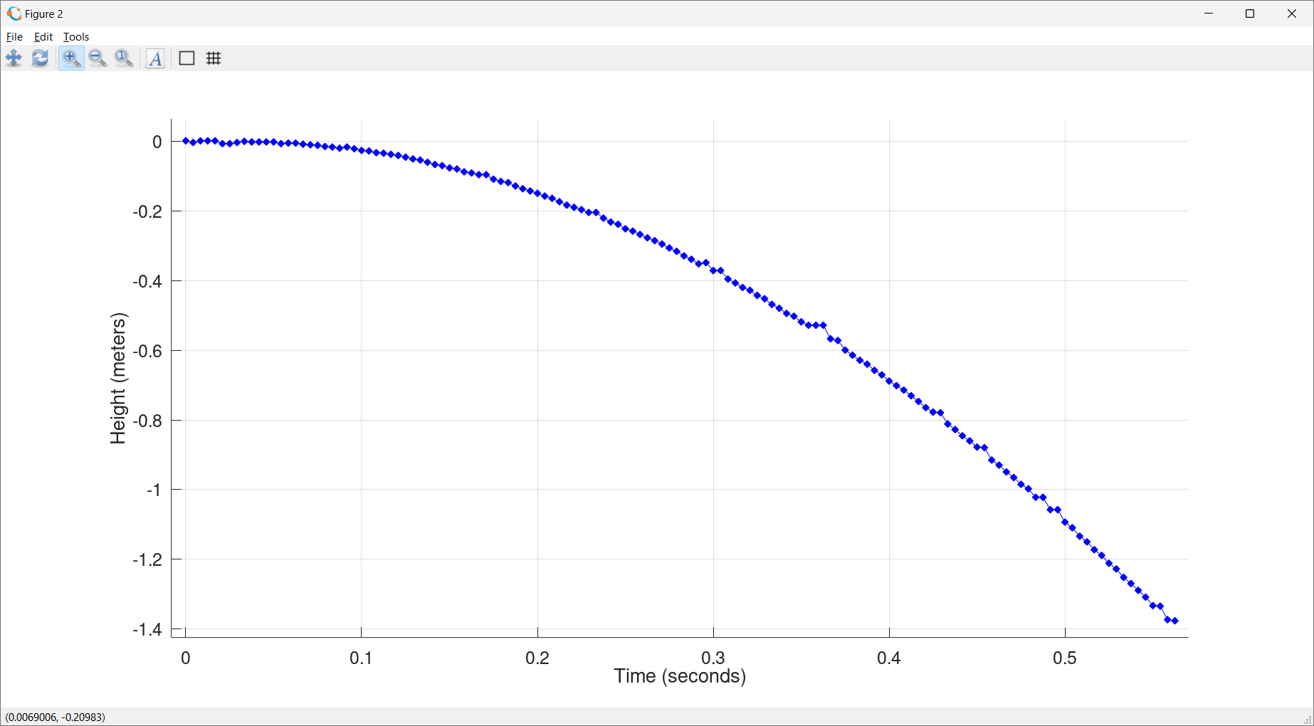

Slide 15
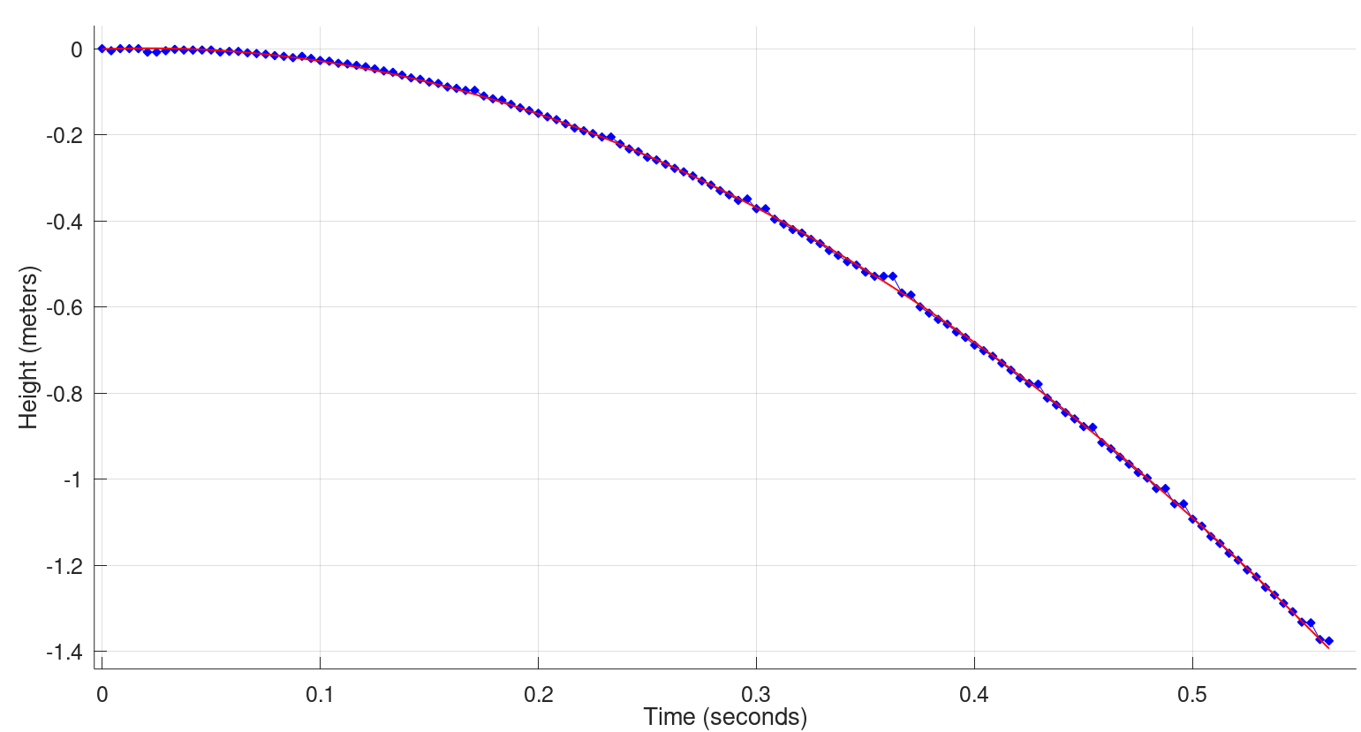
Distance ~ -(4.7m/s^2)*time^2

Slide 16
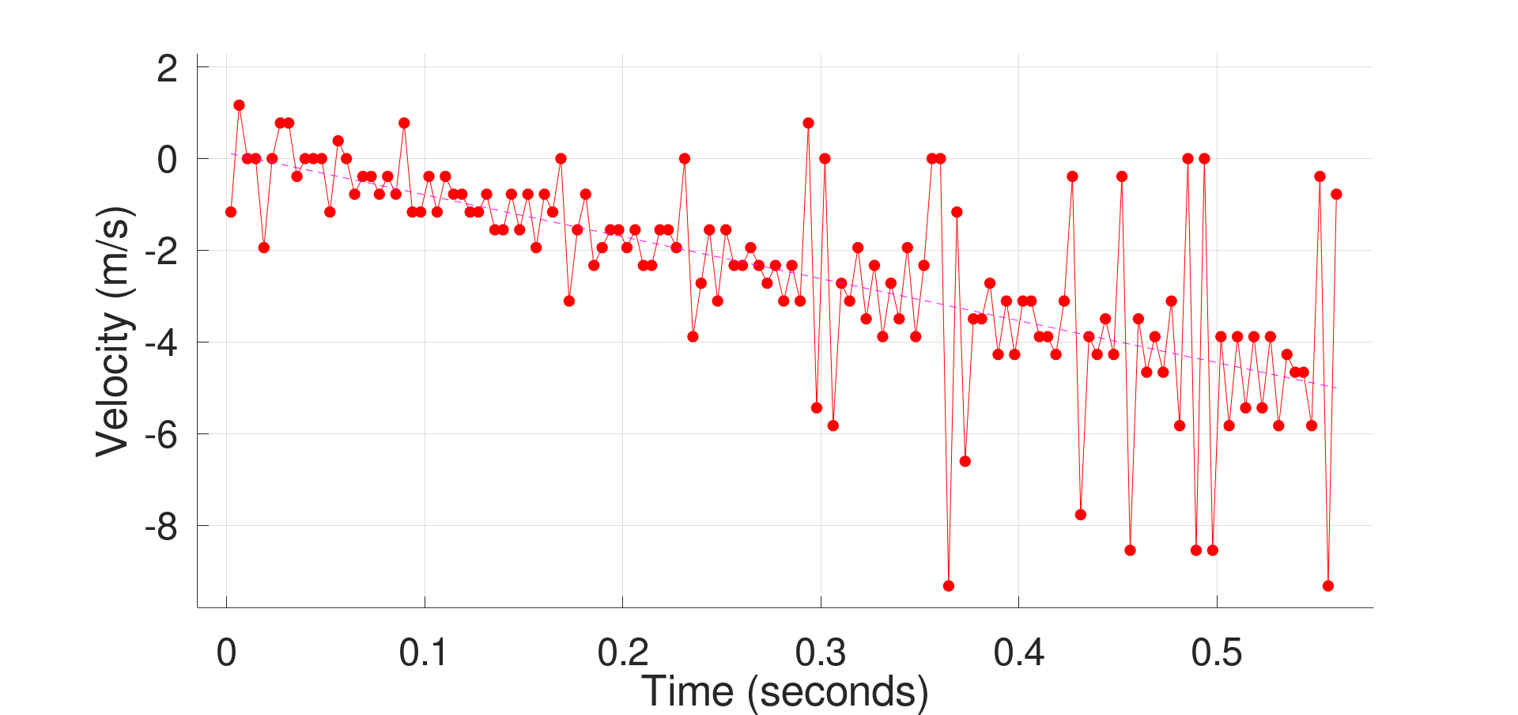
Velocity ~ -(9.4 m/s^2)*time
9.4 m/s^2=2*4.7m/s^2

Slide 17
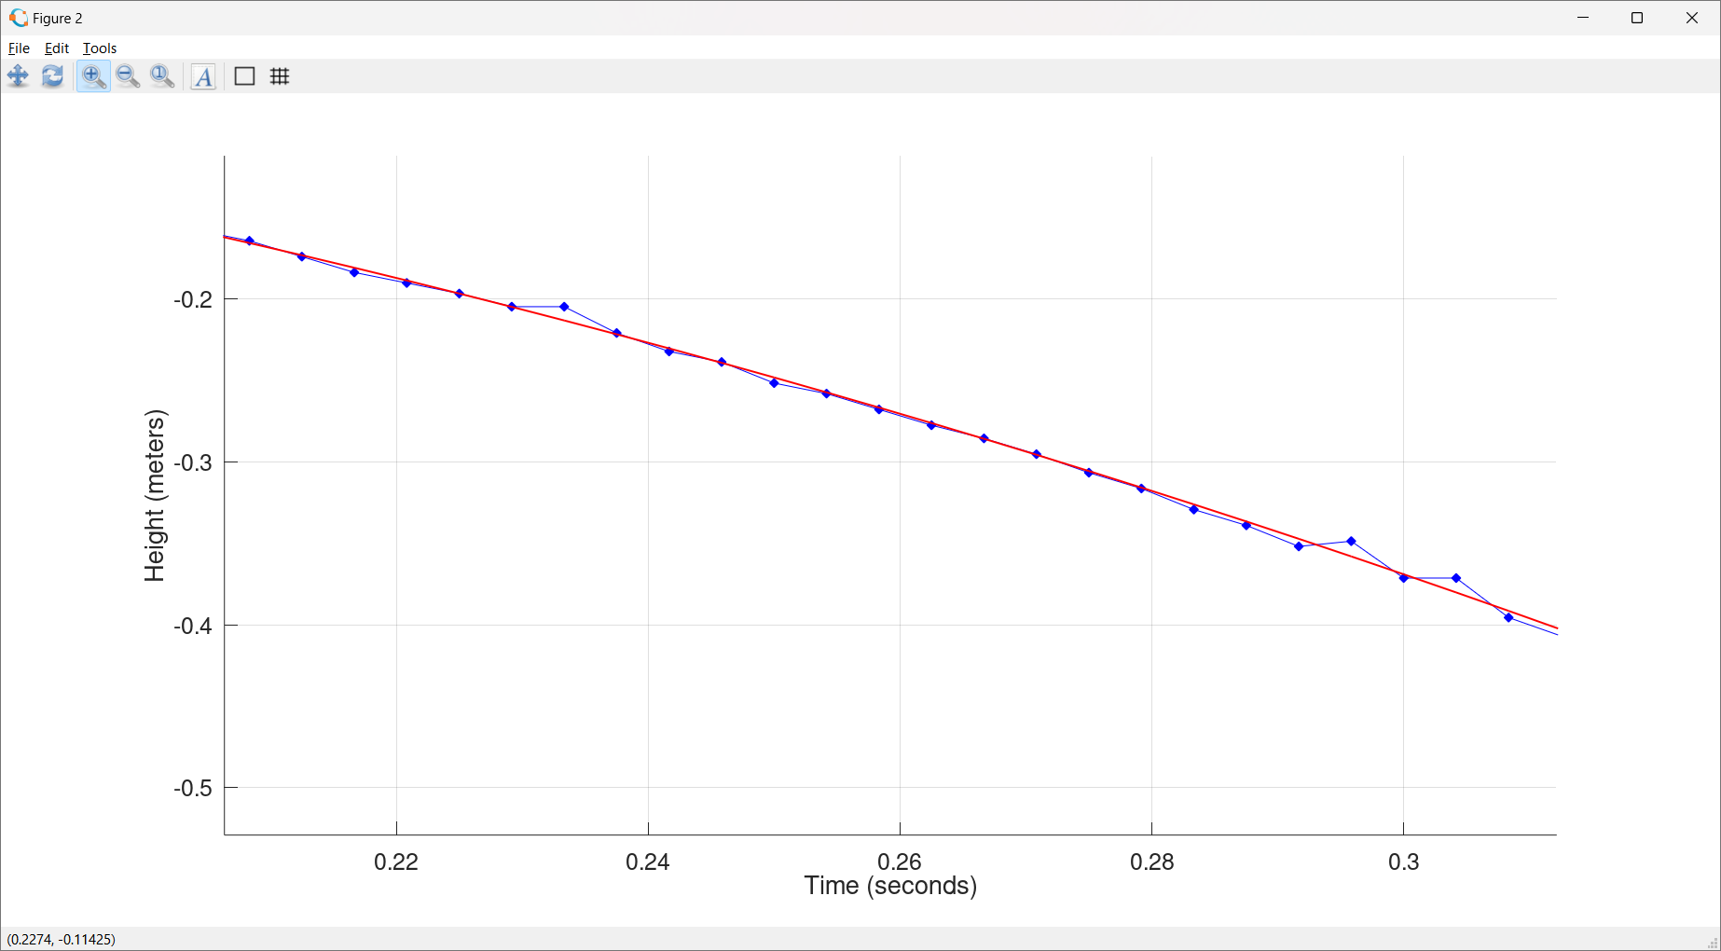

Slide 19
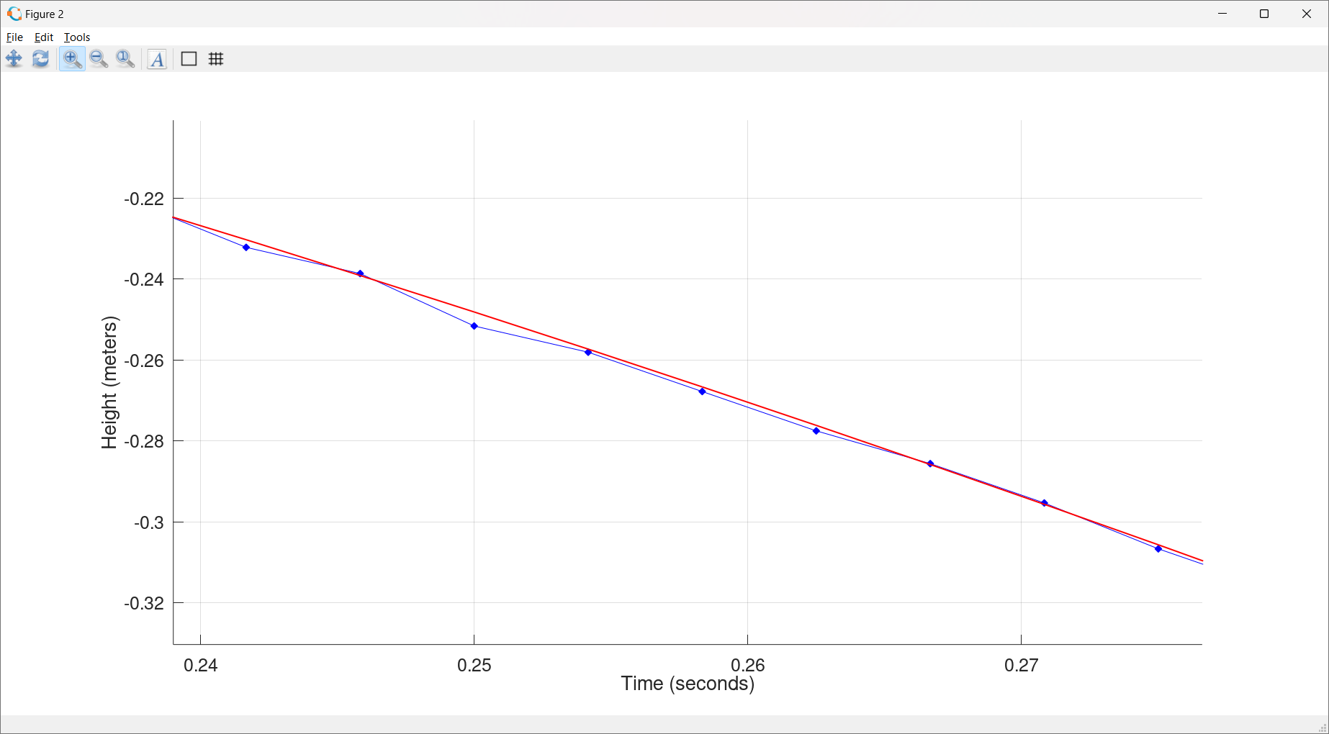

Slide 20
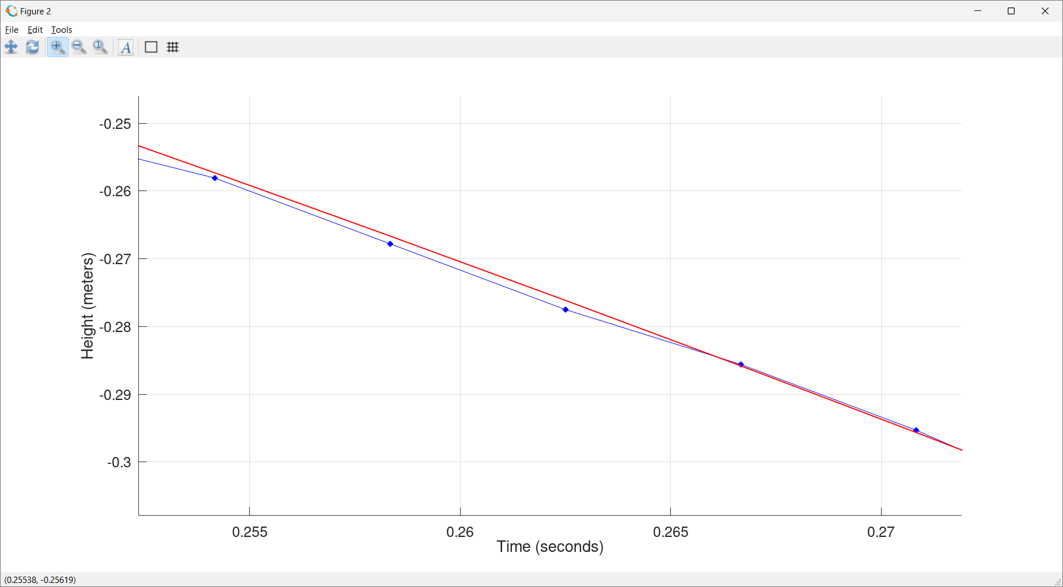

Slide 22
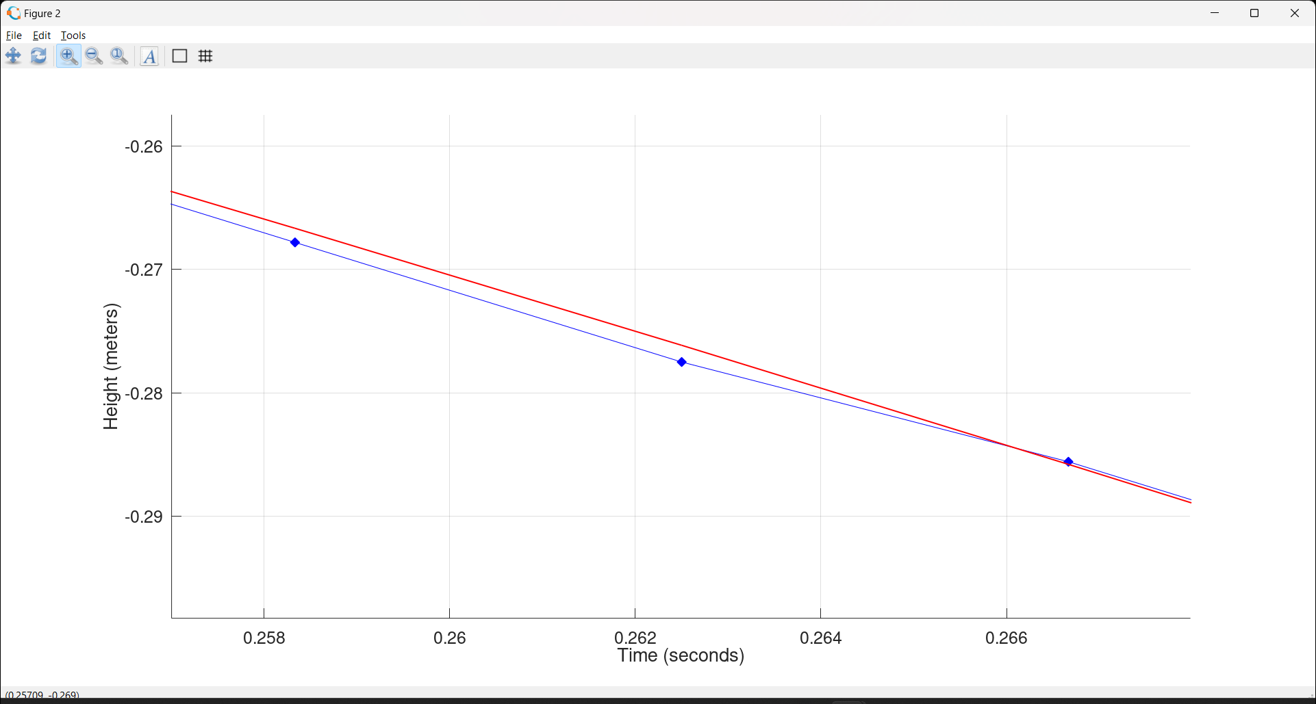

Slide 23
Distance = -(4.7m/s^2)*time^2
+(0.17 m/s)*time
+(.001 m)

Slide 24
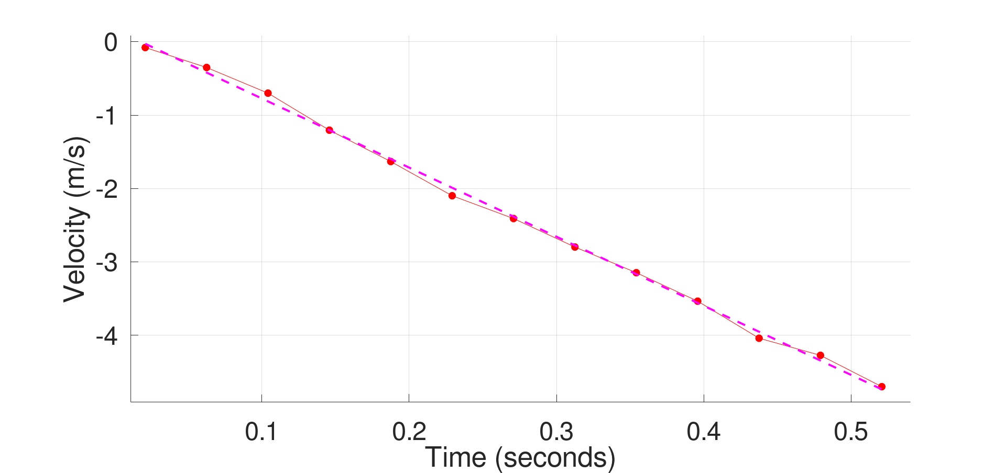
Velocity = -(9.46 m/s^2)*time+.17 m/s

Slide 25
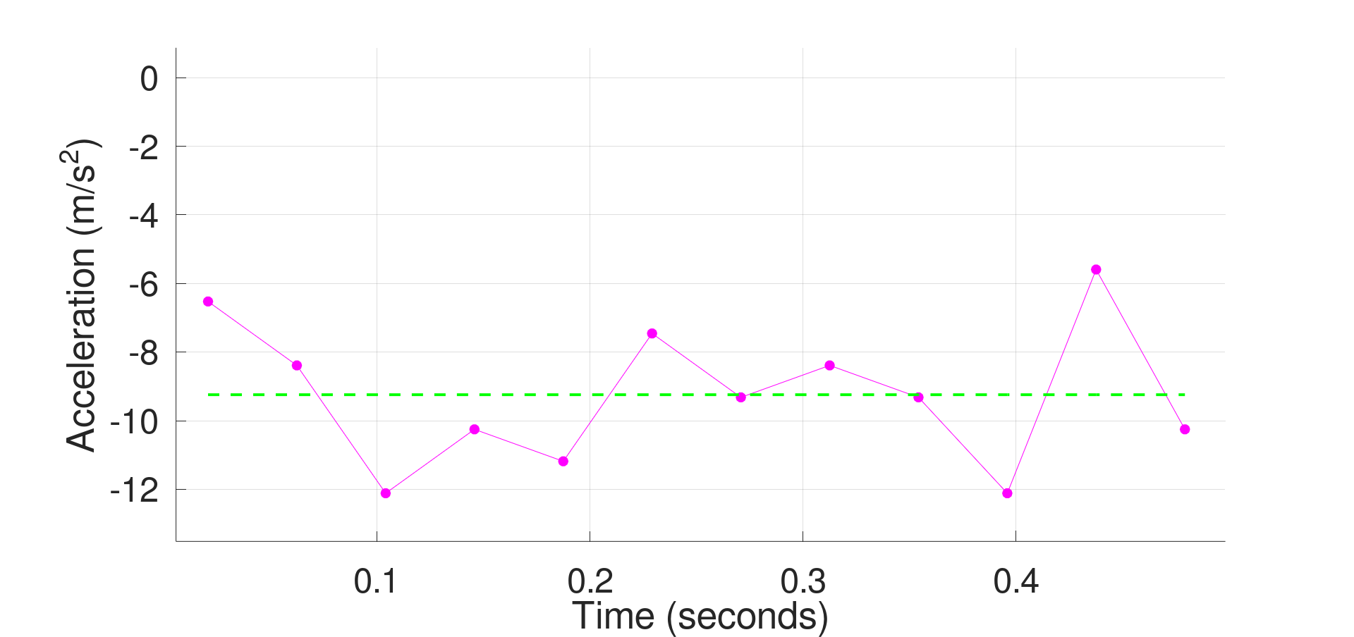

Acceleration = $\frac{Δv}{Δt}$ = -(9.2 m/s^2)

Slide 26
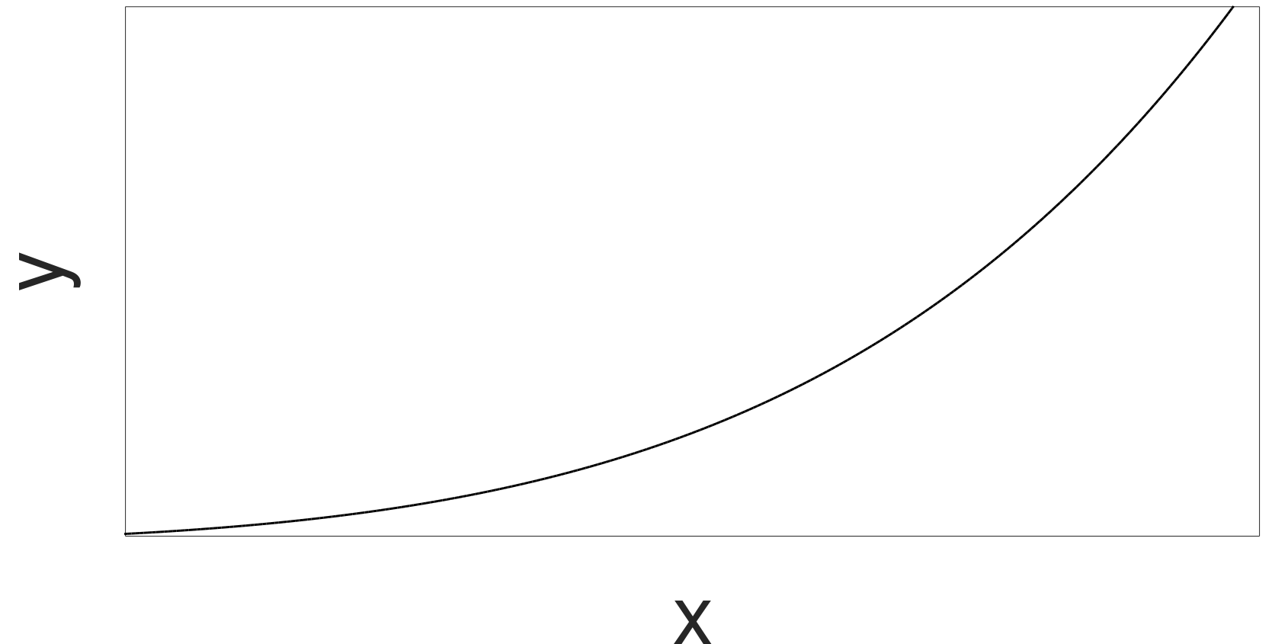



Recall The Definition of The Derivative
s$\underset{}{lope=}\frac{Δy}{Δx}$
$Δ$y
$Δ$x

Slide 27

Recall The Derivative
$\lim_{Δx→0}\frac{Δy}{Δx}≡$ $\frac{dy}{dx}$
s$\underset{}{lope=}\frac{Δy}{Δx}$
$Δ$y
$Δ$x

Slide 28



Recall The Derivative
$\lim_{Δx→0}\frac{Δy}{Δx}≡$ $\frac{dy}{dx}$
$Δ$y
s$\underset{}{lope=}\frac{Δy}{Δx}$
$Δ$x

Slide 29


What about Purely Mathematically?
$$y=f\left(t\right)$$
$$v=\lim_{Δt→0}\frac{Δy}{Δt}≡\frac{ⅆy}{dt}$$
$$a=\lim_{Δt→0}\frac{Δv}{Δt}≡\frac{ⅆv}{dt}$$

Slide 30



What about Purely Mathematically?
$$y=f\left(t\right)=\frac{1}{2}at^{2}$$
$$v=\lim_{Δt→0}\frac{Δy}{Δt}≡\frac{ⅆy}{dt}=a∙t$$
$$a=\lim_{Δt→0}\frac{Δv}{Δt}≡\frac{ⅆv}{dt}≡\frac{ⅆ2y}{dt2}=a$$

Slide 31
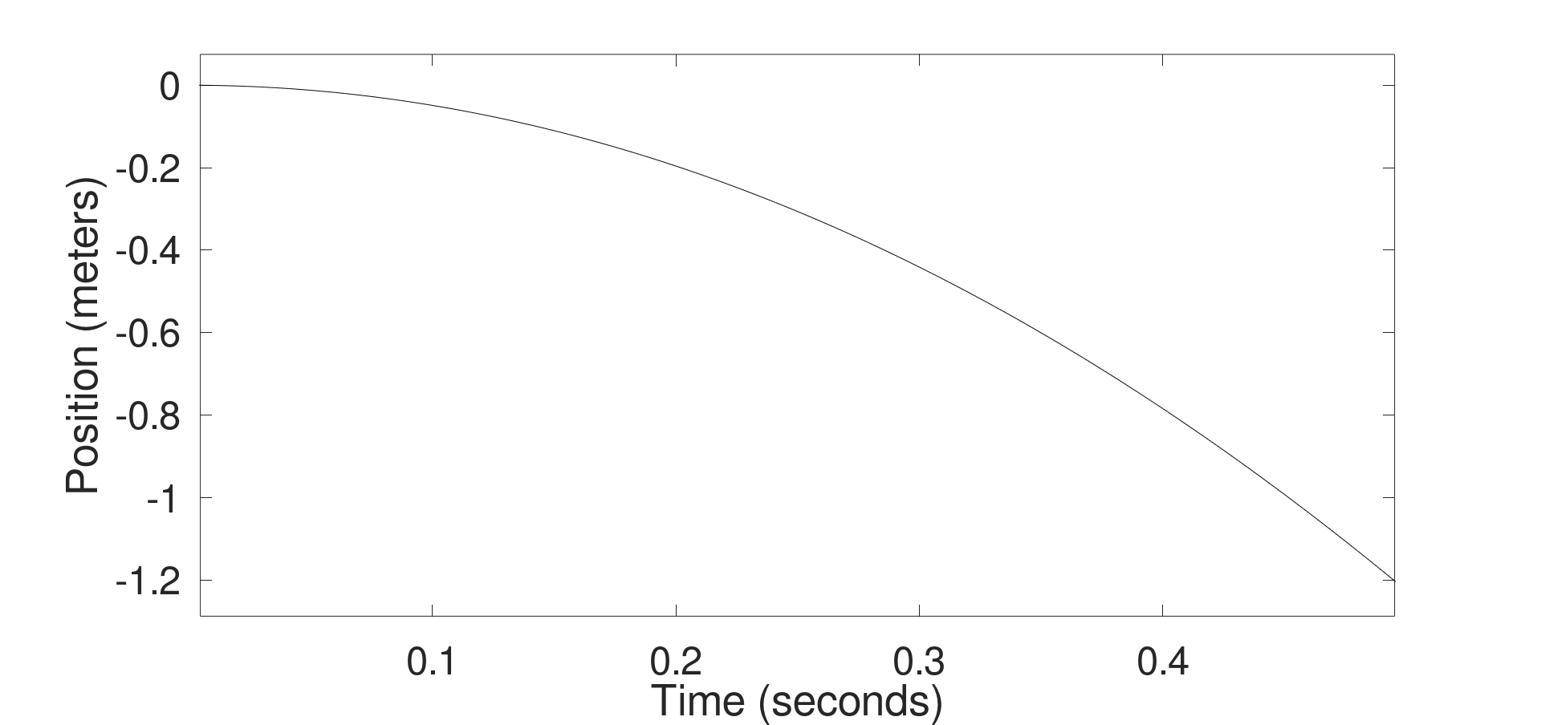
Let’s assume a = 9.8 m/s^2 (the accepted value)

Slide 32
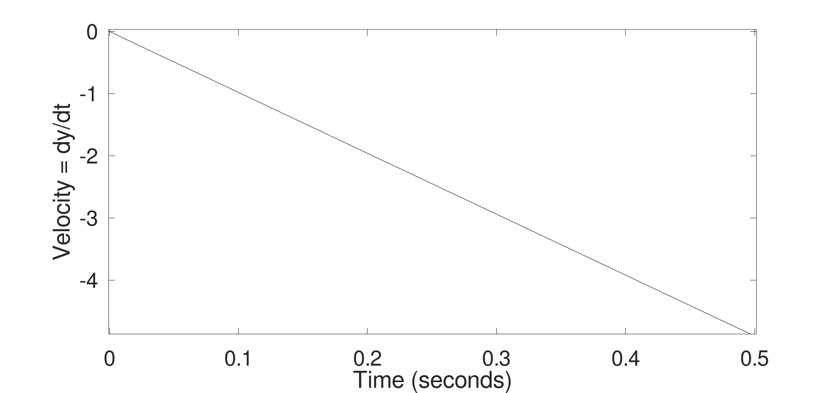

Slide 33
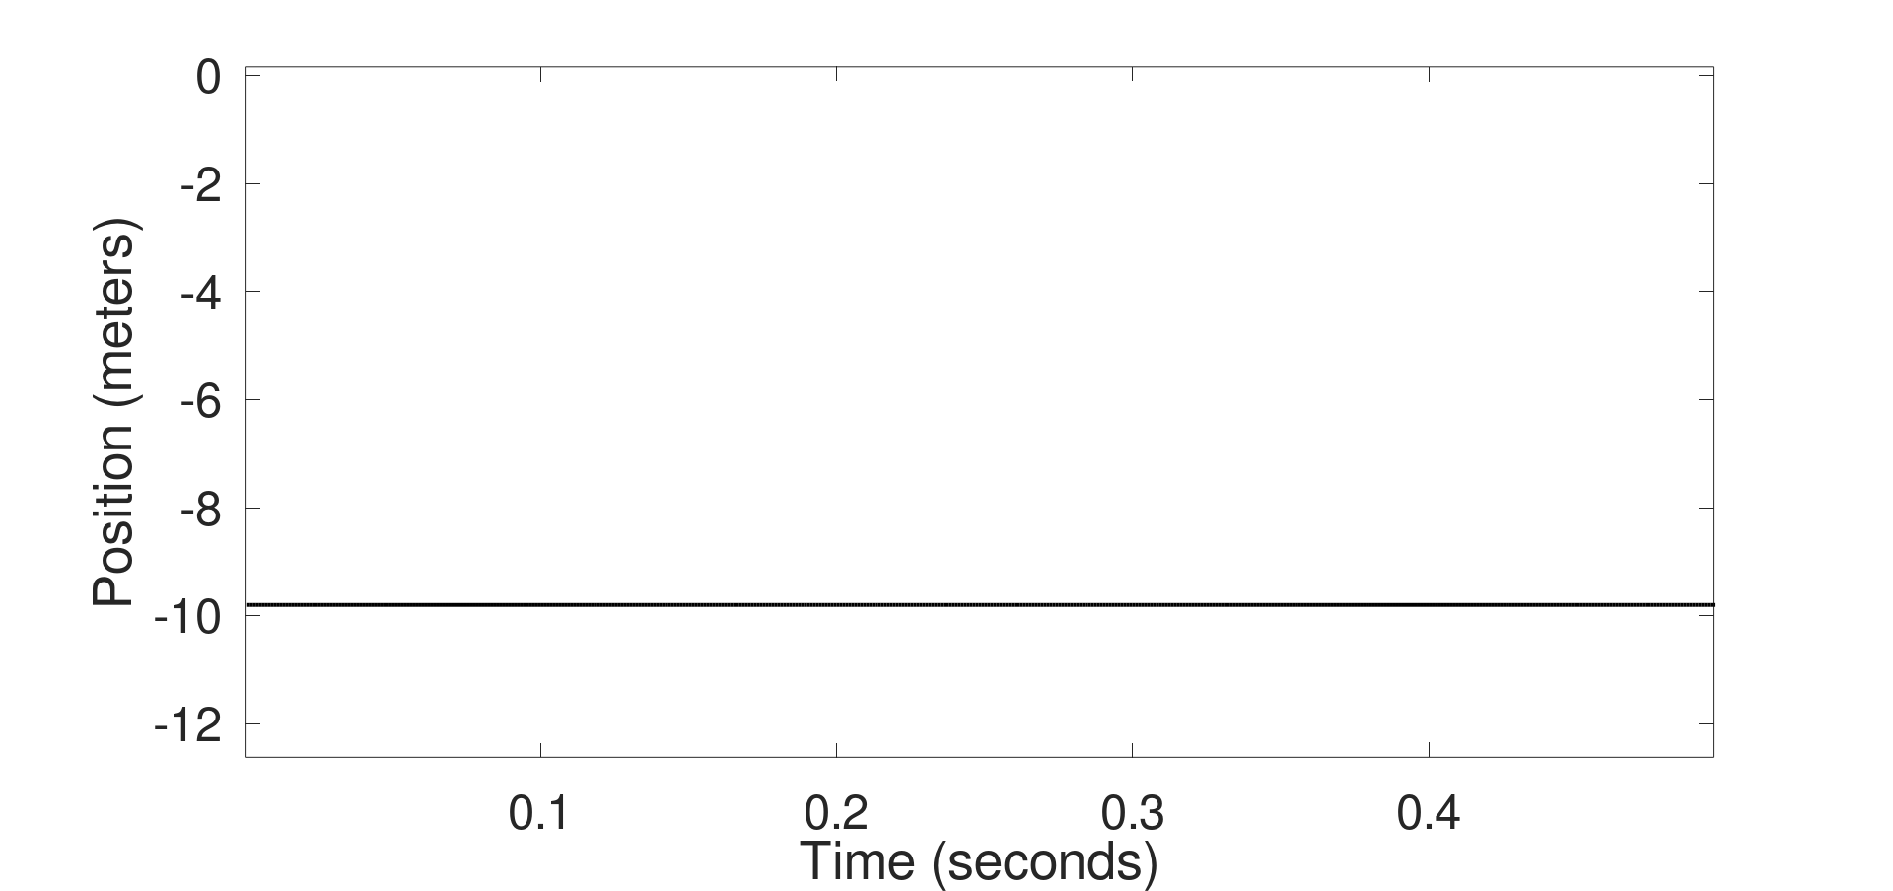
Acceleration (m/s^2)

Slide 34
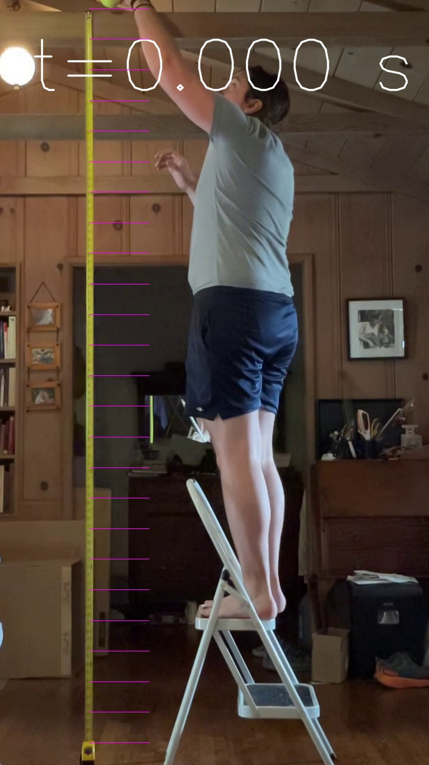


$\frac{1}{2}at^{2}$=9.8/2*0.0^2=0.00 m
$v=at^{}$=9.8*0.0=0.00 m/s

Slide 35
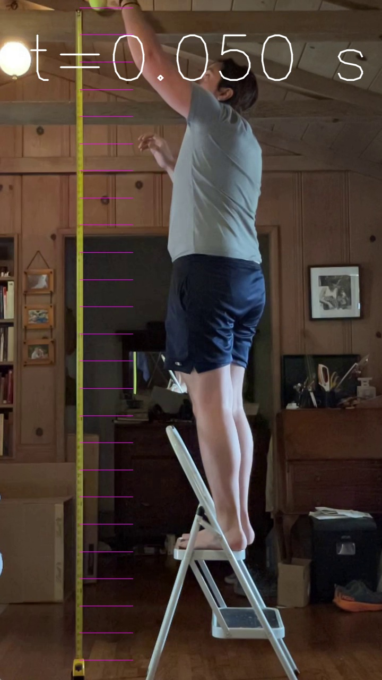


$\frac{1}{2}at^{2}$=9.8/2*0.05^2=0.01 m
$v=at^{}$=9.8*0.05=0.49 m/s

Slide 36
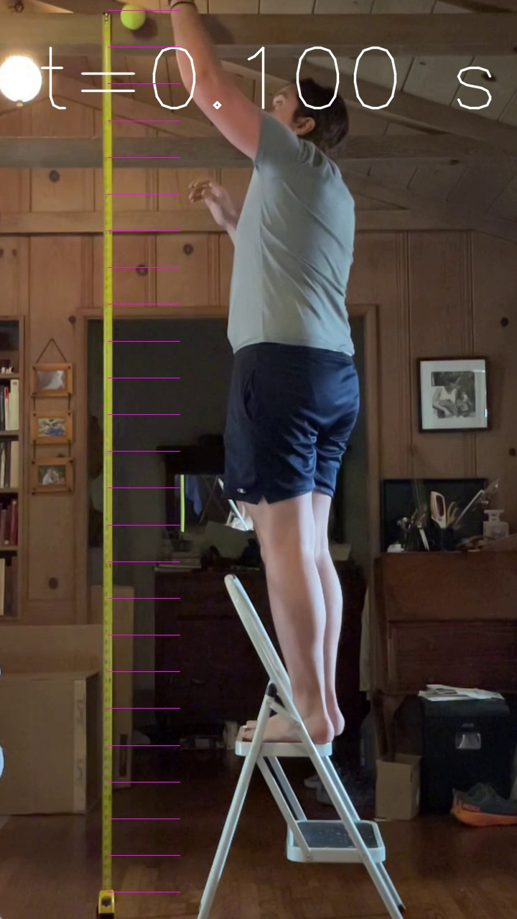


$\frac{1}{2}at^{2}$=9.8/2*0.1^2=0.05 m
$v=at^{}$=9.8*0.1=0.98 m/s

Slide 37
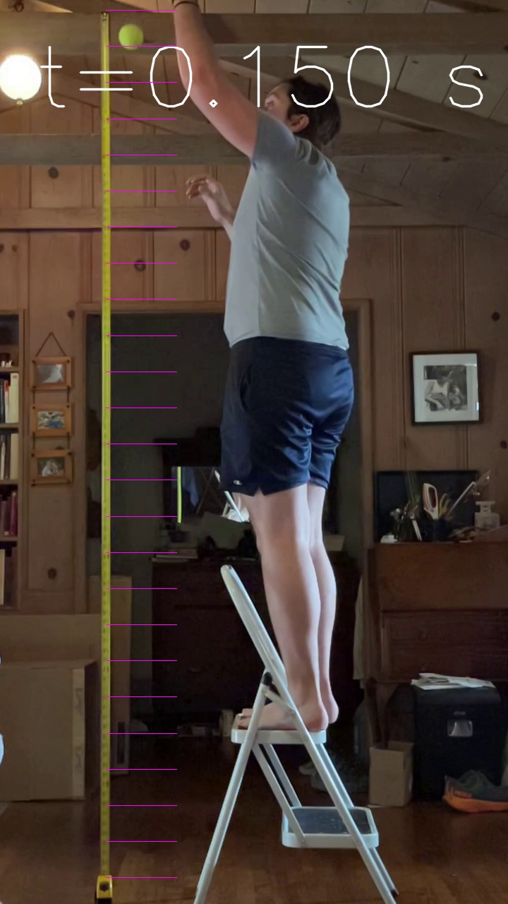


$\frac{1}{2}at^{2}$=9.8/2*0.15^2=0.11 m
$v=at^{}$=9.8*0.05=1.47 m/s

Slide 38



$\frac{1}{2}at^{2}$=9.8/2*0.2^2=0.19 m
$v=at^{}$=9.8*0.2=1.96 m/s

Slide 39
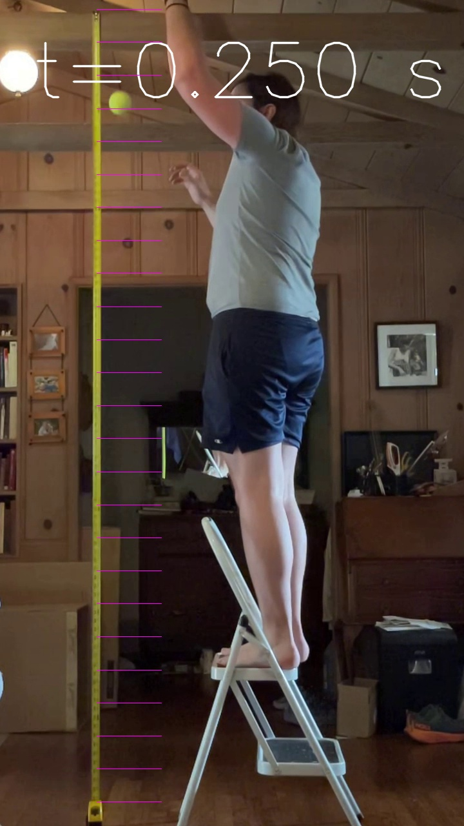


$\frac{1}{2}at^{2}$=9.8/2*0.25^2=0.31 m
$v=at^{}$=9.8*0.25=2.45 m/s

Slide 40
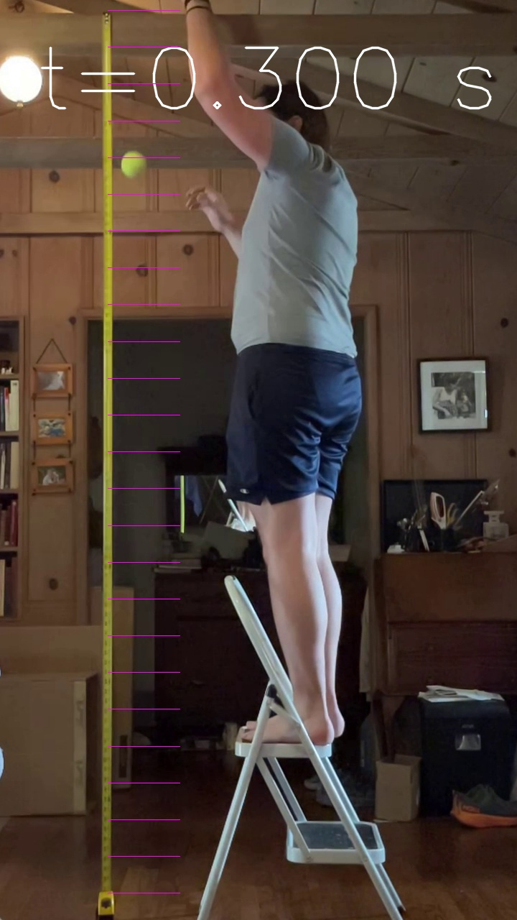


$\frac{1}{2}at^{2}$=9.8/2*0.3^2=0.44 m
$v=at^{}$=9.8*0.05=2.94 m/s

Slide 41



$\frac{1}{2}at^{2}$=9.8/2*0.35^2=0.60 m
$v=at^{}$=9.8*0.05=3.43 m/s

Slide 42



$\frac{1}{2}at^{2}$=9.8/2*0.0^2=0.78 m
$v=at^{}$=9.8*0.4=3.9 m/s

Slide 43
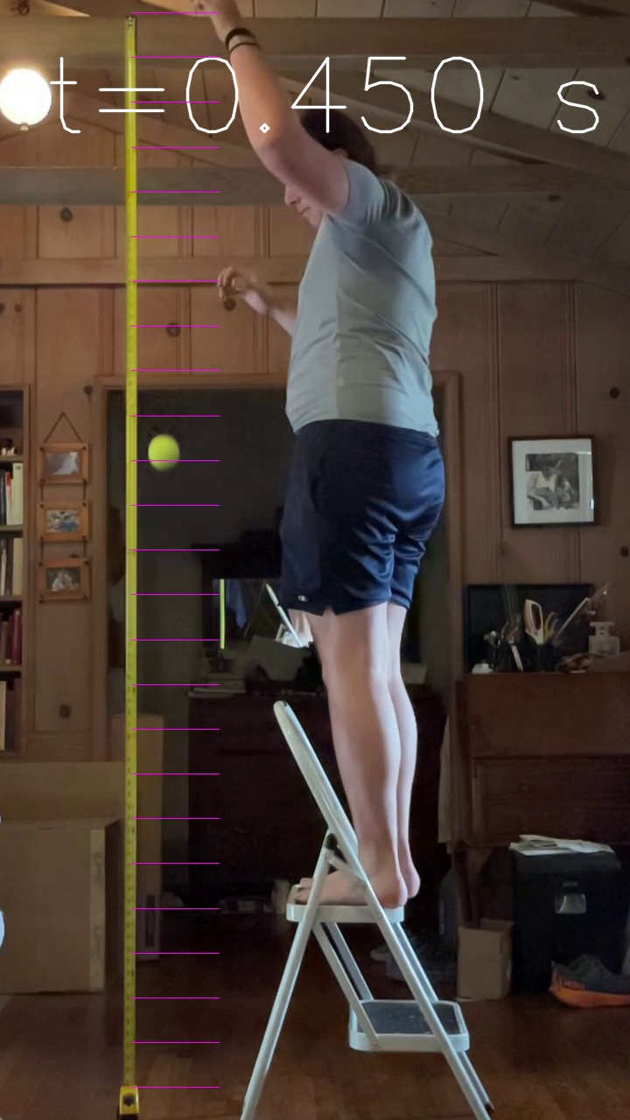


$\frac{1}{2}at^{2}$=9.8/2*0.45^2=0.99 m
$v=at^{}$=9.8*0.05=4.41 m/s

Slide 44



$\frac{1}{2}at^{2}$=9.8/2*0.5^2=1.23 m
$v=at^{}$=9.8*0.05=4.90 m/s

Slide 45
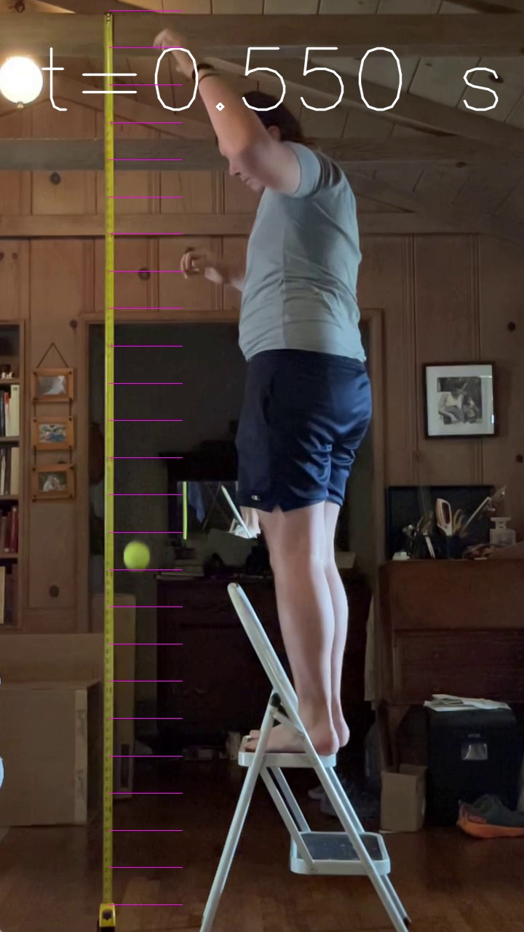


$\frac{1}{2}at^{2}$=9.8/2*0.0^2=1.48 m
$v=at^{}$=9.8*0.05=5.39 m/s

Slide 46
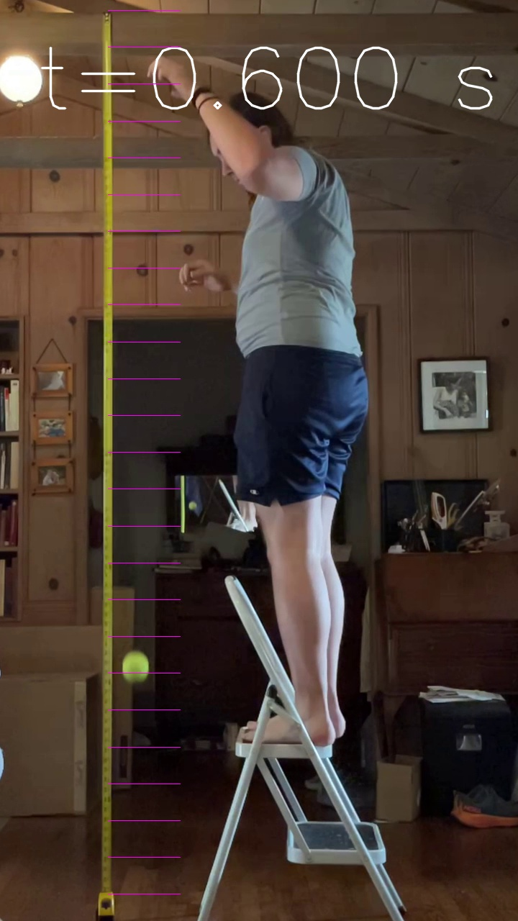


$\frac{1}{2}at^{2}$=9.8/2*0.0^2=1.76 m
$v=at^{}$=9.8*0.05=5.88 m/s

Slide 47
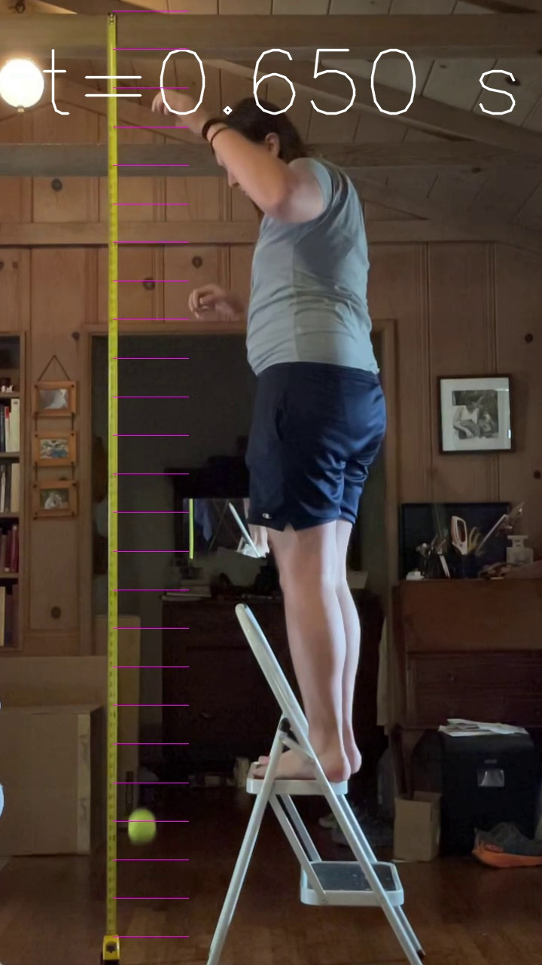

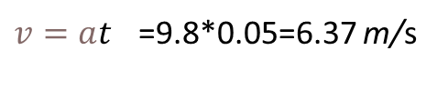
$\frac{1}{2}at^{2}$=9.8/2*0.65^2=2.07 m
$v=at^{}$=9.8*0.05=6.37 m/s

Slide 48
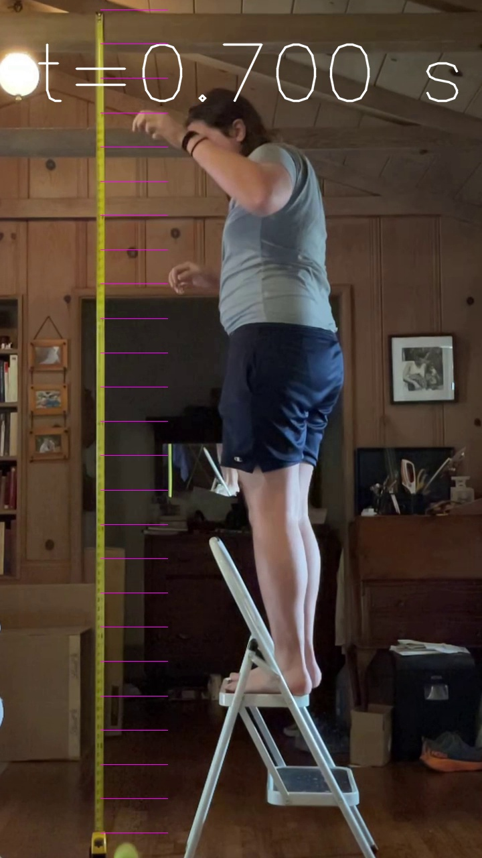


$\frac{1}{2}at^{2}$=9.8/2*0.7^2=02.4 m
$v=at^{}$=9.8*0.05=6.86 m/s

Slide 49
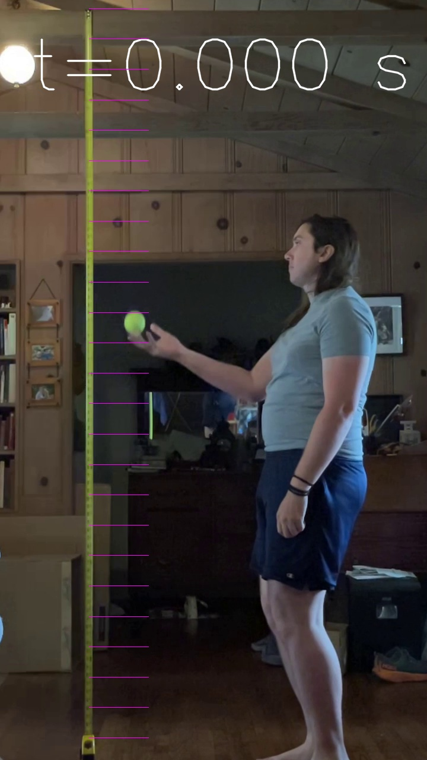
$\frac{1}{2}at^{2}$=9.8/2*0.0^2=0.00 m

Slide 50
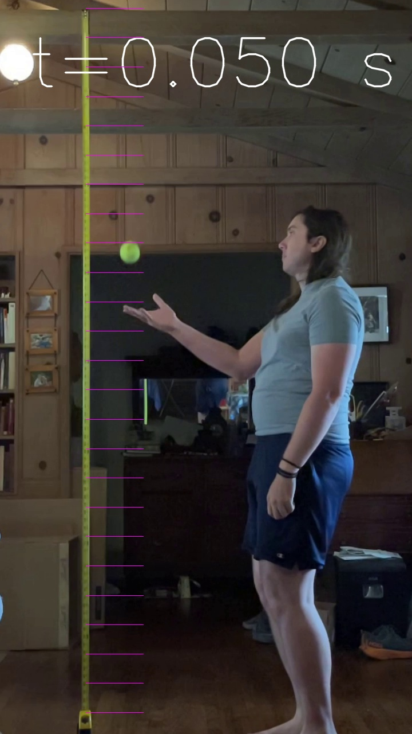
$\frac{1}{2}at^{2}$=9.8/2*0.05^2=0.01 m

Slide 51
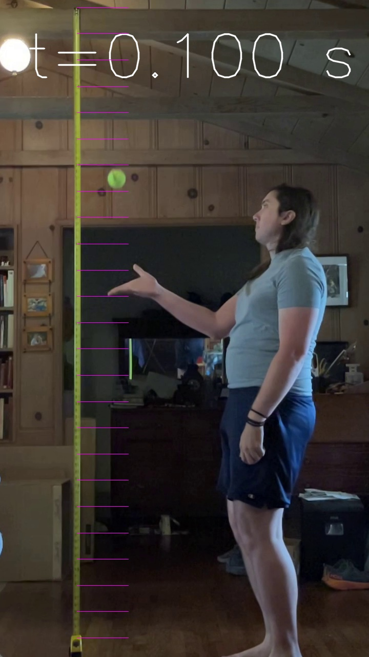
$v=at^{}$=9.8*0.1=0.98 m/s

Slide 52
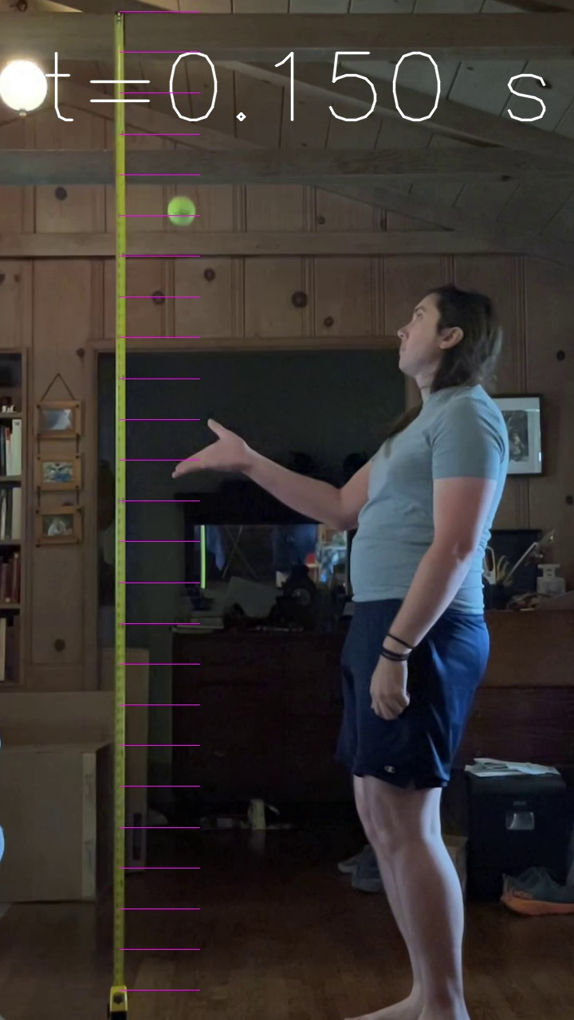
$\frac{1}{2}at^{2}$=9.8/2*0.15^2=0.11 m

Slide 53

$\frac{1}{2}at^{2}$=9.8/2*0.2^2=0.19 m

Slide 54

$\frac{1}{2}at^{2}$=9.8/2*0.25^2=0.31 m

Slide 55
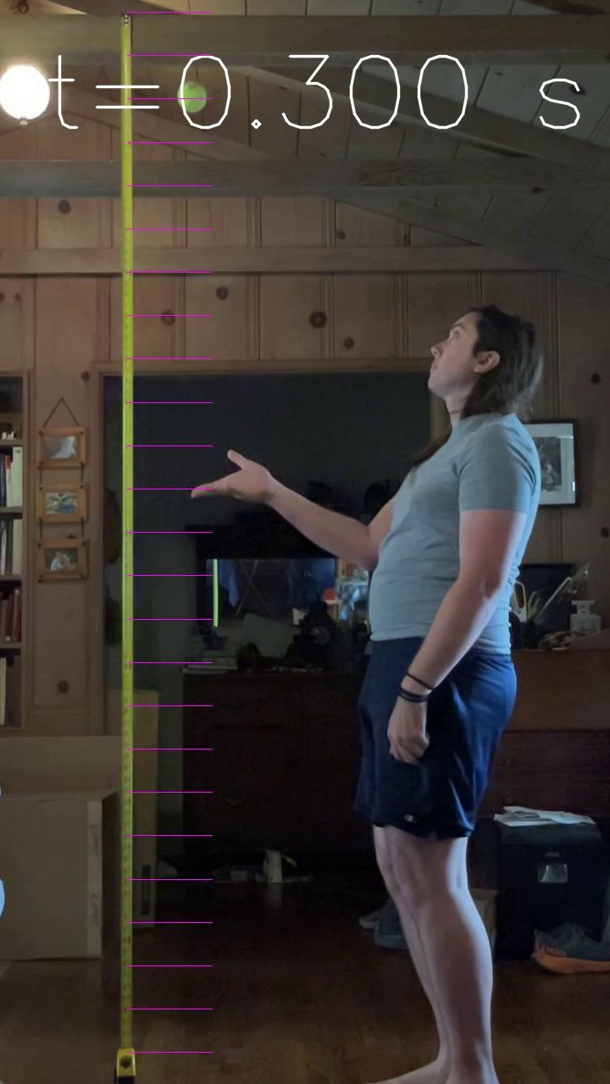
$\frac{1}{2}at^{2}$=9.8/2*0.3^2=0.44 m

Slide 56

$\frac{1}{2}at^{2}$=9.8/2*0.35^2=0.60 m

Slide 57
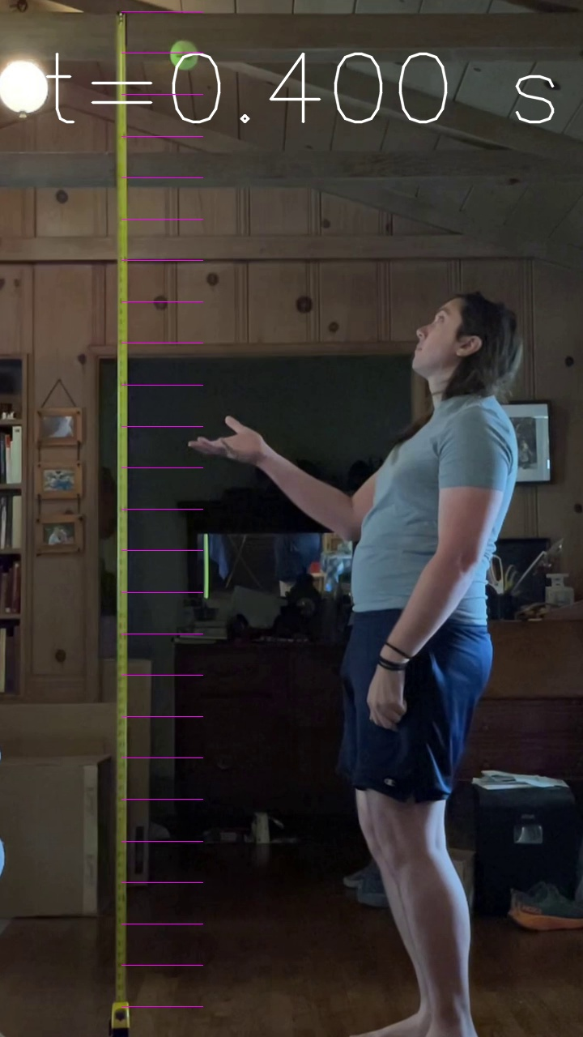
$\frac{1}{2}at^{2}$=9.8/2*0.0^2=0.78 m

Slide 58

$\frac{1}{2}at^{2}$=9.8/2*0.45^2=0.99 m

Slide 59


$\frac{1}{2}at^{2}$=9.8/2*0.50^2=1.25 m

Slide 60
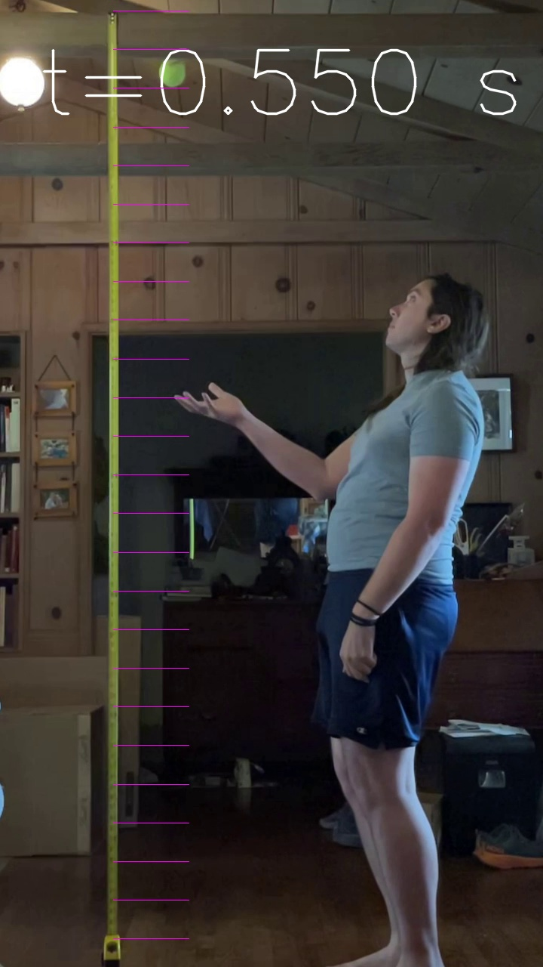

$\frac{1}{2}at^{2}$=9.8/2*0.55^2=1.48 m

Slide 61
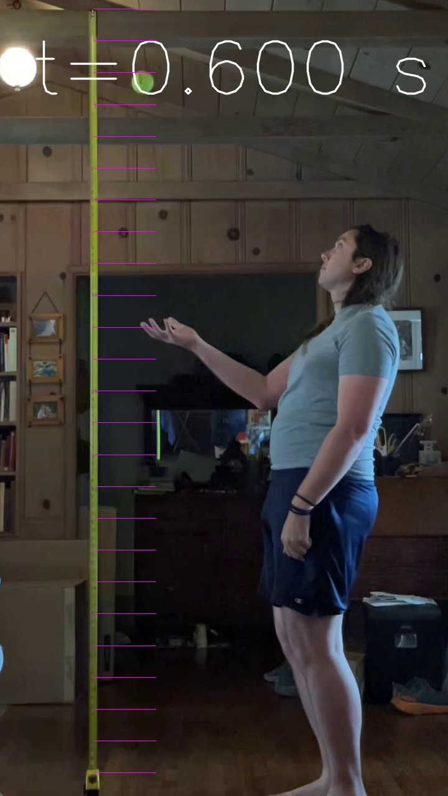

$\frac{1}{2}at^{2}$=9.8/2*0.6^2=1.76 m

Slide 62
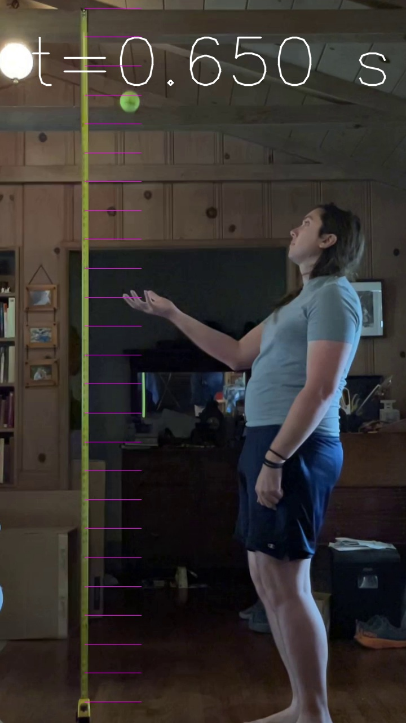

$\frac{1}{2}at^{2}$=9.8/2*0.55^2=2.07 m

Slide 63
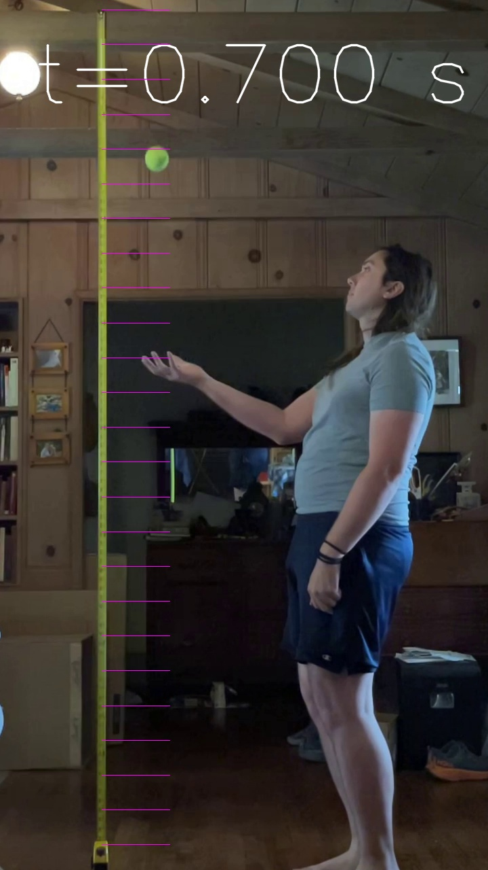

$\frac{1}{2}at^{2}$=9.8/2*0.7^2=2.40 m

Slide 64
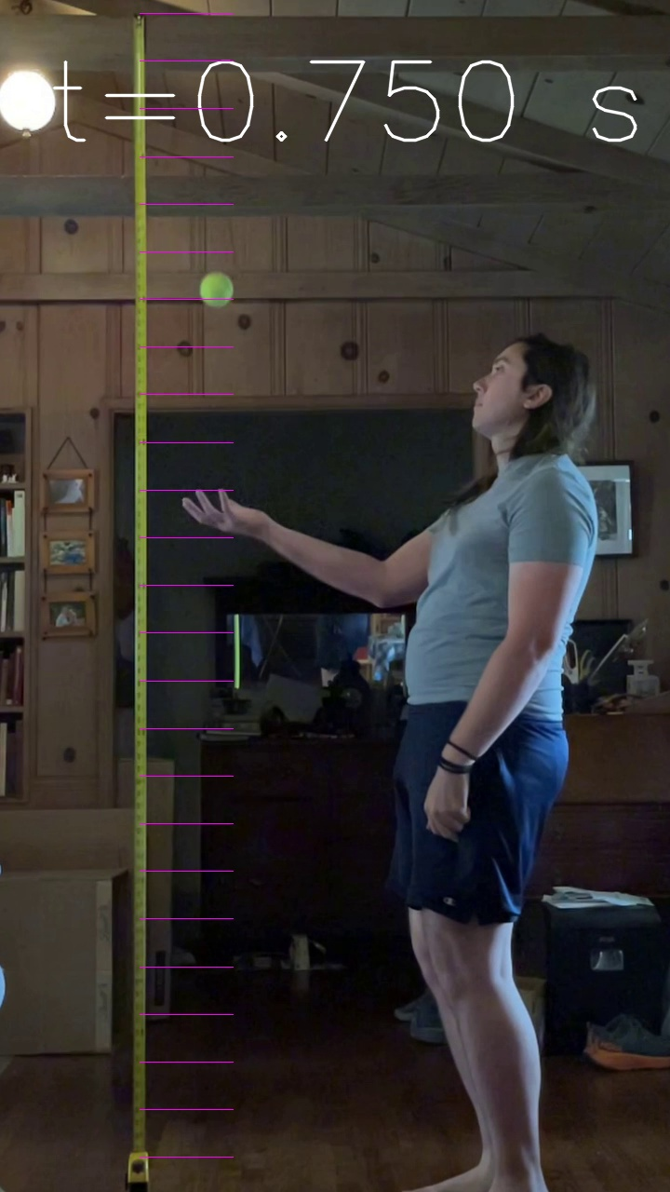

$\frac{1}{2}at^{2}$=9.8/2*0.75^2=2.76 m

Slide 65


$\frac{1}{2}at^{2}$=9.8/2*0.8^2=3.13 m

Slide 66
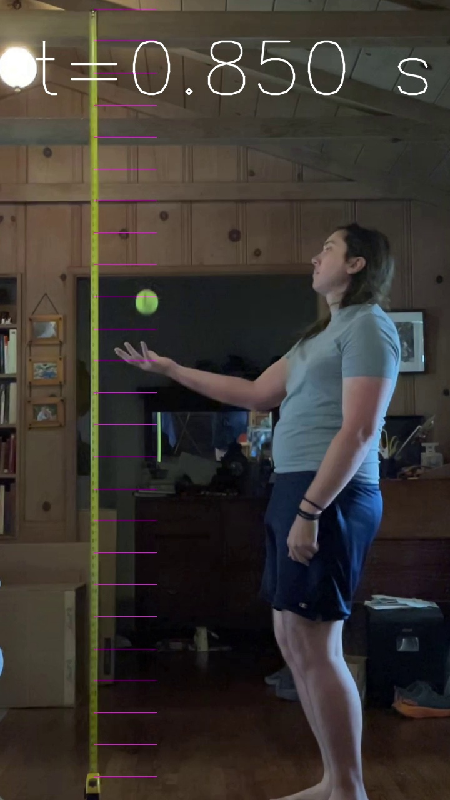

$\frac{1}{2}at^{2}$=9.8/2*0.85^2=3.54 m

Slide 67


$\frac{1}{2}at^{2}$=9.8/2*0.85^2=3.97 m

Slide 68
