Slide 1
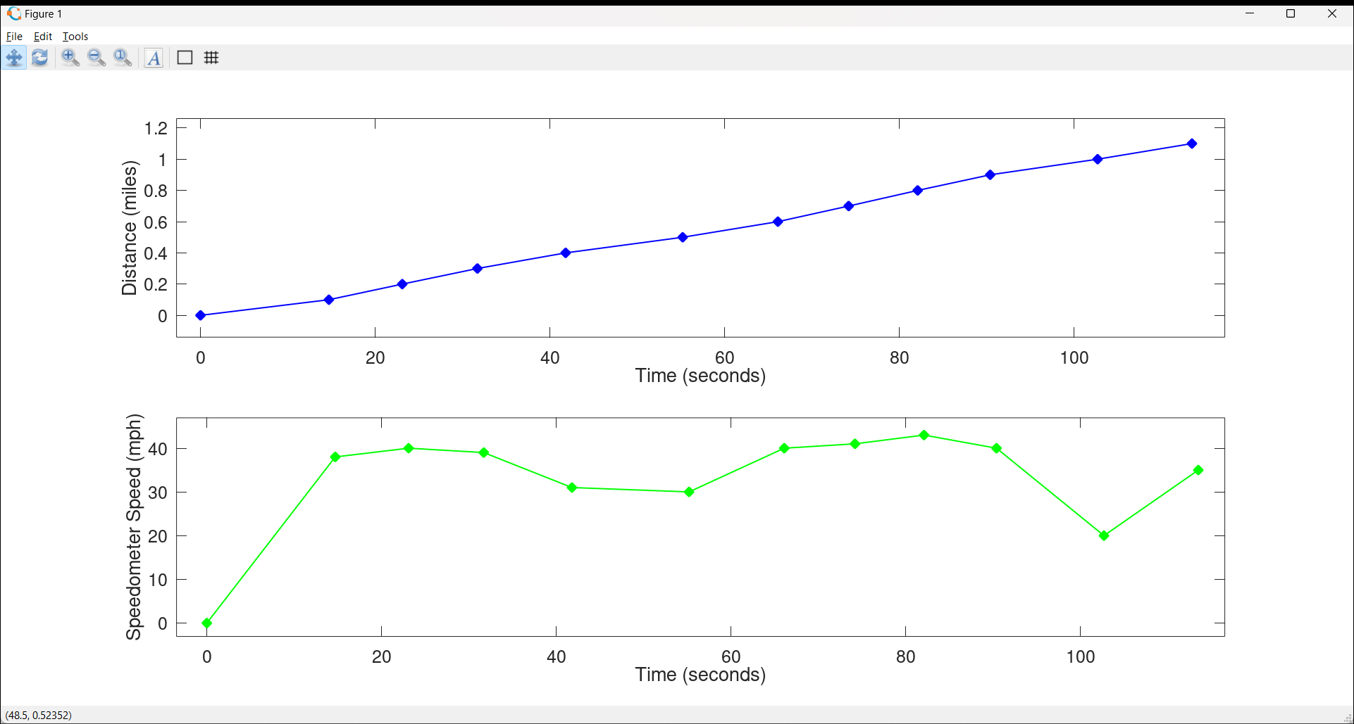

Slide 2
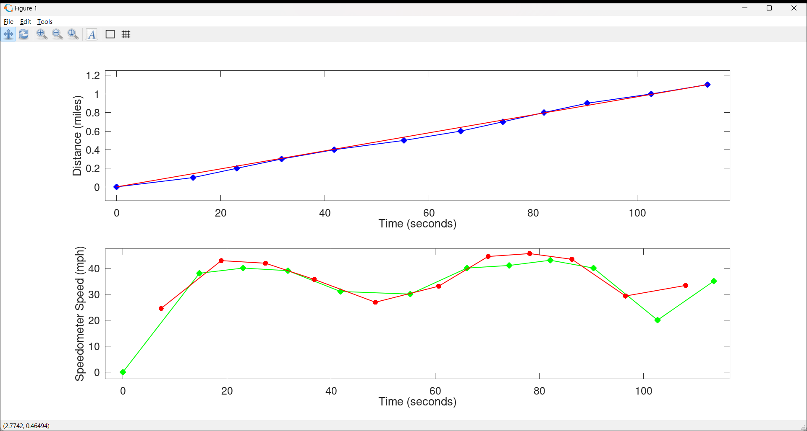
Distance = (35 mph)*time=(1.1 miles)/(113.5s)*t

Slide 3
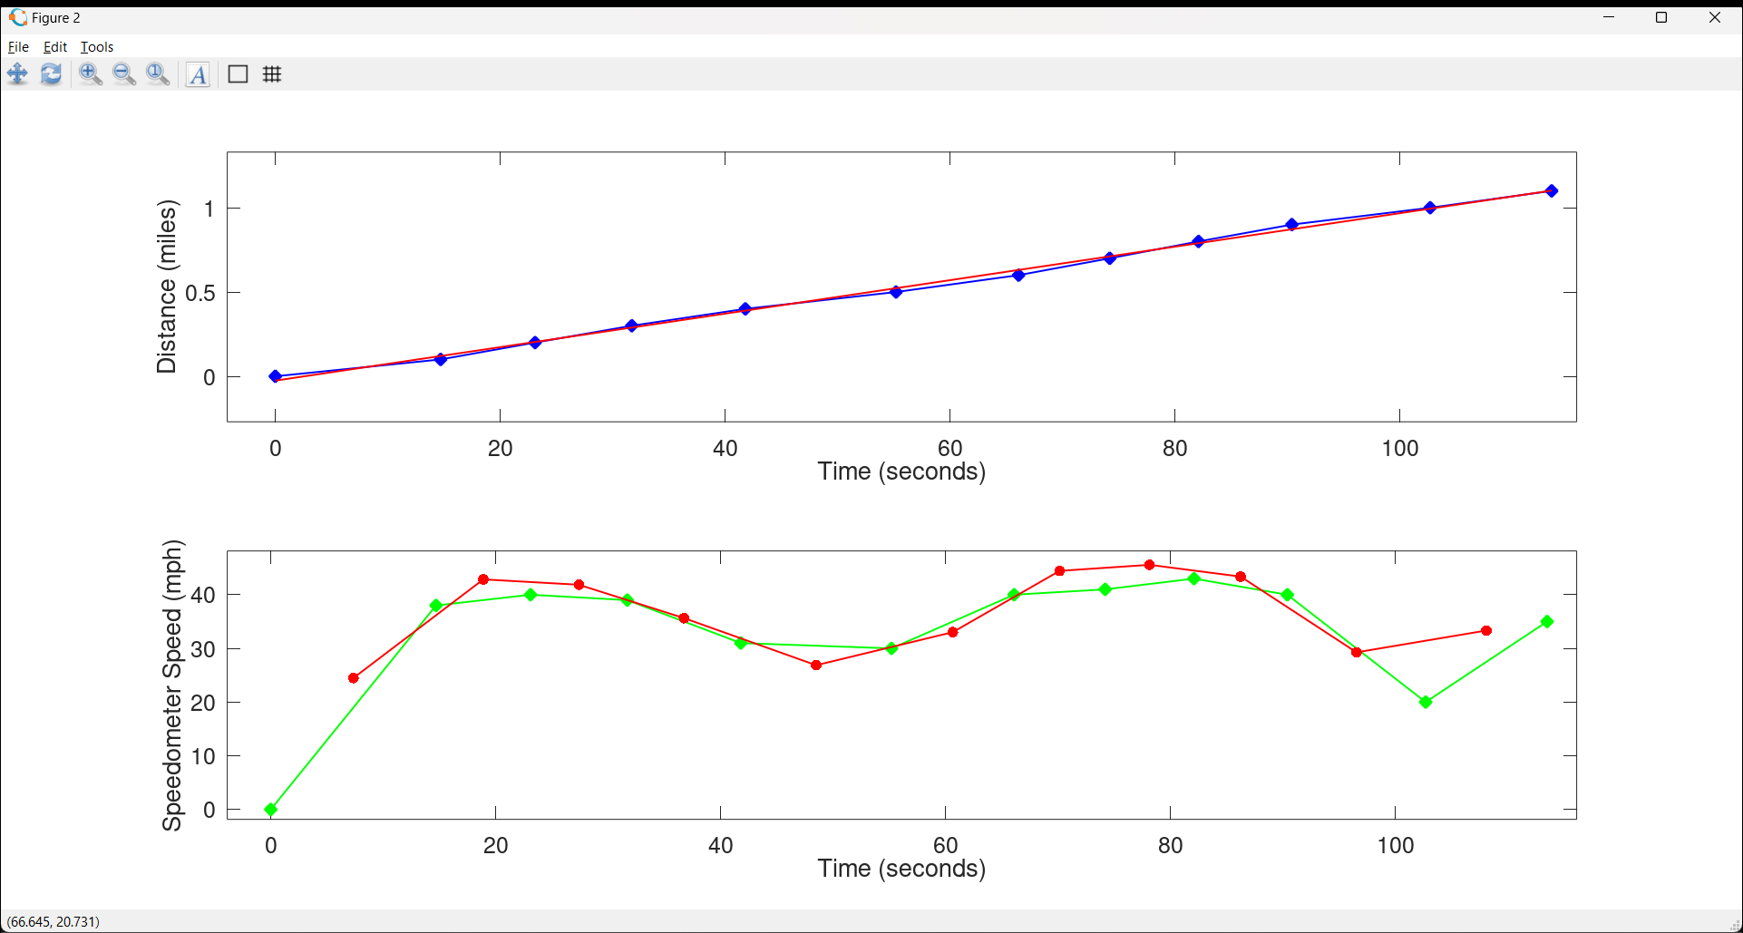
Distance = (36 mph)*time-(0.2 miles)

Slide 7
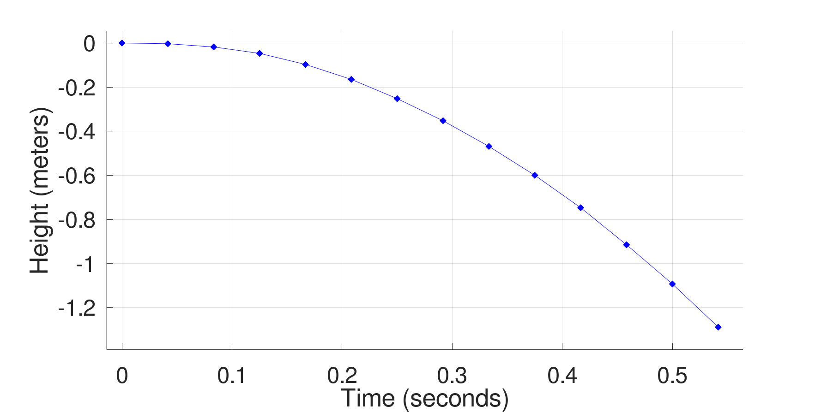

Slide 8
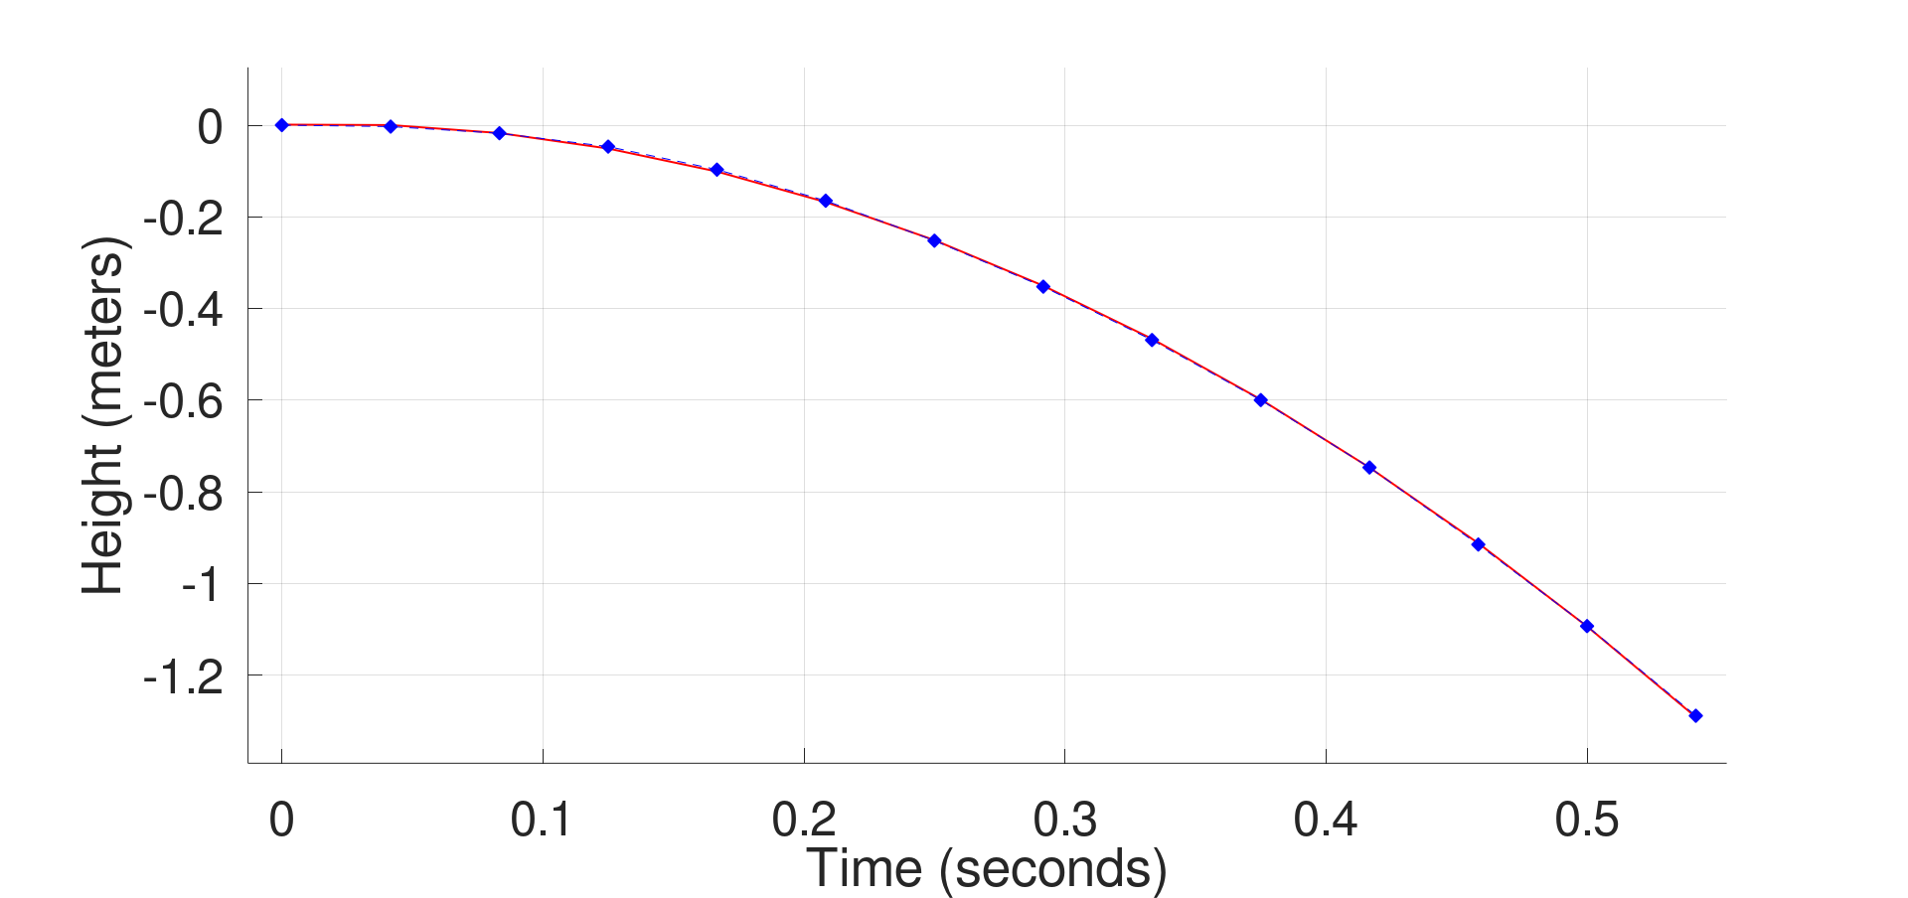
Distance = -(4.7m/s^2)*time^2
+(0.17 m/s)*time
+(.001 m)

Slide 9
Distance = -(4.7m/s^2)*time^2

Slide 10
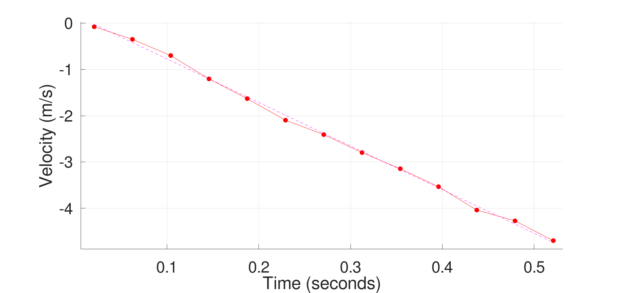
Velocity ~= -(9.4 m/s^2)*time

Slide 11
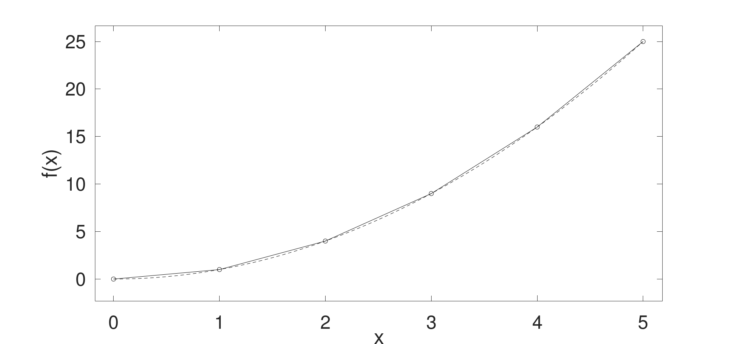





$$\frac{5^{2}−42}{1}=9$$
$$\frac{4^{2}−32}{1}=7$$
$$\frac{3^{2}−22}{1}=5$$
$$\frac{2^{2}−12}{1}=3$$
$$\frac{1^{2}}{1}=1$$

Slide 12





$$\frac{5^{2}−42}{1}=9$$
$$\frac{4^{2}−32}{1}=7$$
$$\frac{3^{2}−22}{1}=5$$
$$\frac{2^{2}−12}{1}=3$$
$$\frac{1^{2}}{1}=1$$
$$0.5$$
$$1.5$$
$$2.5$$
$$3.5$$
$$4.5$$

Slide 13

$$\frac{5^{2}−42}{1}=9$$
$$\frac{d}{∂x}x^{2}=2⋅x$$
$$\frac{4^{2}−32}{1}=7$$
$$\frac{3^{2}−22}{1}=5$$
$$\frac{2^{2}−12}{1}=3$$
$$\frac{1^{2}}{1}=1$$
$$0.5$$
$$1.5$$
$$2.5$$
$$3.5$$
$$4.5$$

Slide 14
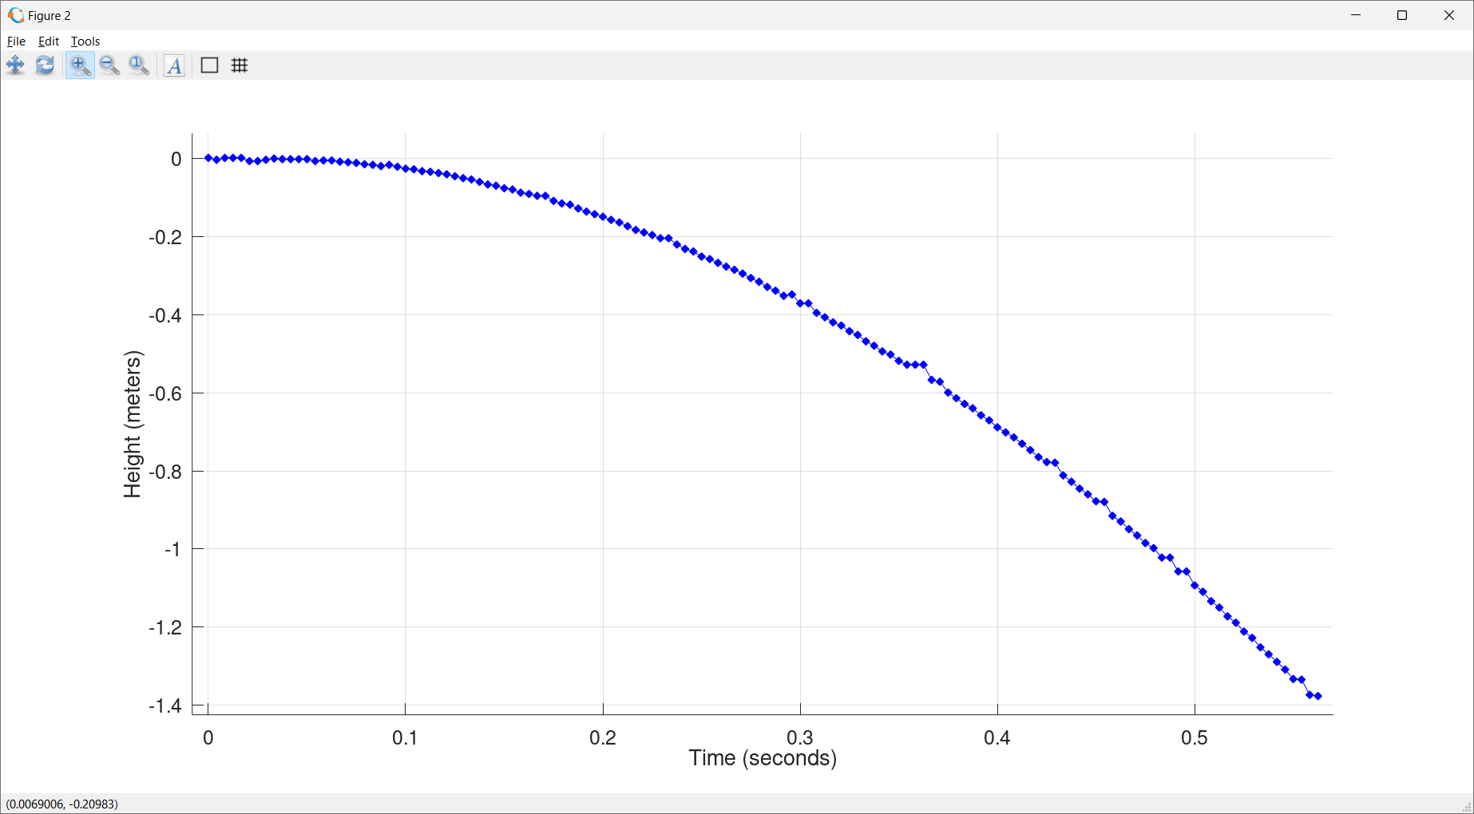

Slide 15
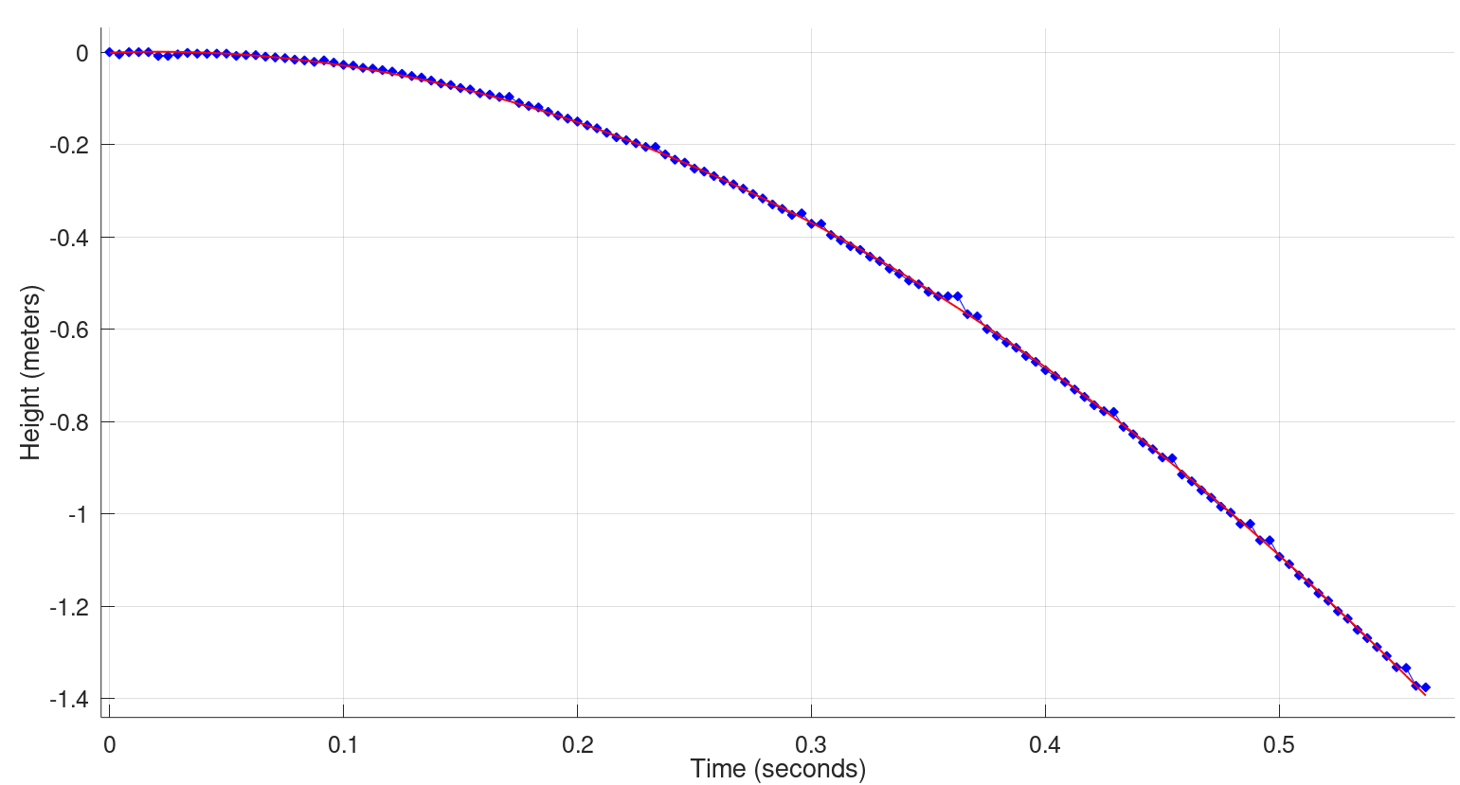
Distance ~ -(4.7m/s^2)*time^2

Slide 16
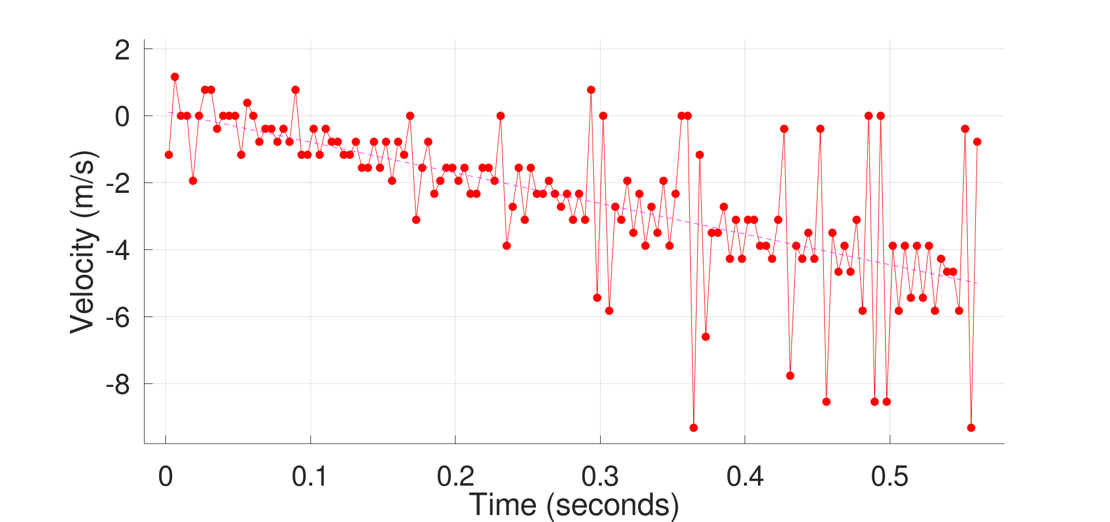
Velocity ~ -(9.4 m/s^2)*time
9.4 m/s^2=2*4.7m/s^2

Slide 17
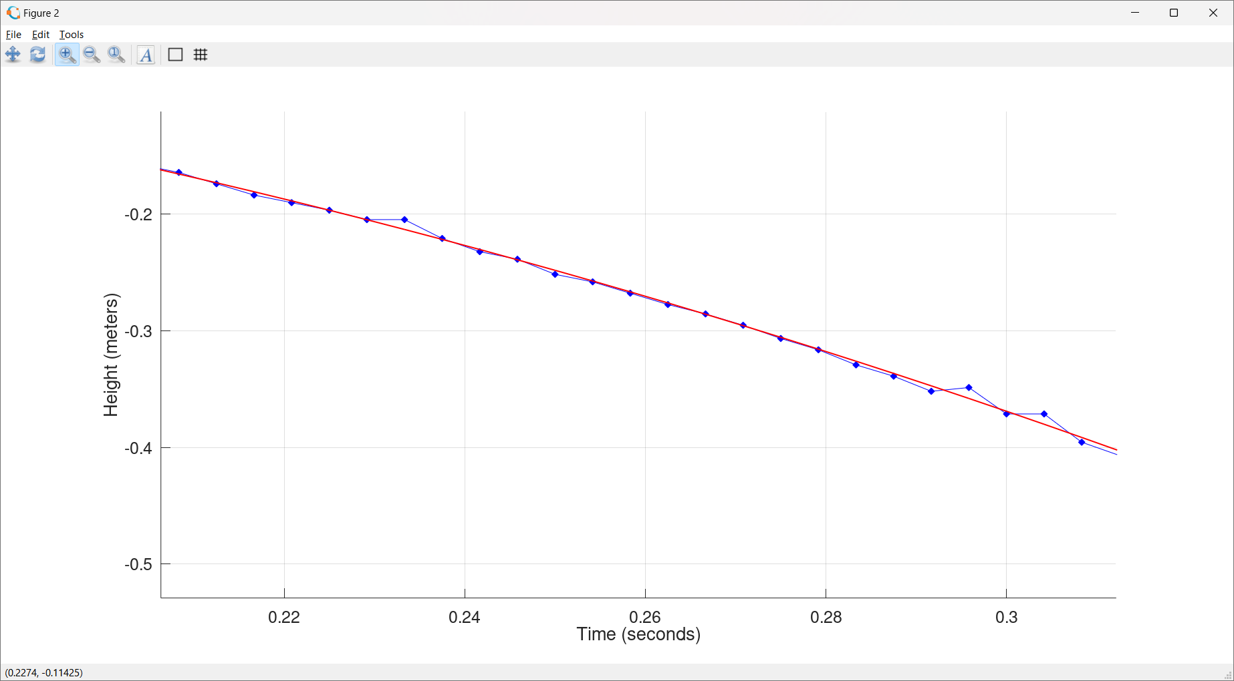

Slide 19
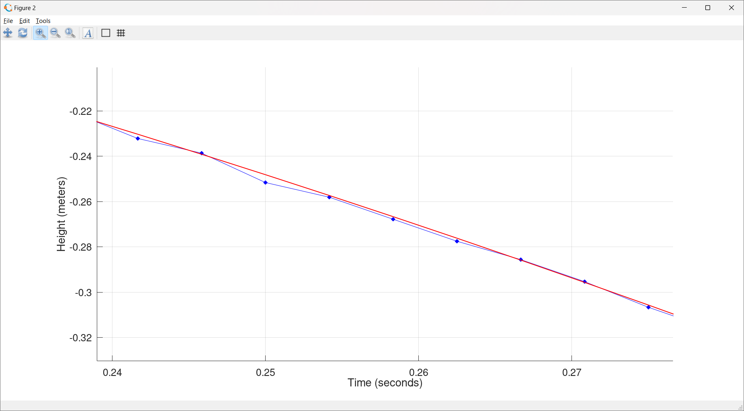

Slide 20
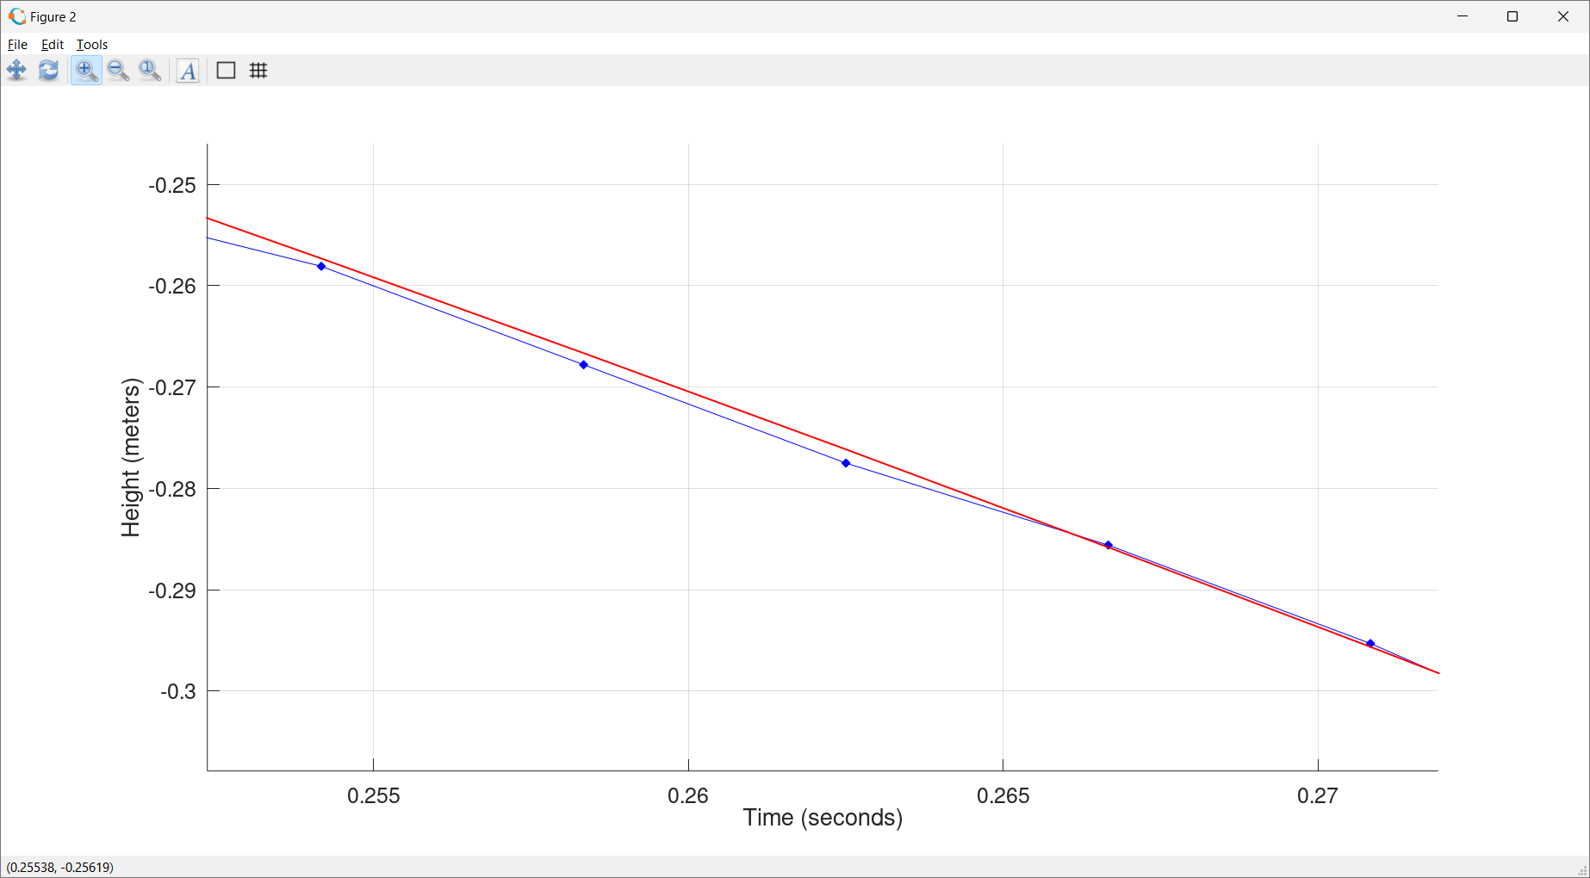

Slide 22
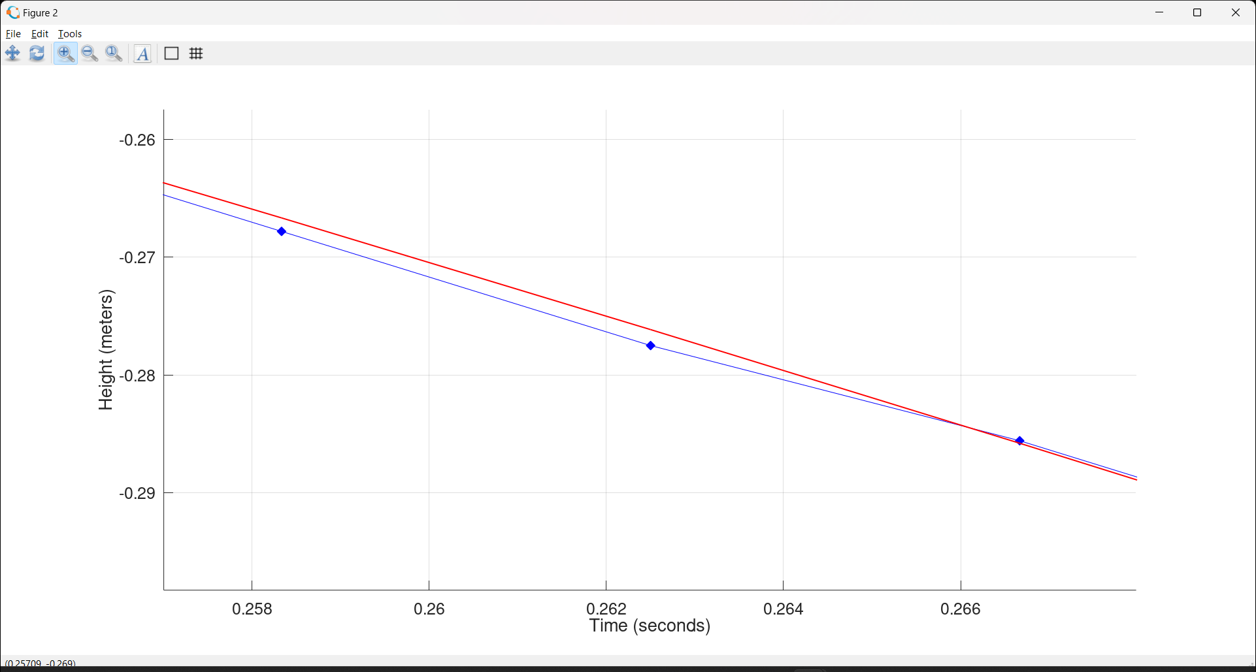

Slide 23
Distance = -(4.7m/s^2)*time^2
+(0.17 m/s)*time
+(.001 m)

Slide 24
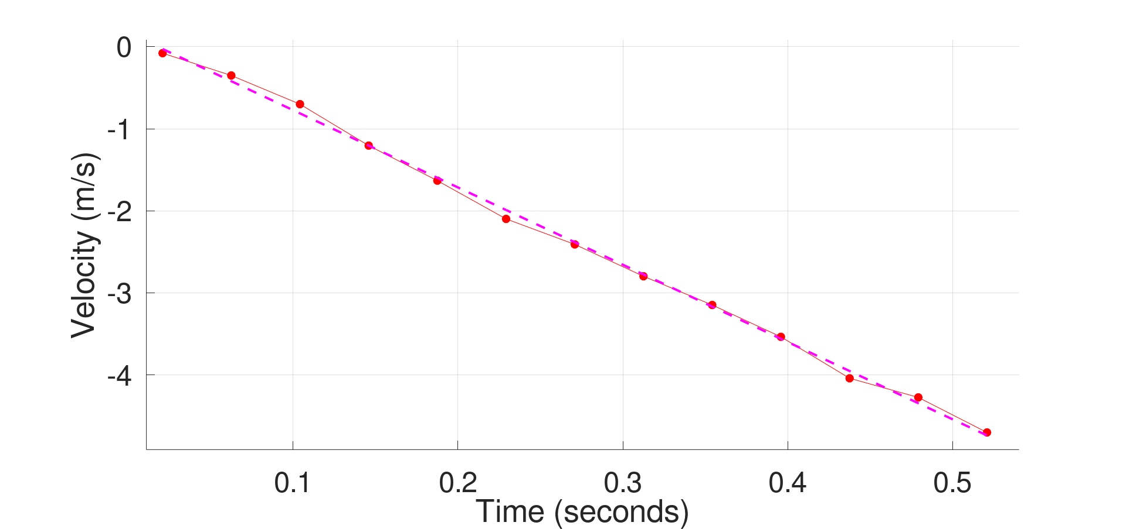
Velocity = -(9.46 m/s^2)*time+.17 m/s

Slide 25
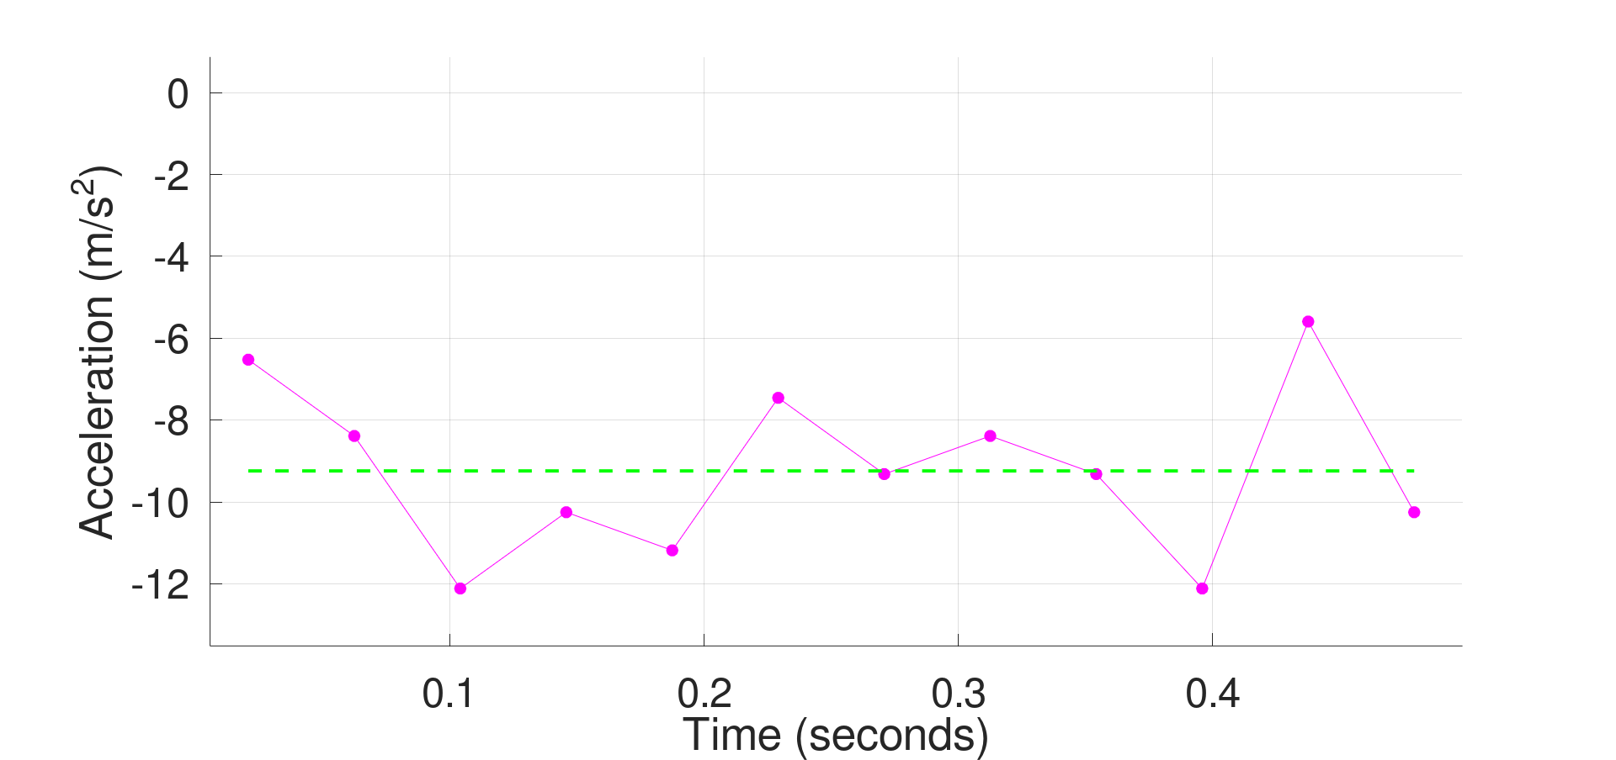

Acceleration = $\frac{Δv}{Δt}$ = -(9.2 m/s^2)

Slide 26
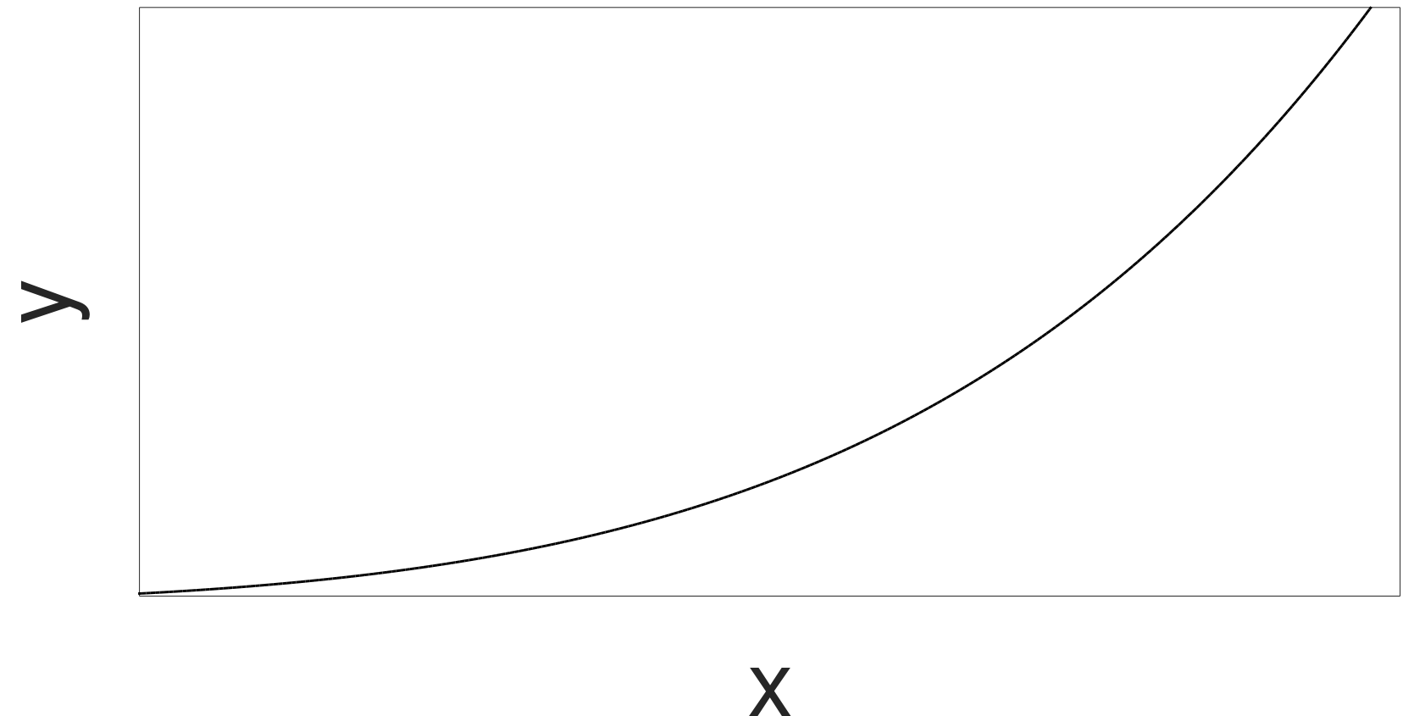



Recall The Definition of The Derivative
s$\underset{}{lope=}\frac{Δy}{Δx}$
$Δ$y
$Δ$x

Slide 27

Recall The Derivative
$\lim_{Δx→0}\frac{Δy}{Δx}≡$ $\frac{dy}{dx}$
s$\underset{}{lope=}\frac{Δy}{Δx}$
$Δ$y
$Δ$x

Slide 28



Recall The Derivative
$\lim_{Δx→0}\frac{Δy}{Δx}≡$ $\frac{dy}{dx}$
$Δ$y
s$\underset{}{lope=}\frac{Δy}{Δx}$
$Δ$x

Slide 29


What about Purely Mathematically?
$$y=f\left(t\right)$$
$$v=\lim_{Δt→0}\frac{Δy}{Δt}≡\frac{ⅆy}{dt}$$
$$a=\lim_{Δt→0}\frac{Δv}{Δt}≡\frac{ⅆv}{dt}$$

Slide 30



What about Purely Mathematically?
$$y=f\left(t\right)=\frac{1}{2}at^{2}$$
$$v=\lim_{Δt→0}\frac{Δy}{Δt}≡\frac{ⅆy}{dt}=a∙t$$
$$a=\lim_{Δt→0}\frac{Δv}{Δt}≡\frac{ⅆv}{dt}≡\frac{ⅆ2y}{dt2}=a$$

Slide 31
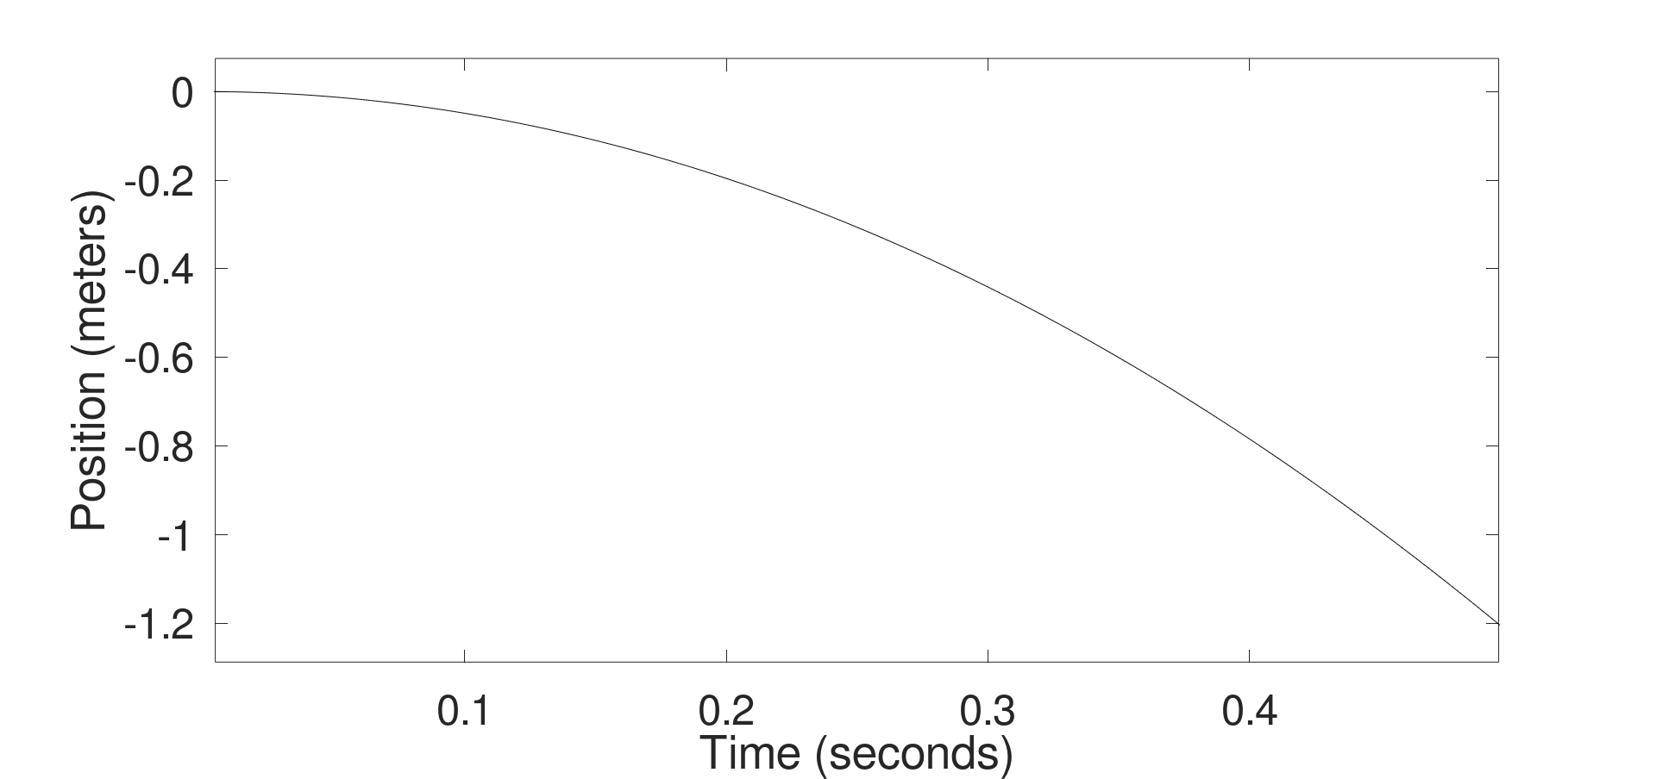
Let’s assume a = 9.8 m/s^2 (the accepted value)

Slide 32
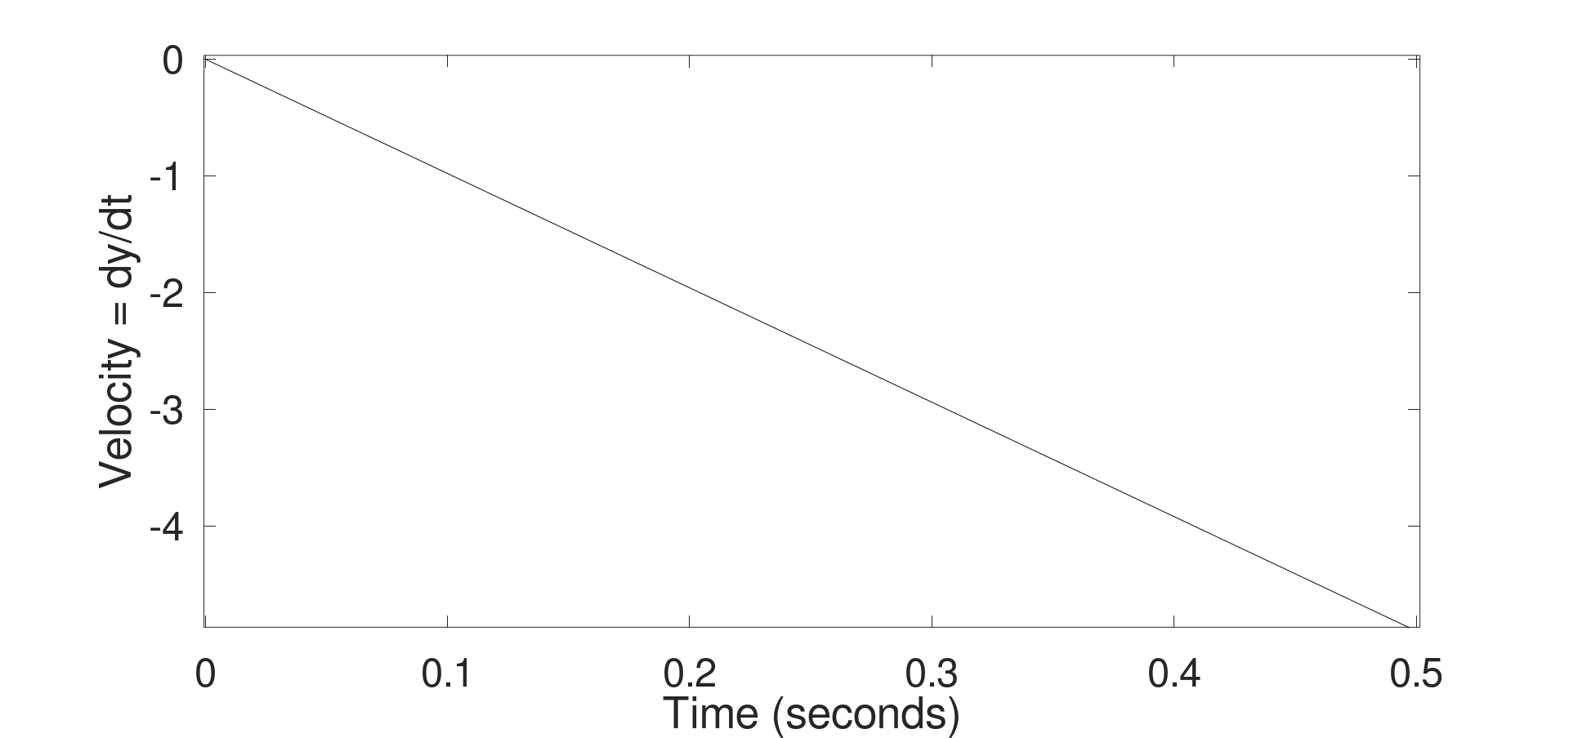

Slide 33
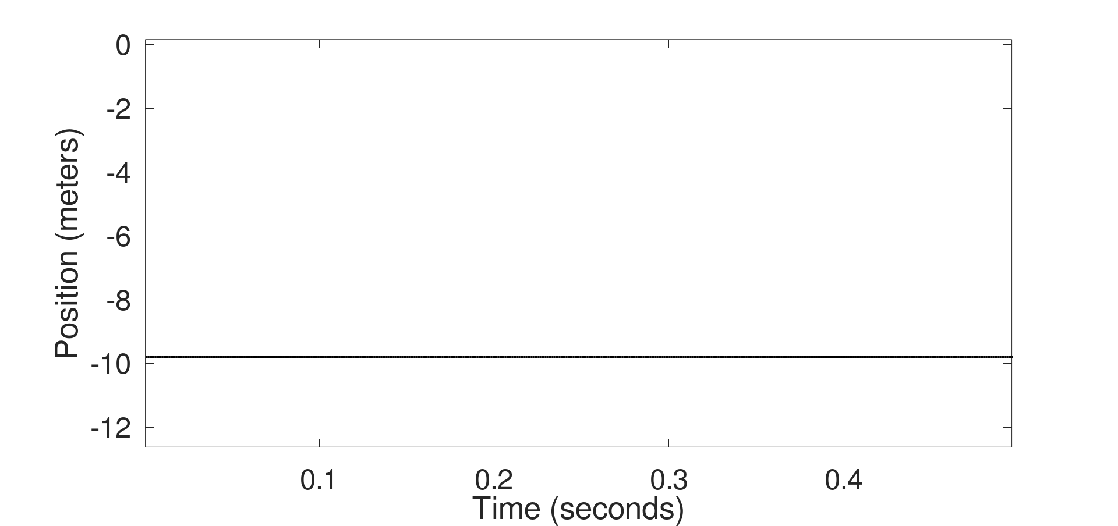
Acceleration (m/s^2)

Slide 34
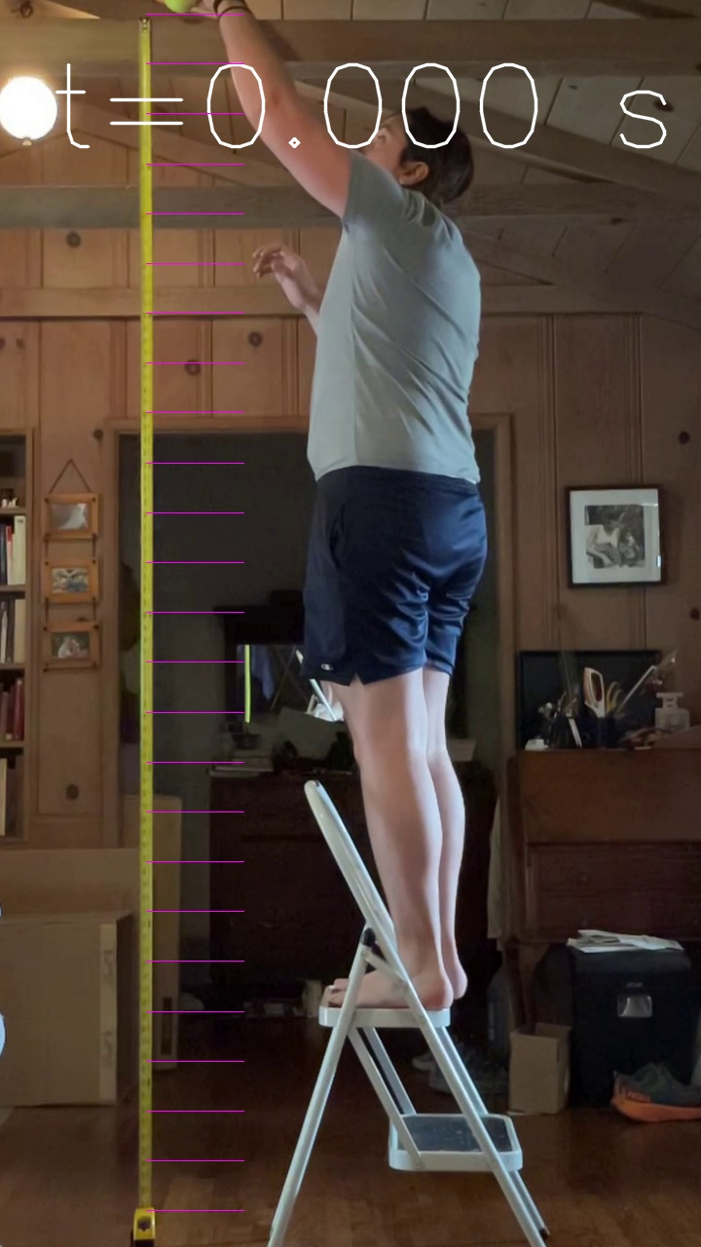


$\frac{1}{2}at^{2}$=9.8/2*0.0^2=0.00 m
$v=at^{}$=9.8*0.0=0.00 m/s

Slide 35
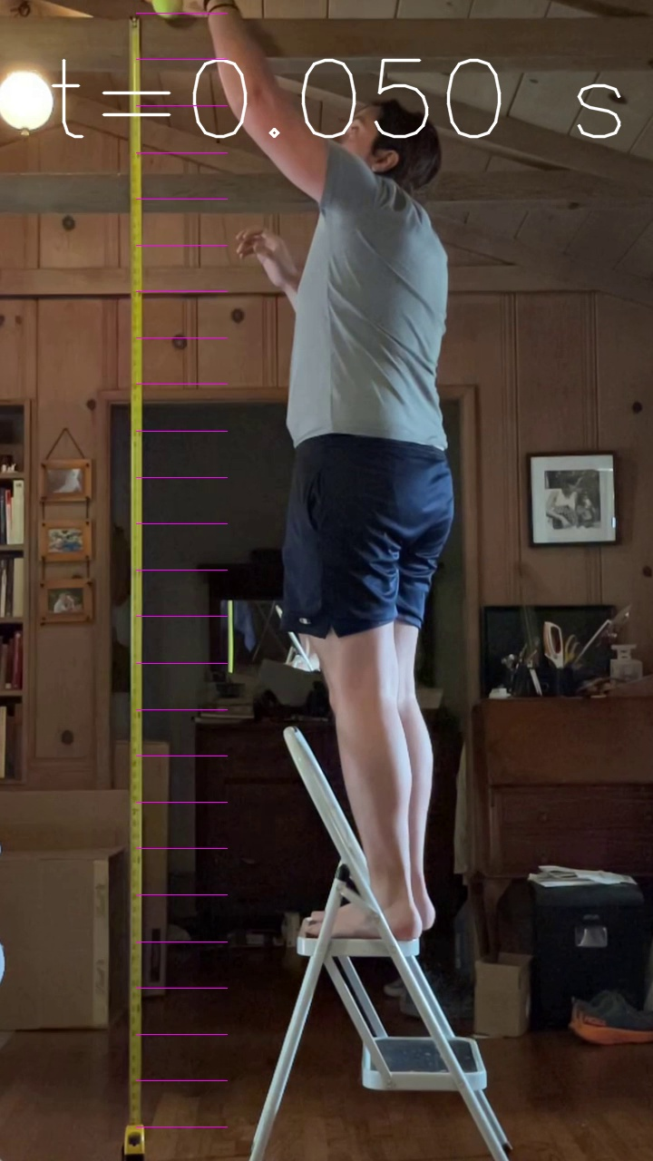


$\frac{1}{2}at^{2}$=9.8/2*0.05^2=0.01 m
$v=at^{}$=9.8*0.05=0.49 m/s

Slide 36
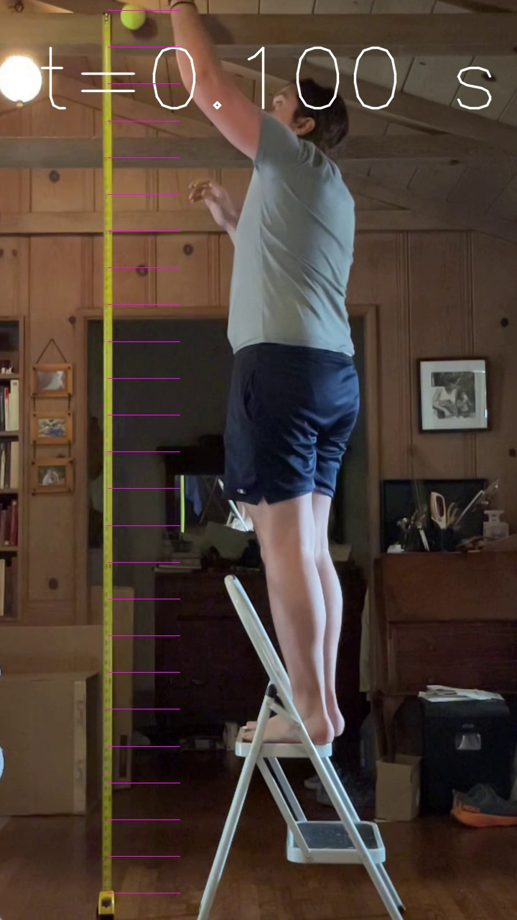


$\frac{1}{2}at^{2}$=9.8/2*0.1^2=0.05 m
$v=at^{}$=9.8*0.1=0.98 m/s

Slide 37
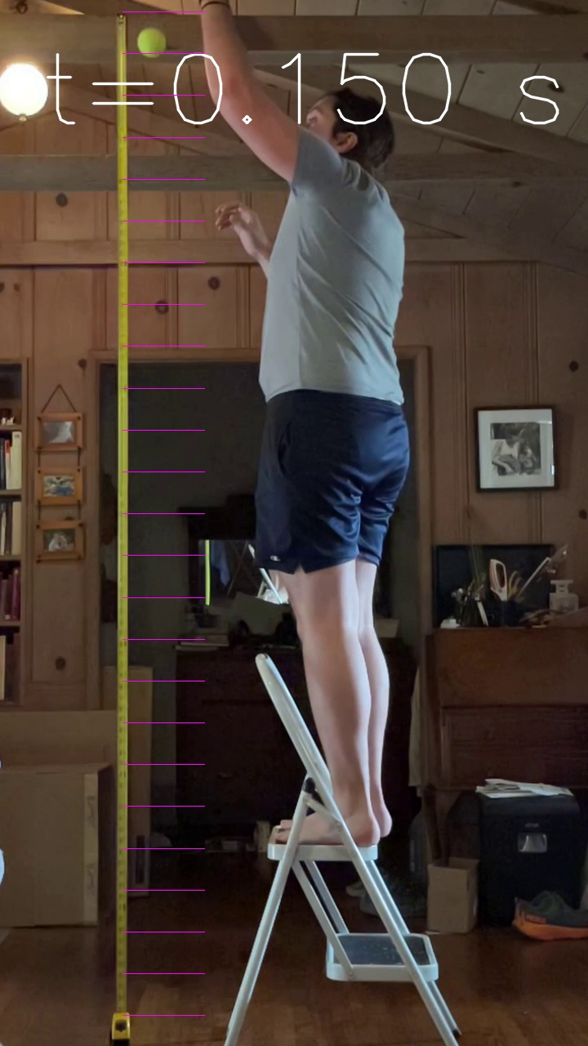


$\frac{1}{2}at^{2}$=9.8/2*0.15^2=0.11 m
$v=at^{}$=9.8*0.05=1.47 m/s

Slide 38



$\frac{1}{2}at^{2}$=9.8/2*0.2^2=0.19 m
$v=at^{}$=9.8*0.2=1.96 m/s

Slide 39
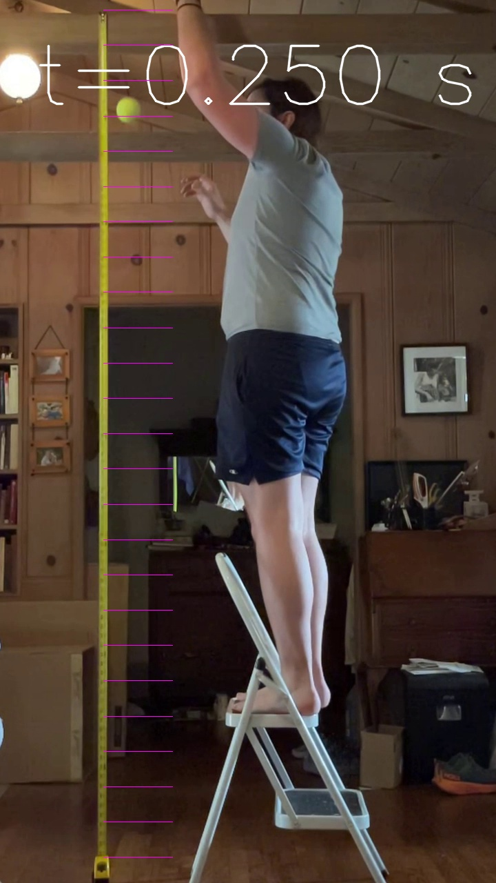


$\frac{1}{2}at^{2}$=9.8/2*0.25^2=0.31 m
$v=at^{}$=9.8*0.25=2.45 m/s

Slide 40
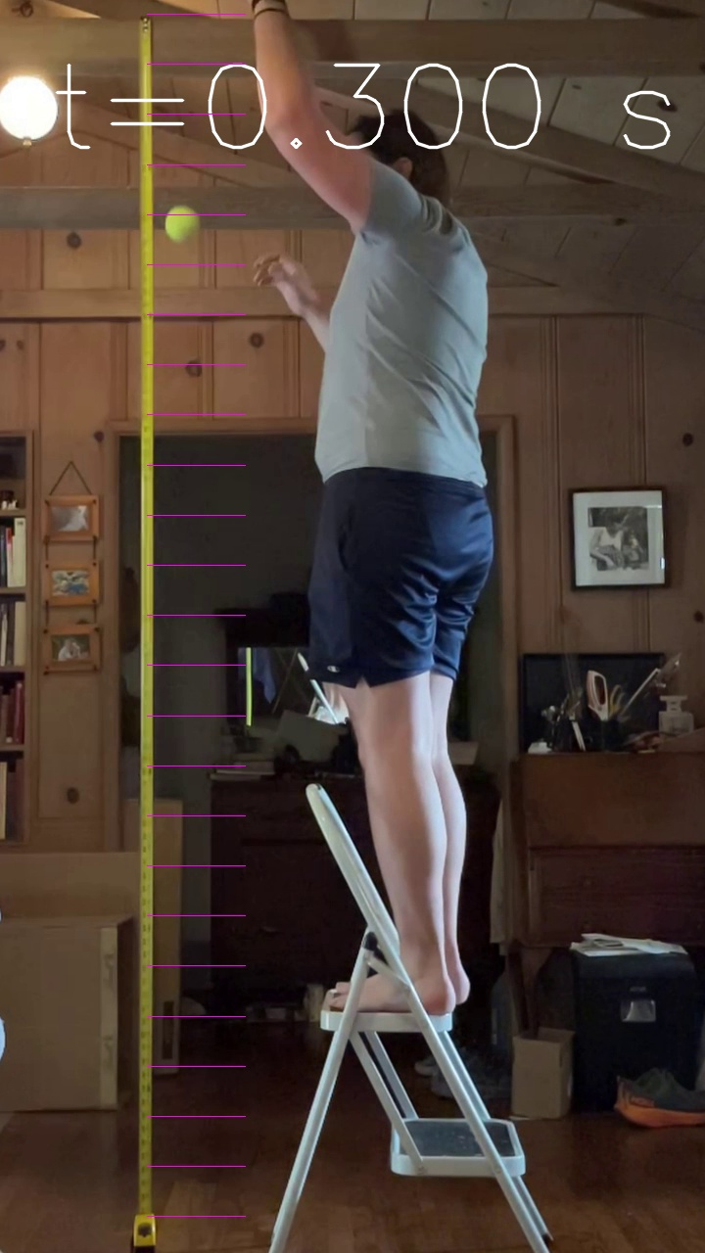


$\frac{1}{2}at^{2}$=9.8/2*0.3^2=0.44 m
$v=at^{}$=9.8*0.05=2.94 m/s

Slide 41



$\frac{1}{2}at^{2}$=9.8/2*0.35^2=0.60 m
$v=at^{}$=9.8*0.05=3.43 m/s

Slide 42



$\frac{1}{2}at^{2}$=9.8/2*0.0^2=0.78 m
$v=at^{}$=9.8*0.4=3.9 m/s

Slide 43
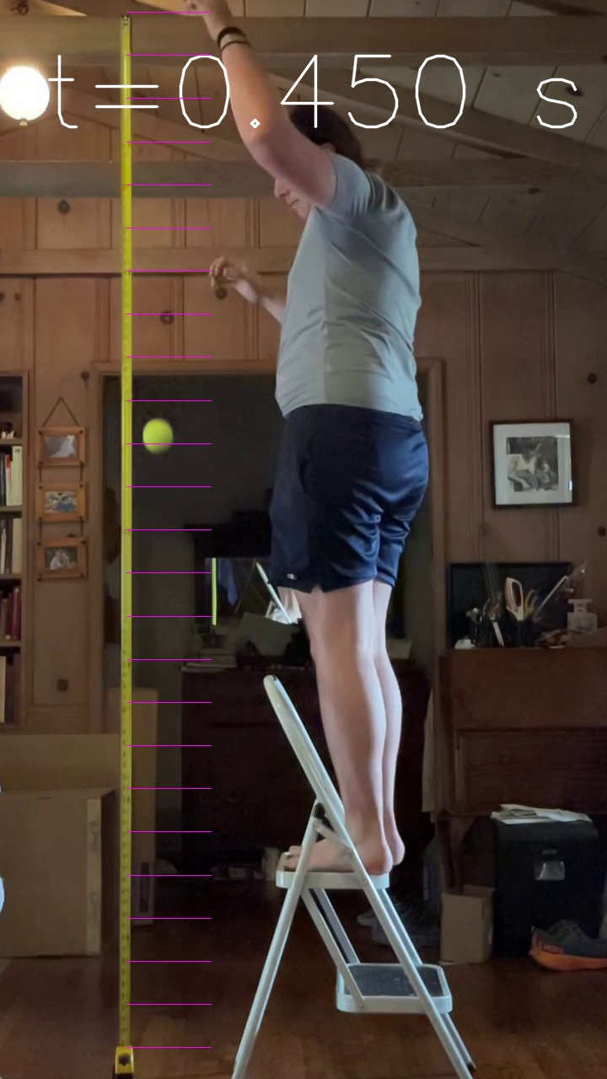


$\frac{1}{2}at^{2}$=9.8/2*0.45^2=0.99 m
$v=at^{}$=9.8*0.05=4.41 m/s

Slide 44



$\frac{1}{2}at^{2}$=9.8/2*0.5^2=1.23 m
$v=at^{}$=9.8*0.05=4.90 m/s

Slide 45
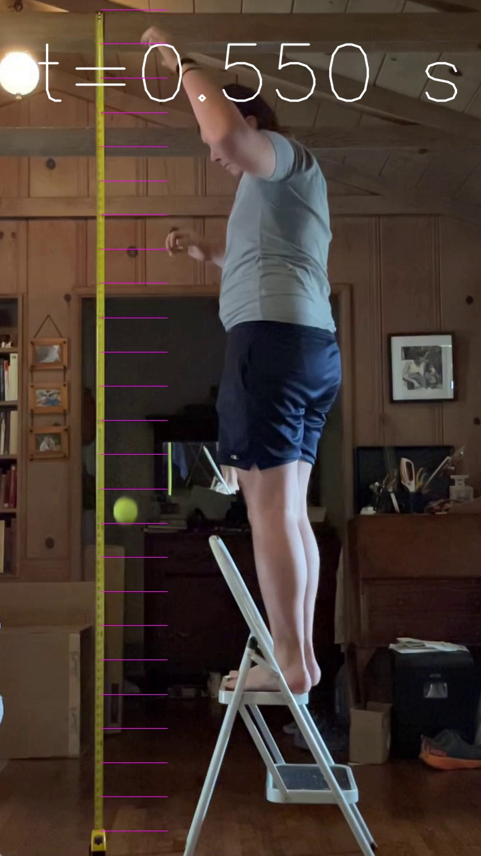


$\frac{1}{2}at^{2}$=9.8/2*0.0^2=1.48 m
$v=at^{}$=9.8*0.05=5.39 m/s

Slide 46
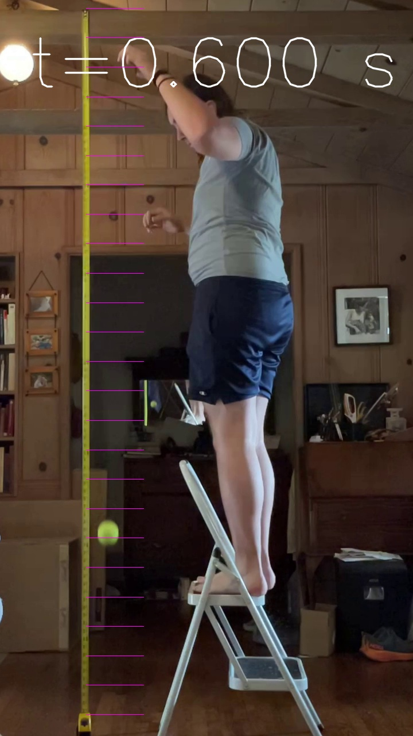


$\frac{1}{2}at^{2}$=9.8/2*0.0^2=1.76 m
$v=at^{}$=9.8*0.05=5.88 m/s

Slide 47
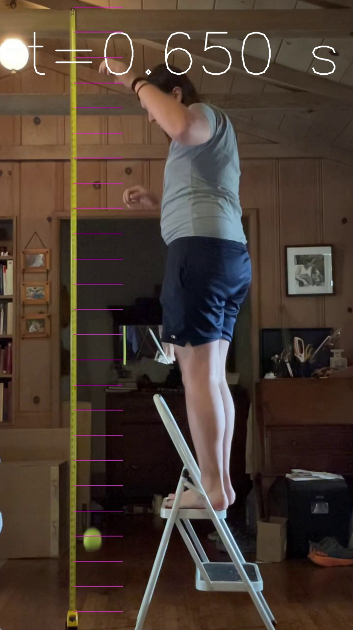

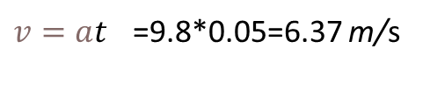
$\frac{1}{2}at^{2}$=9.8/2*0.65^2=2.07 m
$v=at^{}$=9.8*0.05=6.37 m/s

Slide 48
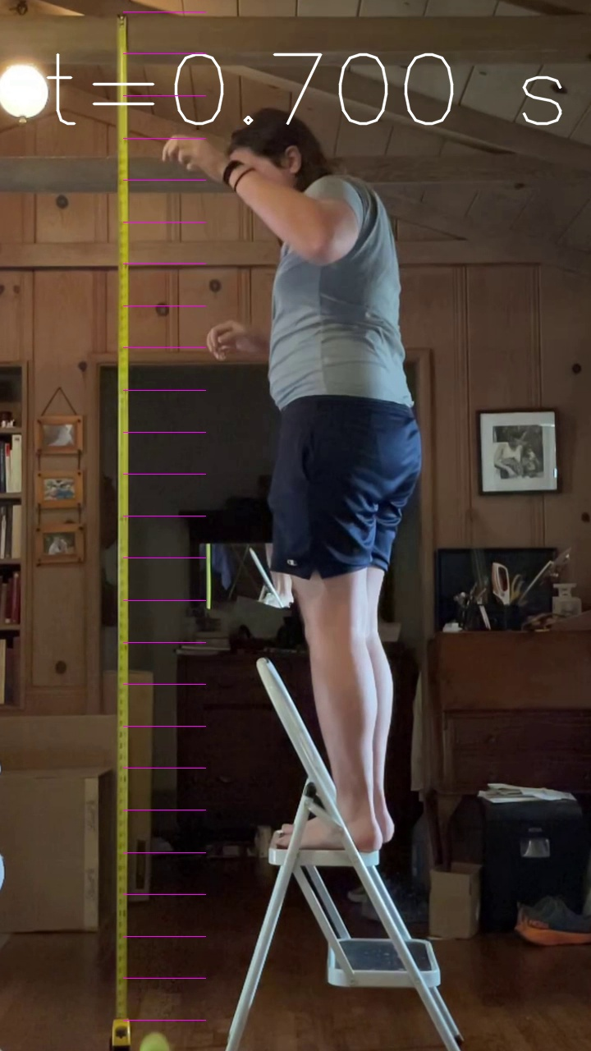


$\frac{1}{2}at^{2}$=9.8/2*0.7^2=02.4 m
$v=at^{}$=9.8*0.05=6.86 m/s

Slide 49
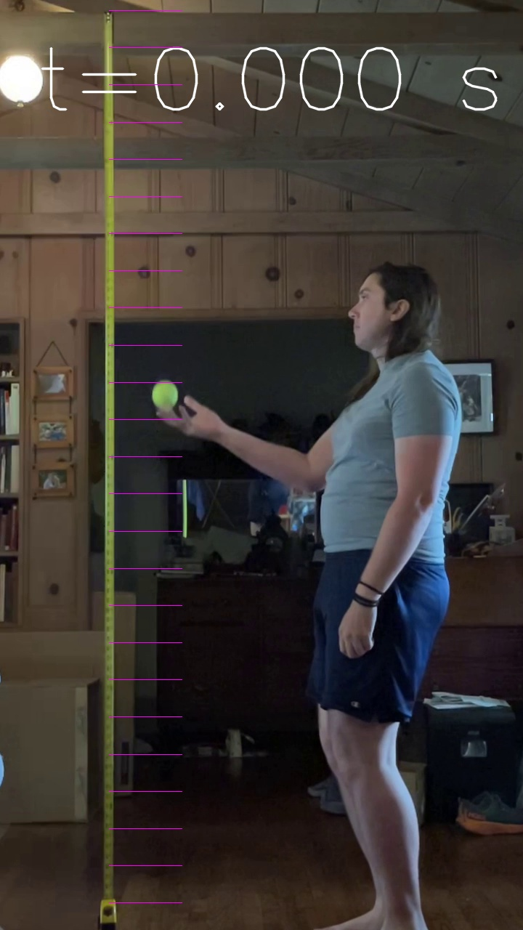
$\frac{1}{2}at^{2}$=9.8/2*0.0^2=0.00 m

Slide 50
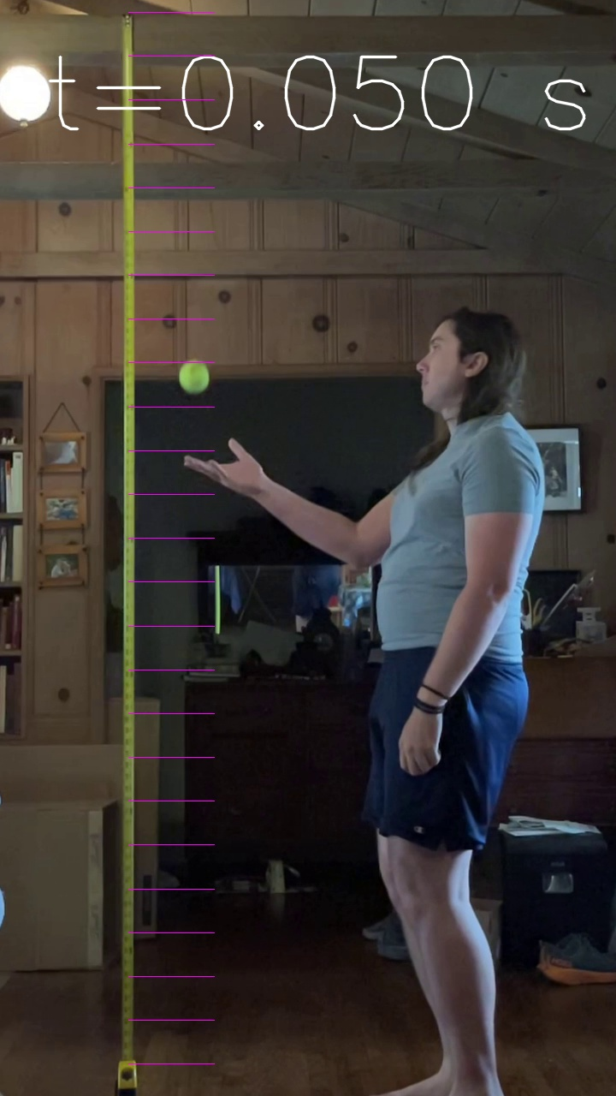
$\frac{1}{2}at^{2}$=9.8/2*0.05^2=0.01 m

Slide 51
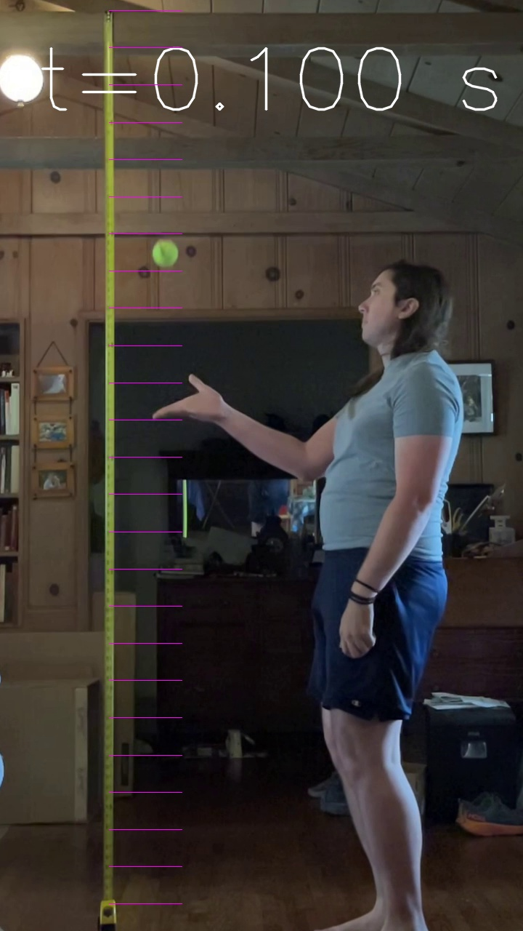
$v=at^{}$=9.8*0.1=0.98 m/s

Slide 52
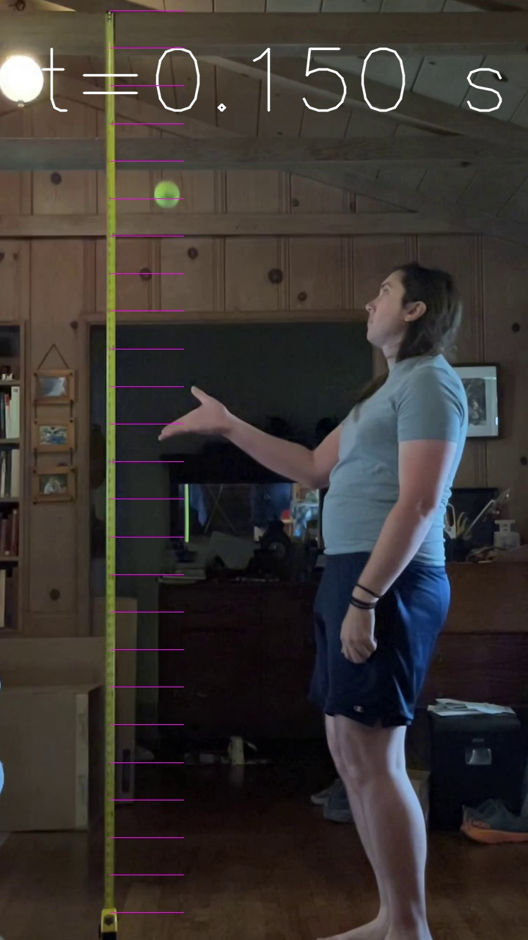
$\frac{1}{2}at^{2}$=9.8/2*0.15^2=0.11 m

Slide 53

$\frac{1}{2}at^{2}$=9.8/2*0.2^2=0.19 m

Slide 54

$\frac{1}{2}at^{2}$=9.8/2*0.25^2=0.31 m

Slide 55
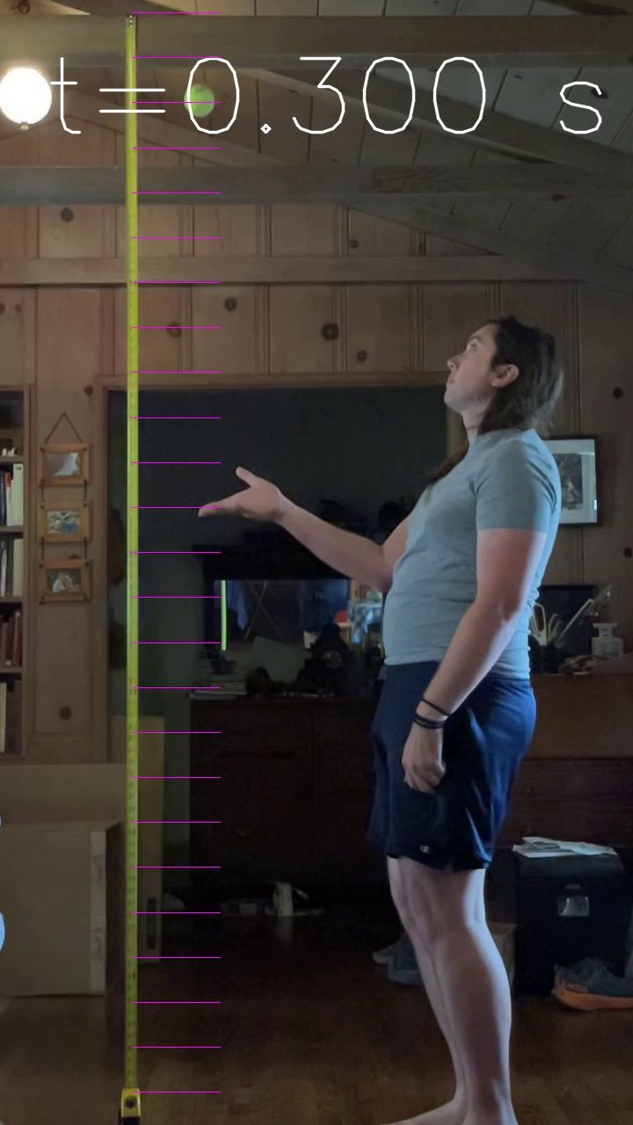
$\frac{1}{2}at^{2}$=9.8/2*0.3^2=0.44 m

Slide 56

$\frac{1}{2}at^{2}$=9.8/2*0.35^2=0.60 m

Slide 57
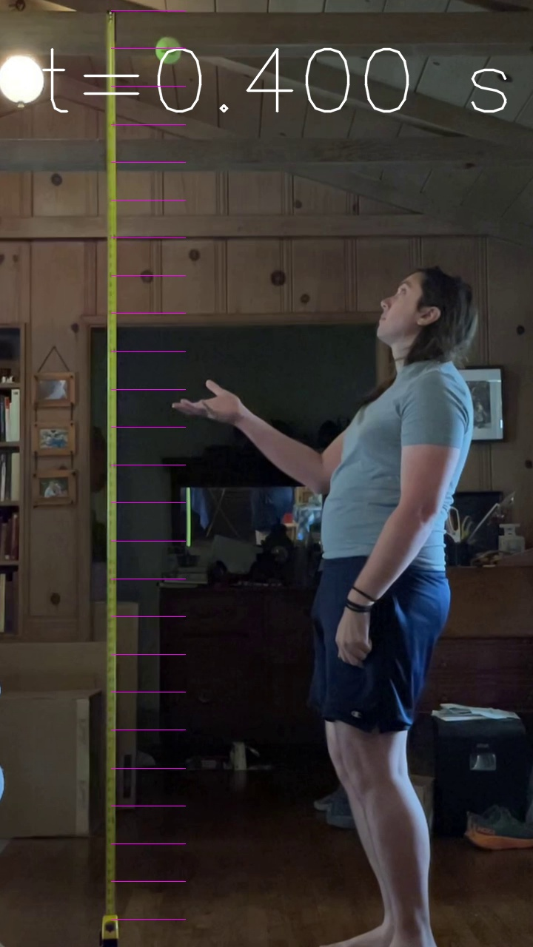
$\frac{1}{2}at^{2}$=9.8/2*0.0^2=0.78 m

Slide 58

$\frac{1}{2}at^{2}$=9.8/2*0.45^2=0.99 m

Slide 59


$\frac{1}{2}at^{2}$=9.8/2*0.50^2=1.25 m

Slide 60
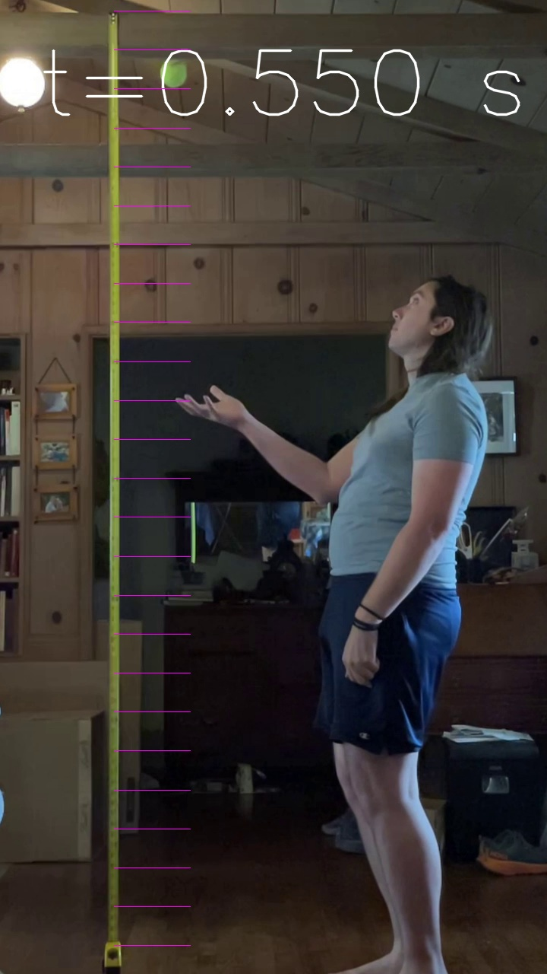

$\frac{1}{2}at^{2}$=9.8/2*0.55^2=1.48 m

Slide 61
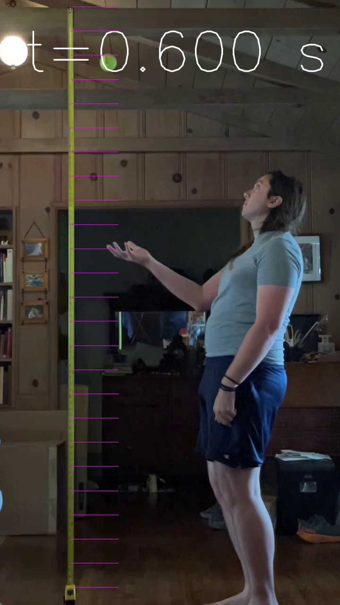

$\frac{1}{2}at^{2}$=9.8/2*0.6^2=1.76 m

Slide 62
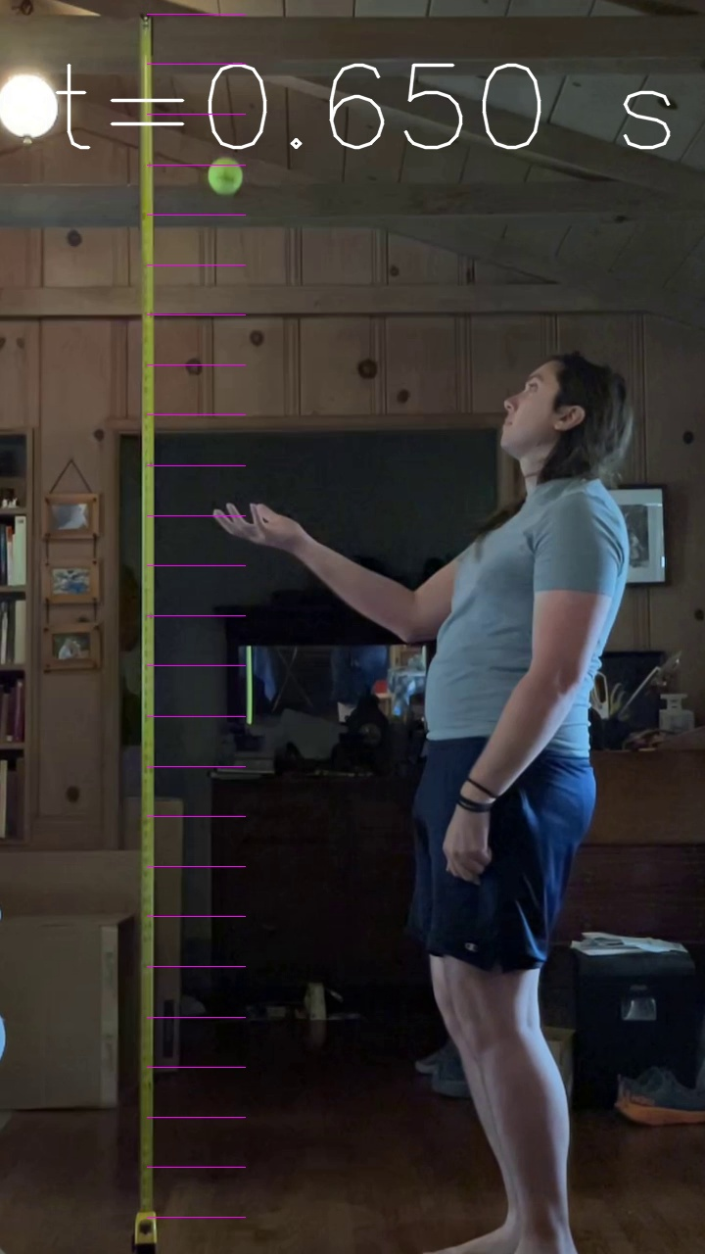

$\frac{1}{2}at^{2}$=9.8/2*0.55^2=2.07 m

Slide 63
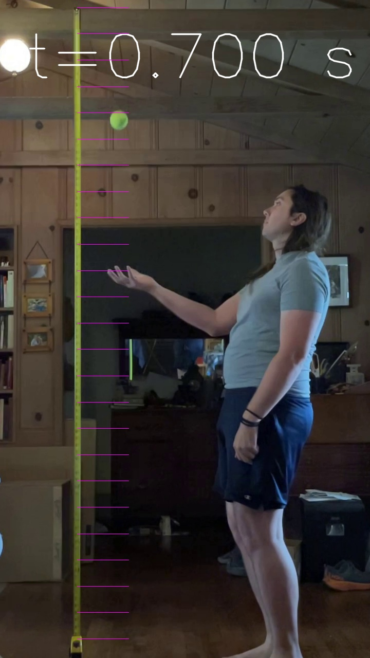

$\frac{1}{2}at^{2}$=9.8/2*0.7^2=2.40 m

Slide 64
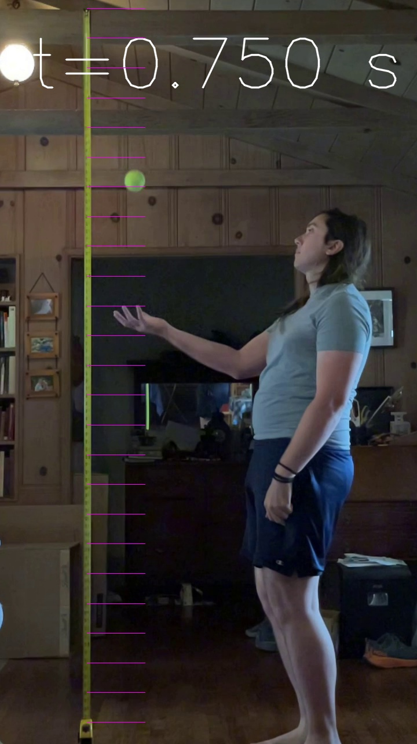

$\frac{1}{2}at^{2}$=9.8/2*0.75^2=2.76 m

Slide 65


$\frac{1}{2}at^{2}$=9.8/2*0.8^2=3.13 m

Slide 66
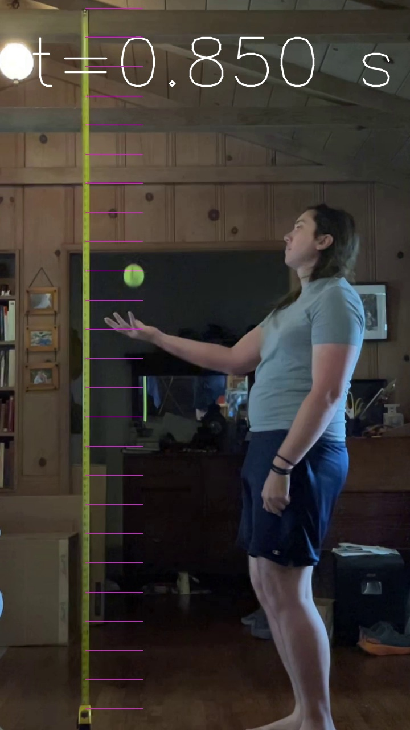

$\frac{1}{2}at^{2}$=9.8/2*0.85^2=3.54 m

Slide 67


$\frac{1}{2}at^{2}$=9.8/2*0.85^2=3.97 m

Slide 68
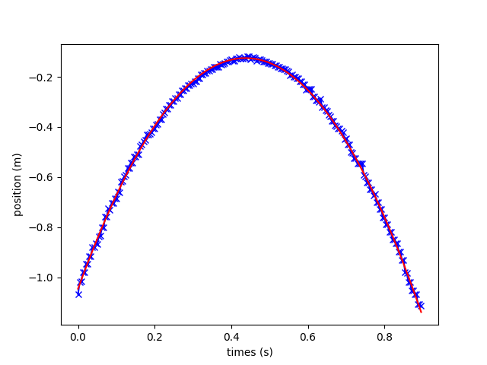

Slide 69
[-4.63141311, 3.53448133, -1.55123846]
[1.96729656, 0.4032183 ]

Slide 70
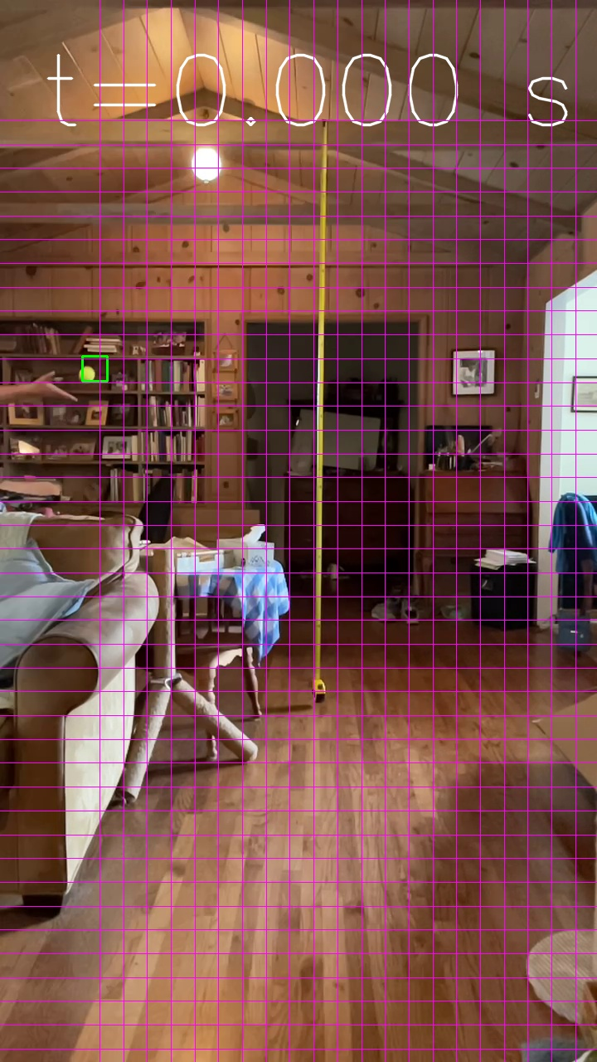

Slide 71


Slide 72
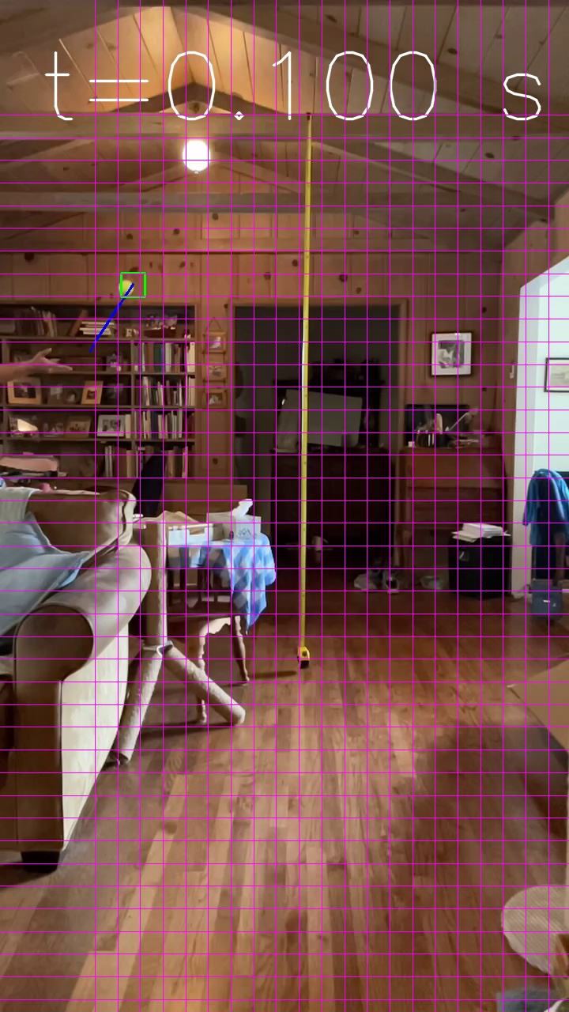

Slide 73


Slide 74


Slide 75
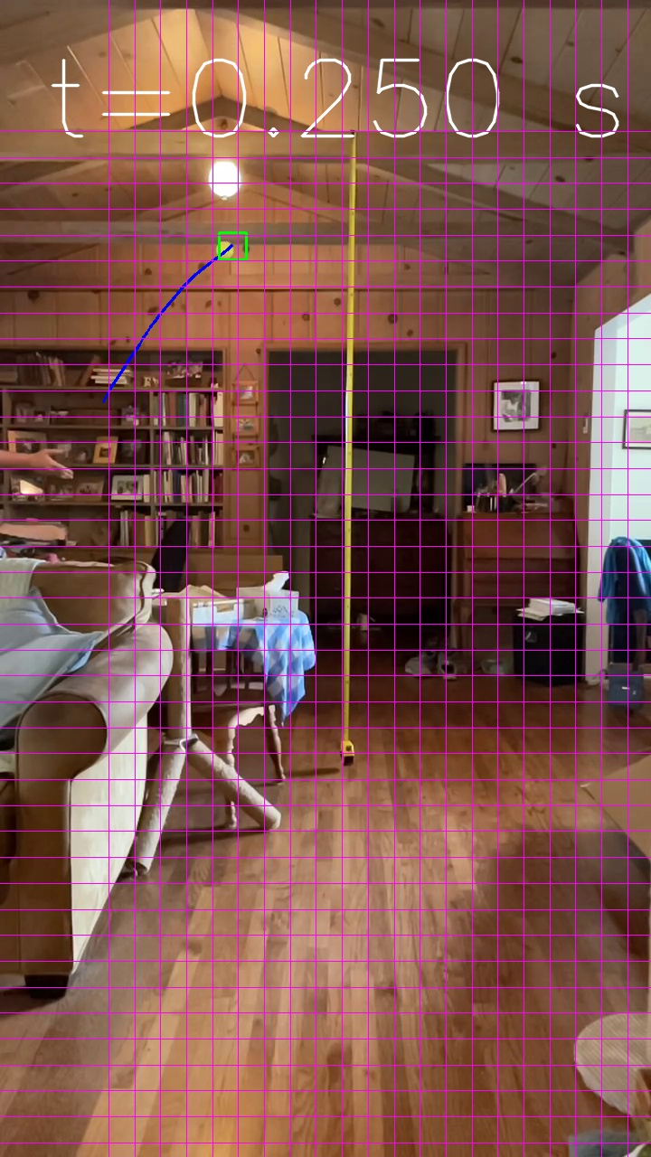

Slide 76


Slide 77


Slide 78


Slide 79


Slide 80


Slide 81


Slide 82


Slide 83


Slide 84


Slide 85


Slide 86


Slide 87


Slide 88



$y=−\frac{1}{2}at^{2}+Vyot+y0$= -4.6*t^2+3.5*t-1.5
$y=Vxot+x0$= 2.0*t+0.4

Slide 90



$$arctangent\left(\frac{3.5}{2.0}\right)=60o$$
$$√(3.52+2.02)=4.0\frac{m}{s}$$

Slide 91


$\frac{a}{v}=\frac{3.5}{9.8}=0.35$ s
$y=−\frac{1}{2}at^{2}+Vyot+y0$= -4.6*t^2+3.5*t-1.5
$y=Vxot+x0$= 2.0*t+0.4

Slide 92

$y=−\frac{1}{2}at^{2}+Vyot+y0$= -4.6*t^2+3.5*t-1.5
$y=Vxot+x0$= 2.0*t+0.4

Slide 93


$y=−\frac{1}{2}at^{2}+Vyot+y0$= -4.6*t^2+3.5*t-1.5
$y=Vxot+x0$= 2.0*t+0.4

Slide 94

$y=−\frac{1}{2}at^{2}+Vyot+y0$= -4.6*t^2+3.5*t-1.5
$$y0=1.5 m \& yf=−2.9 m$$
-2.8 m = -4.6*t^2+3.5*t-1.5 so
$$t=(−3.5+\sqrt{3.52+4∗4.6∗1.4})/9.2=1.1s$$
$y=Vxot+x0$= 2.0*t+0.4

Slide 95
0.9
1.4

