Slide 1
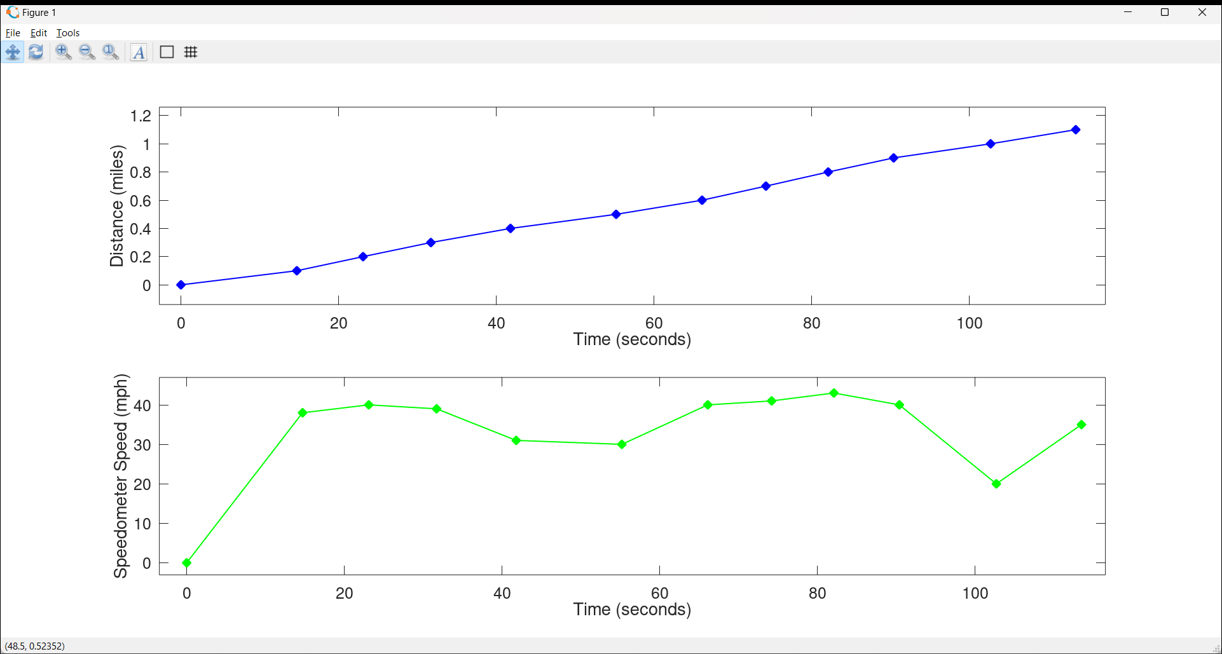

Slide 2
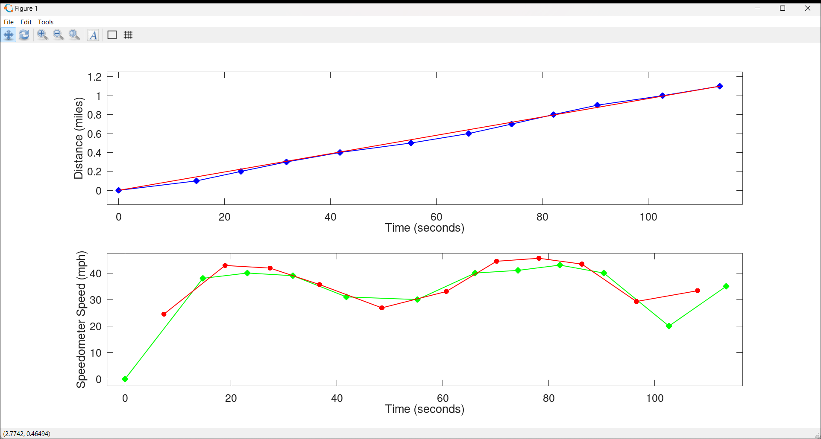
Distance = (35 mph)*time=(1.1 miles)/(113.5s)*t

Slide 3
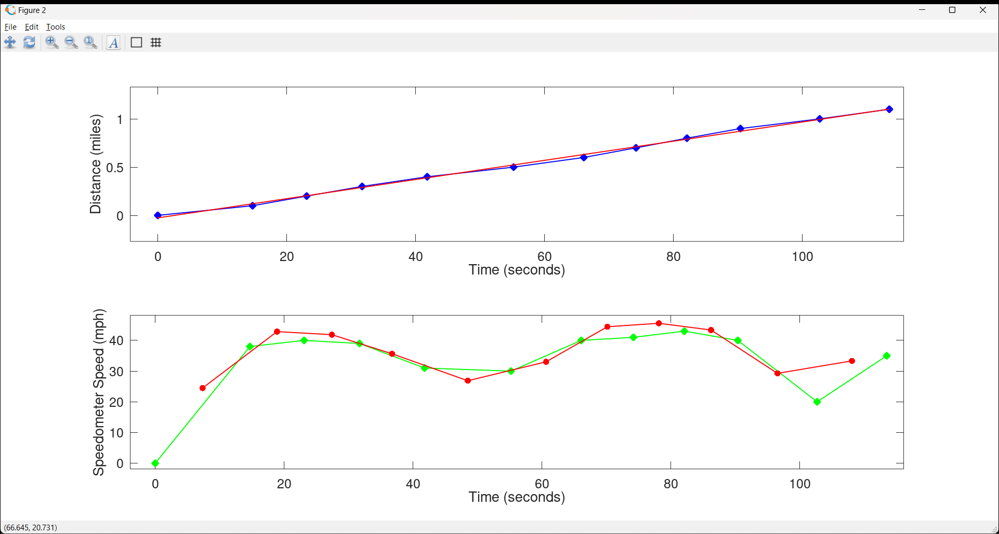
Distance = (36 mph)*time-(0.2 miles)

Slide 7
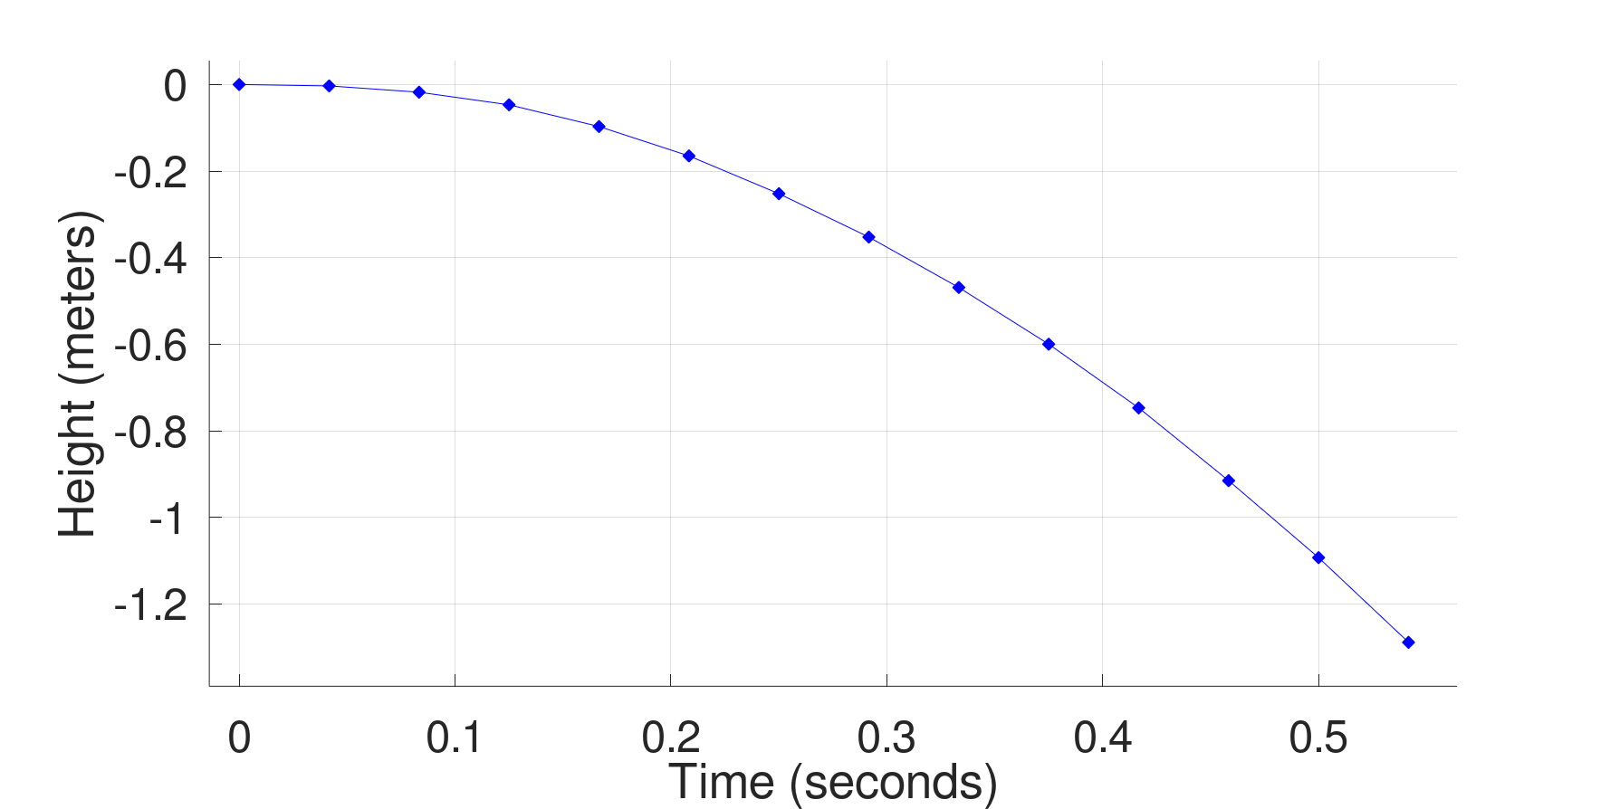

Slide 8
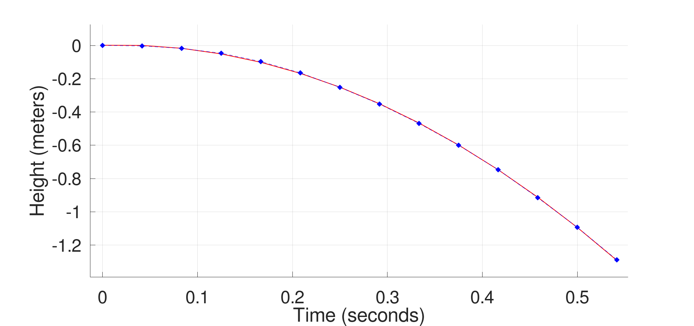
Distance = -(4.7m/s^2)*time^2
+(0.17 m/s)*time
+(.001 m)

Slide 9
Distance = -(4.7m/s^2)*time^2

Slide 10
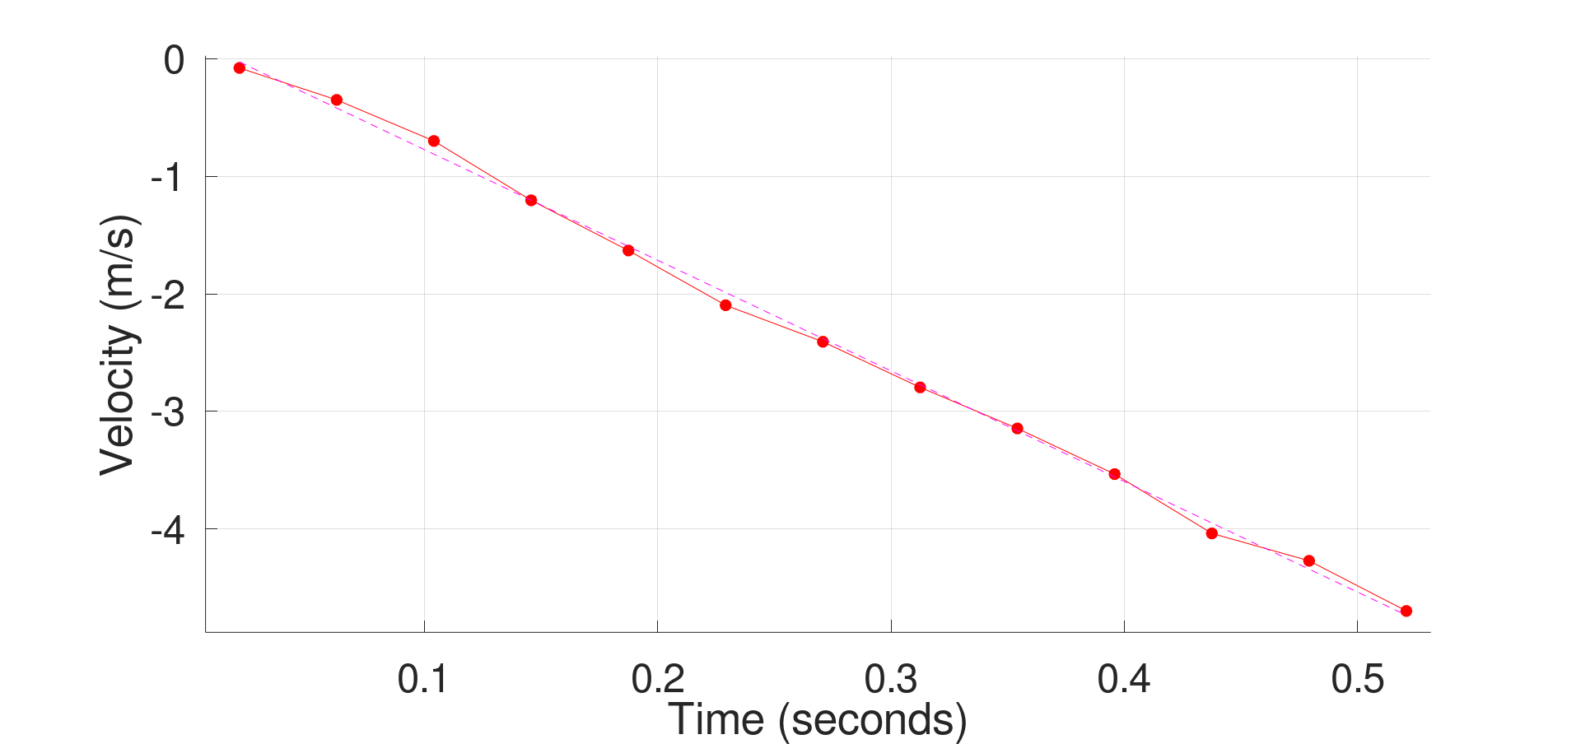
Velocity ~= -(9.4 m/s^2)*time

Slide 11
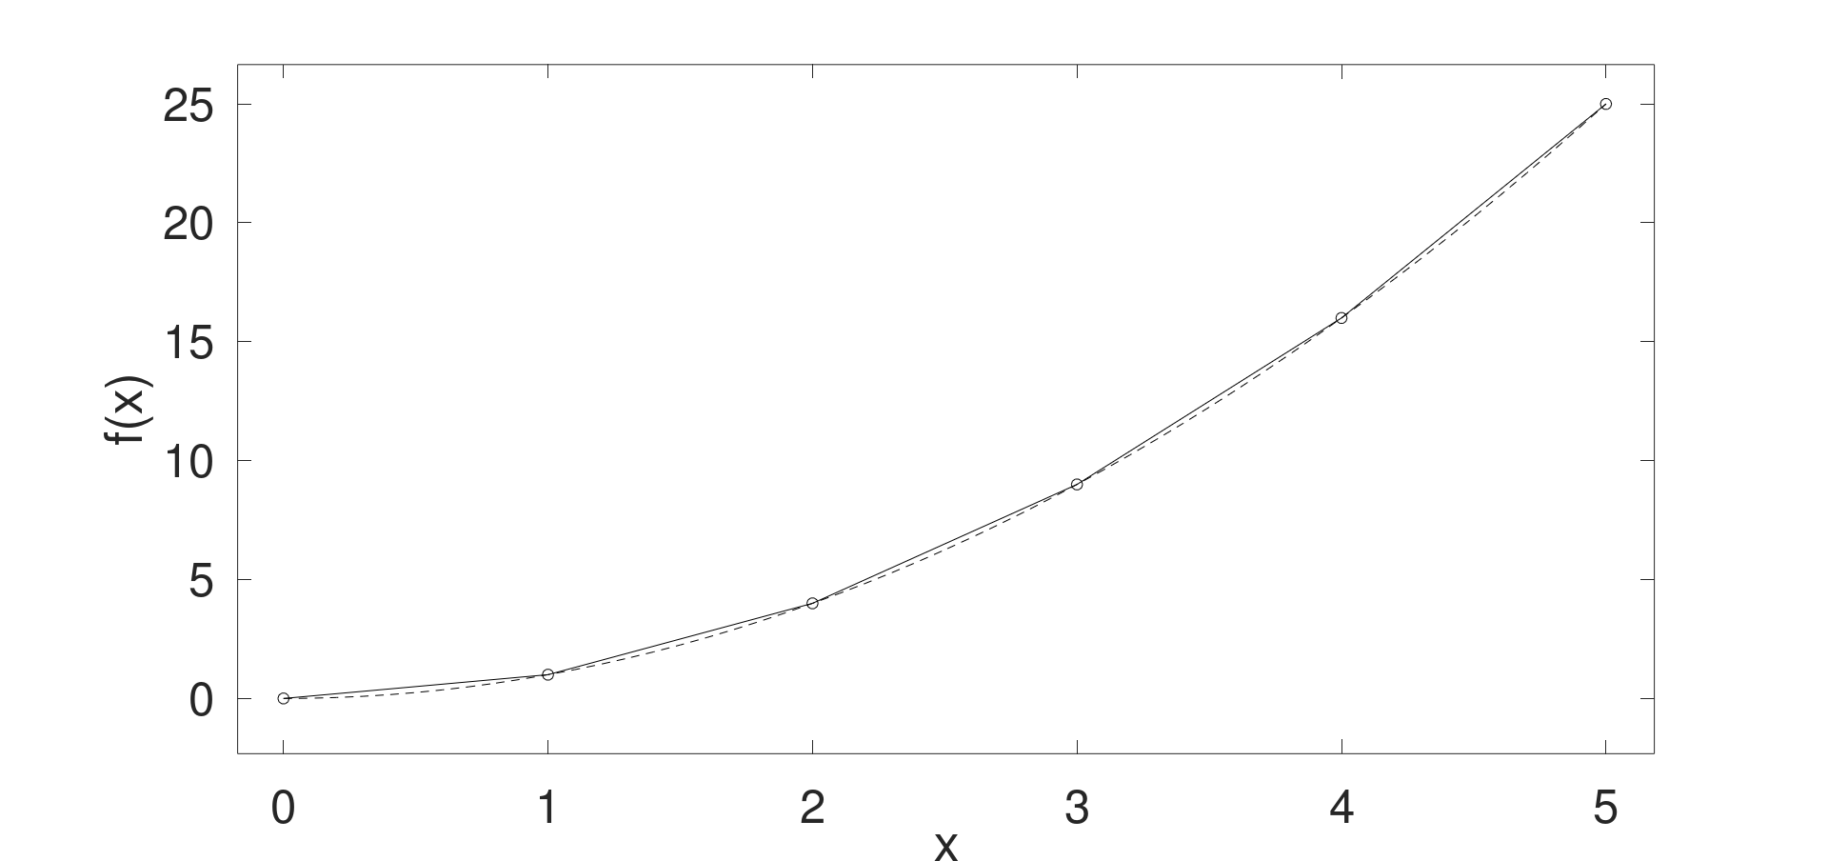





$$\frac{5^{2}−42}{1}=9$$
$$\frac{4^{2}−32}{1}=7$$
$$\frac{3^{2}−22}{1}=5$$
$$\frac{2^{2}−12}{1}=3$$
$$\frac{1^{2}}{1}=1$$

Slide 12





$$\frac{5^{2}−42}{1}=9$$
$$\frac{4^{2}−32}{1}=7$$
$$\frac{3^{2}−22}{1}=5$$
$$\frac{2^{2}−12}{1}=3$$
$$\frac{1^{2}}{1}=1$$
$$0.5$$
$$1.5$$
$$2.5$$
$$3.5$$
$$4.5$$

Slide 13

$$\frac{5^{2}−42}{1}=9$$
$$\frac{d}{∂x}x^{2}=2⋅x$$
$$\frac{4^{2}−32}{1}=7$$
$$\frac{3^{2}−22}{1}=5$$
$$\frac{2^{2}−12}{1}=3$$
$$\frac{1^{2}}{1}=1$$
$$0.5$$
$$1.5$$
$$2.5$$
$$3.5$$
$$4.5$$

Slide 14
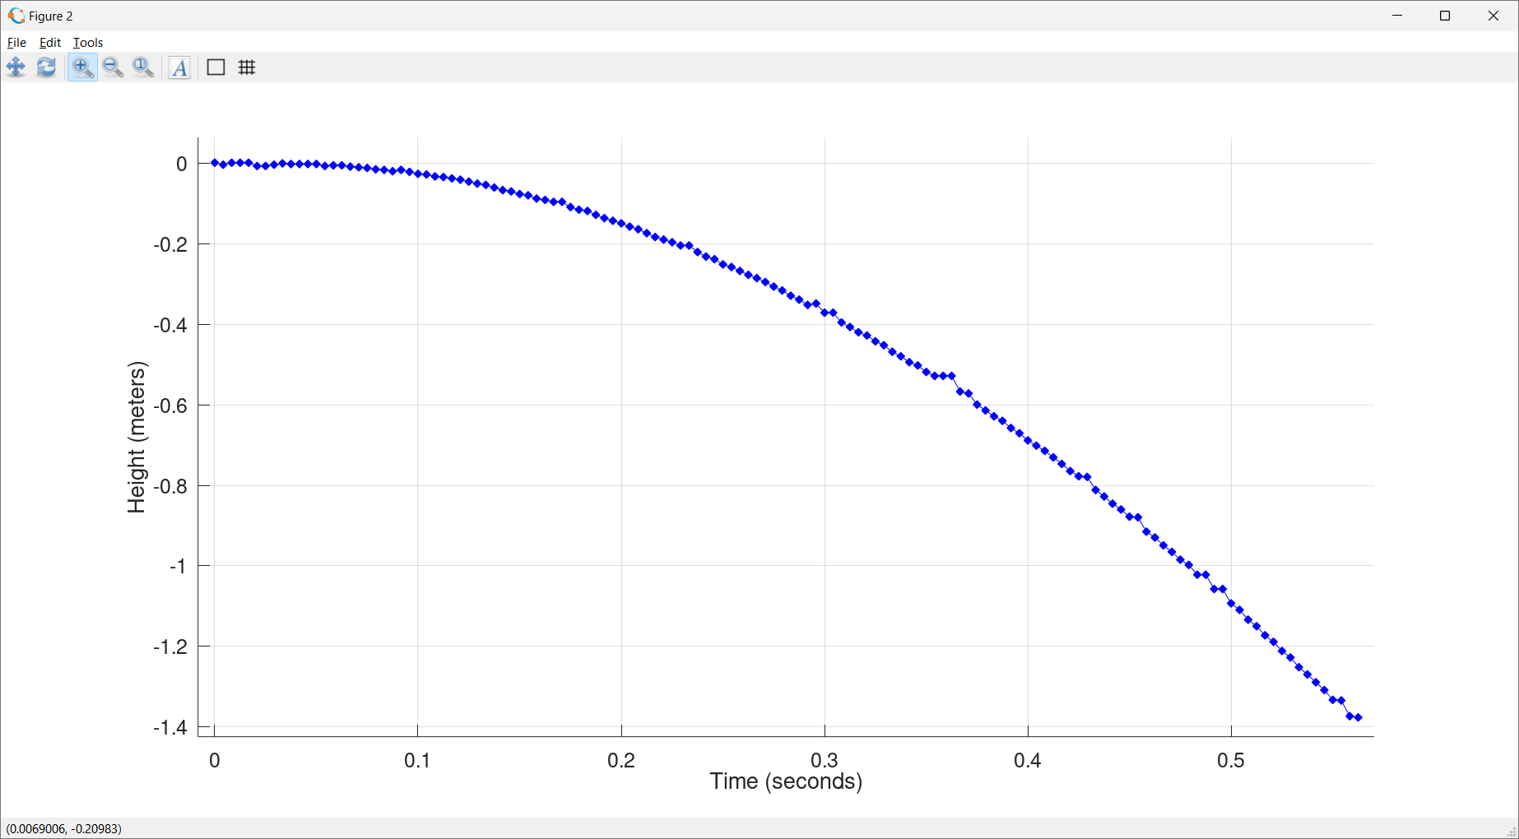

Slide 15
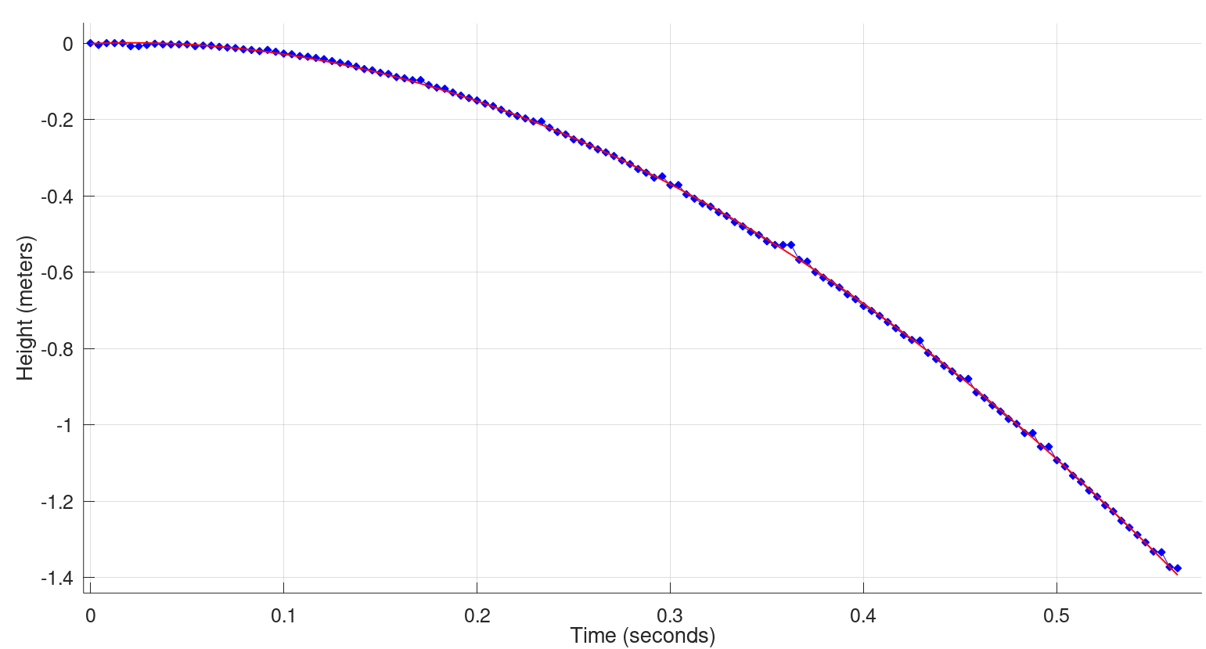
Distance ~ -(4.7m/s^2)*time^2

Slide 16
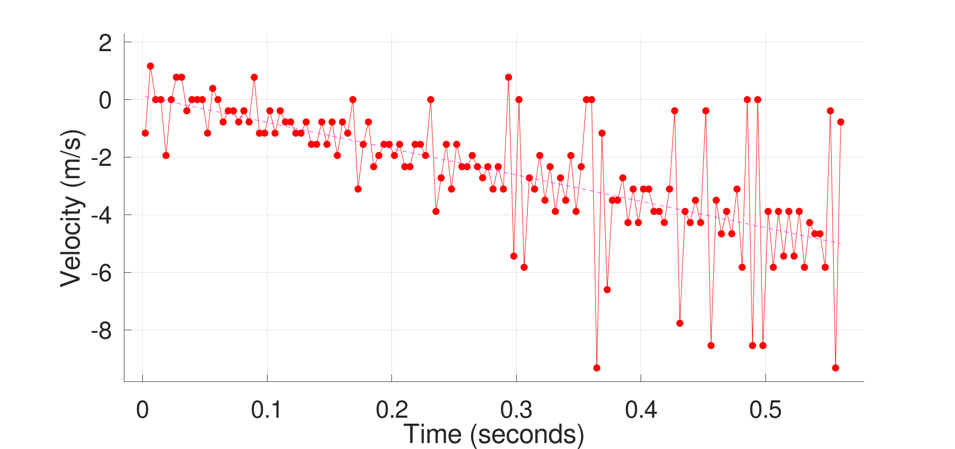
Velocity ~ -(9.4 m/s^2)*time
9.4 m/s^2=2*4.7m/s^2

Slide 17
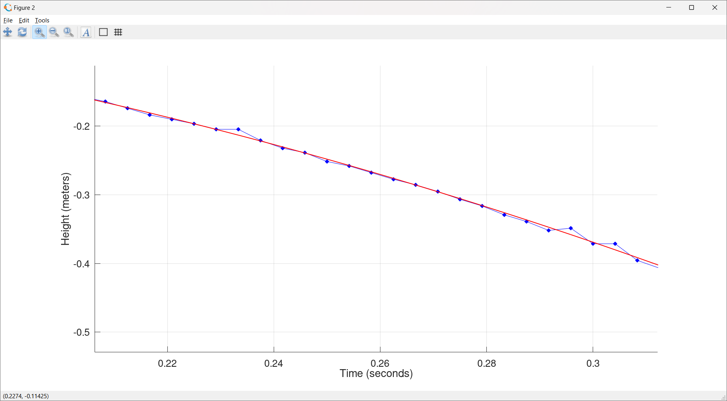

Slide 19
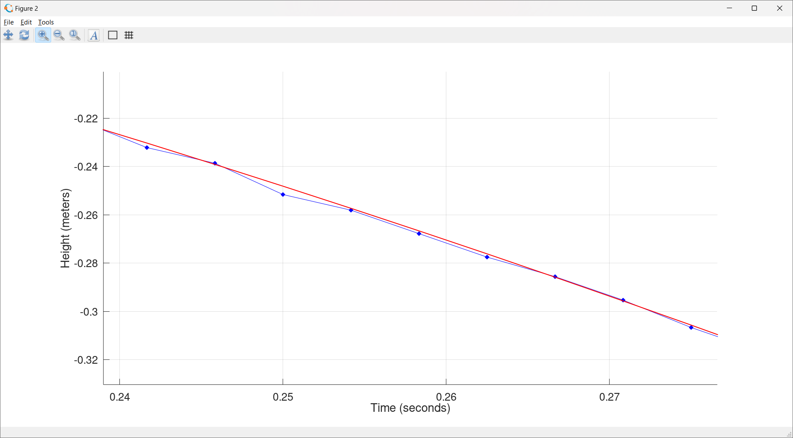

Slide 20
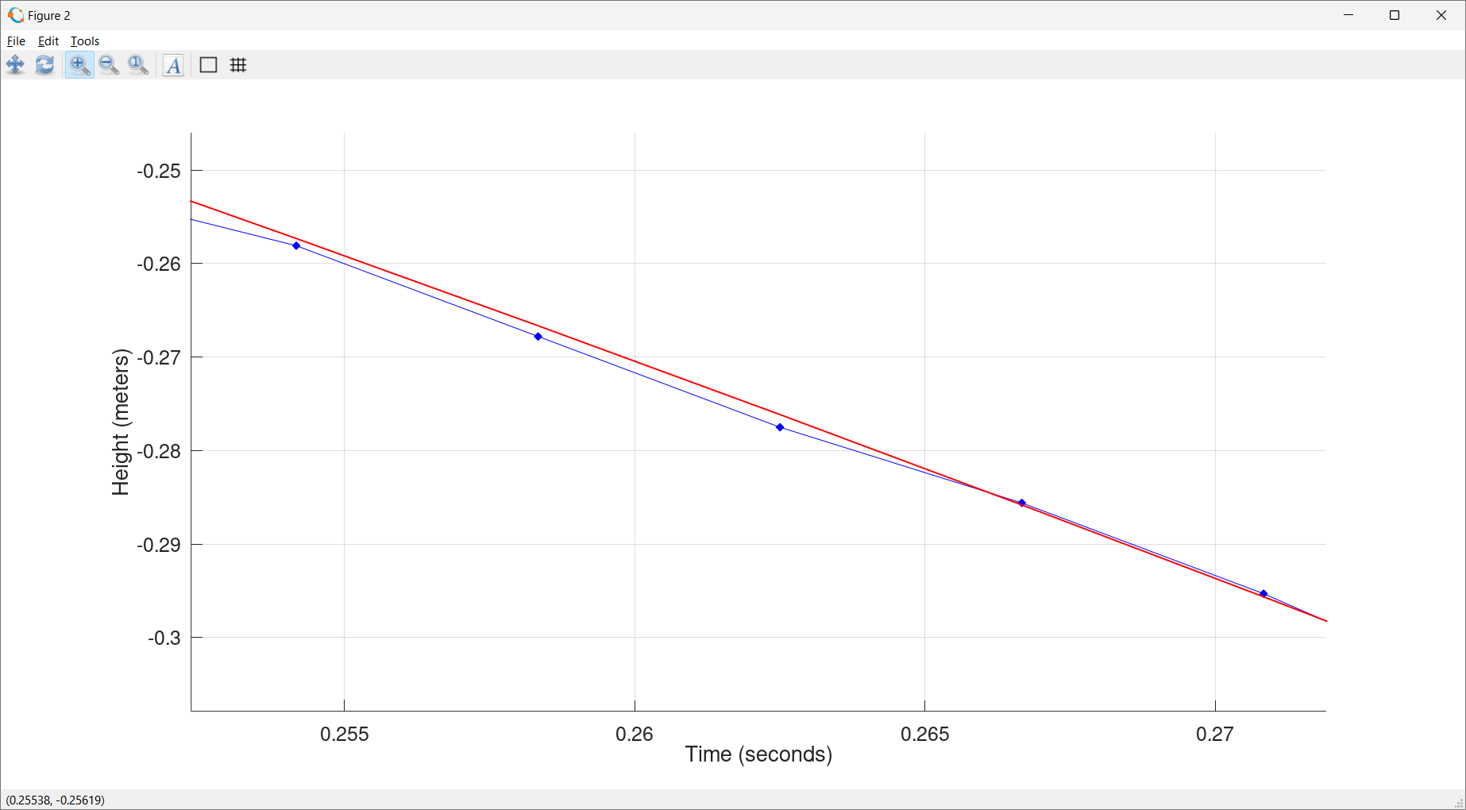

Slide 22
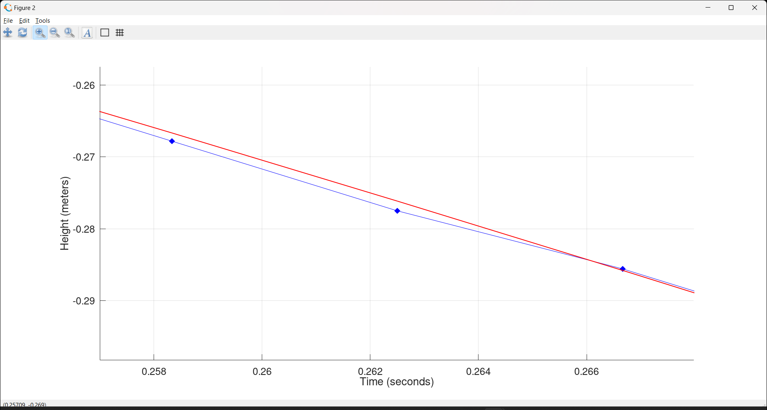

Slide 23
Distance = -(4.7m/s^2)*time^2
+(0.17 m/s)*time
+(.001 m)

Slide 24
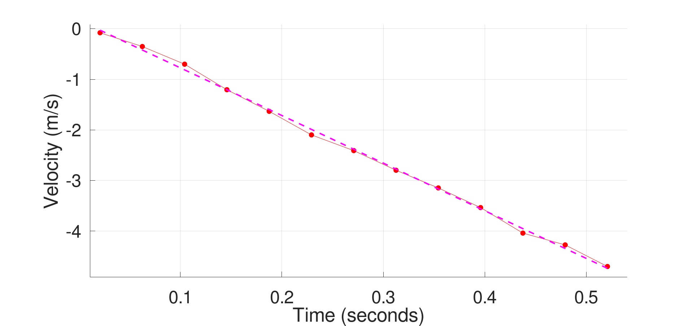
Velocity = -(9.46 m/s^2)*time+.17 m/s

Slide 25
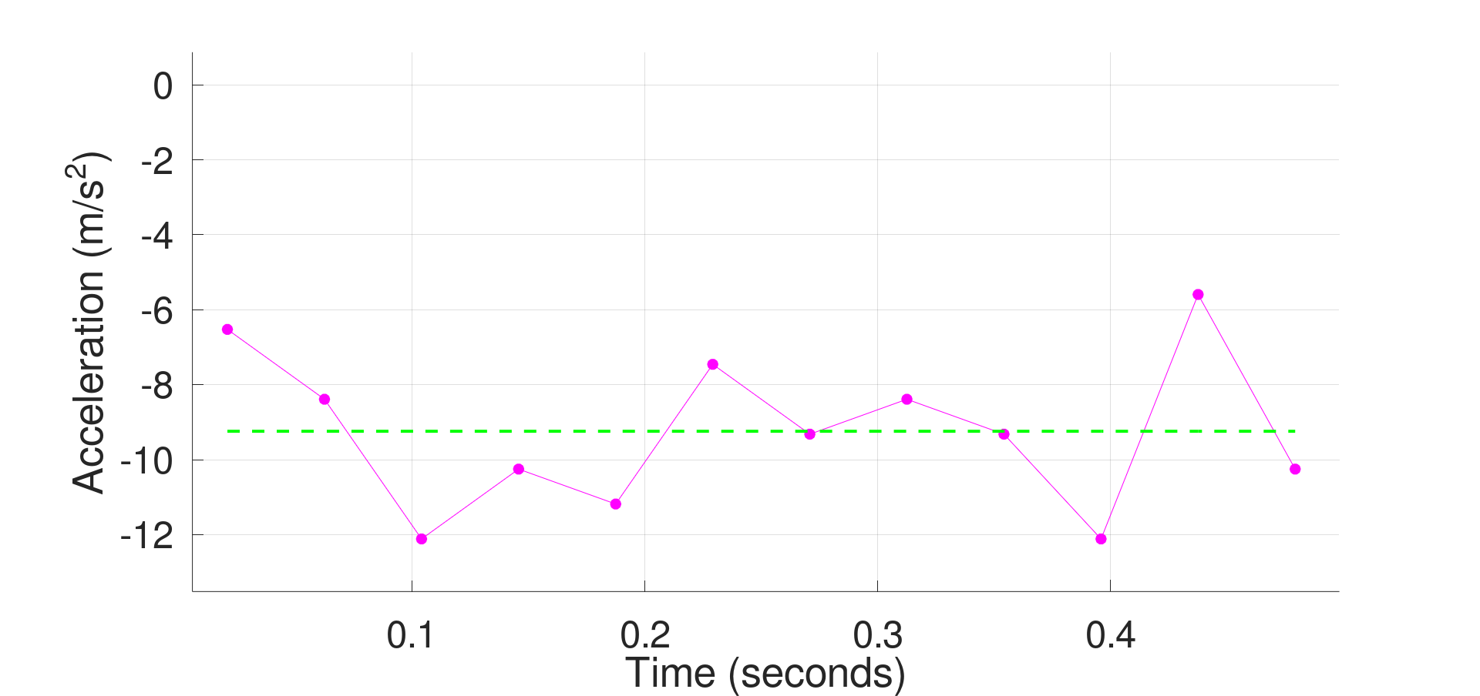

Acceleration = $\frac{Δv}{Δt}$ = -(9.2 m/s^2)

Slide 26
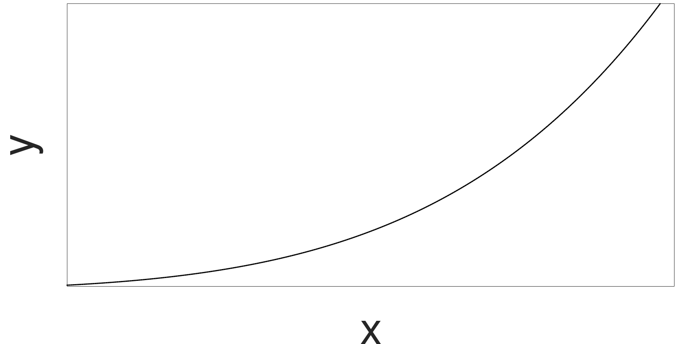



Recall The Definition of The Derivative
s$\underset{}{lope=}\frac{Δy}{Δx}$
$Δ$y
$Δ$x

Slide 27

Recall The Derivative
$\lim_{Δx→0}\frac{Δy}{Δx}≡$ $\frac{dy}{dx}$
s$\underset{}{lope=}\frac{Δy}{Δx}$
$Δ$y
$Δ$x

Slide 28



Recall The Derivative
$\lim_{Δx→0}\frac{Δy}{Δx}≡$ $\frac{dy}{dx}$
$Δ$y
s$\underset{}{lope=}\frac{Δy}{Δx}$
$Δ$x

Slide 29


What about Purely Mathematically?
$$y=f\left(t\right)$$
$$v=\lim_{Δt→0}\frac{Δy}{Δt}≡\frac{ⅆy}{dt}$$
$$a=\lim_{Δt→0}\frac{Δv}{Δt}≡\frac{ⅆv}{dt}$$

Slide 30



What about Purely Mathematically?
$$y=f\left(t\right)=\frac{1}{2}at^{2}$$
$$v=\lim_{Δt→0}\frac{Δy}{Δt}≡\frac{ⅆy}{dt}=a∙t$$
$$a=\lim_{Δt→0}\frac{Δv}{Δt}≡\frac{ⅆv}{dt}≡\frac{ⅆ2y}{dt2}=a$$

Slide 31
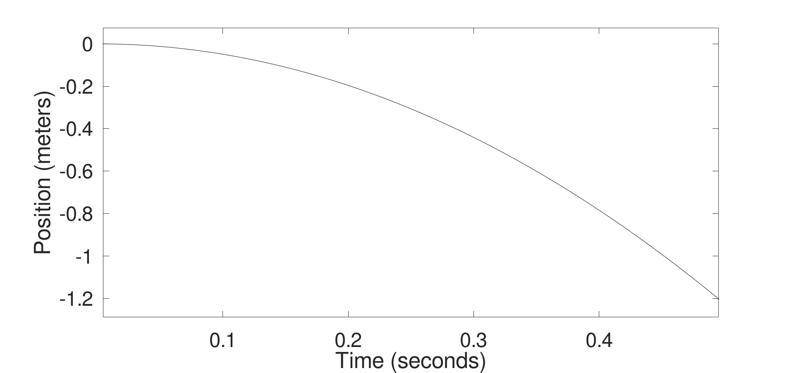
Let’s assume a = 9.8 m/s^2 (the accepted value)

Slide 32
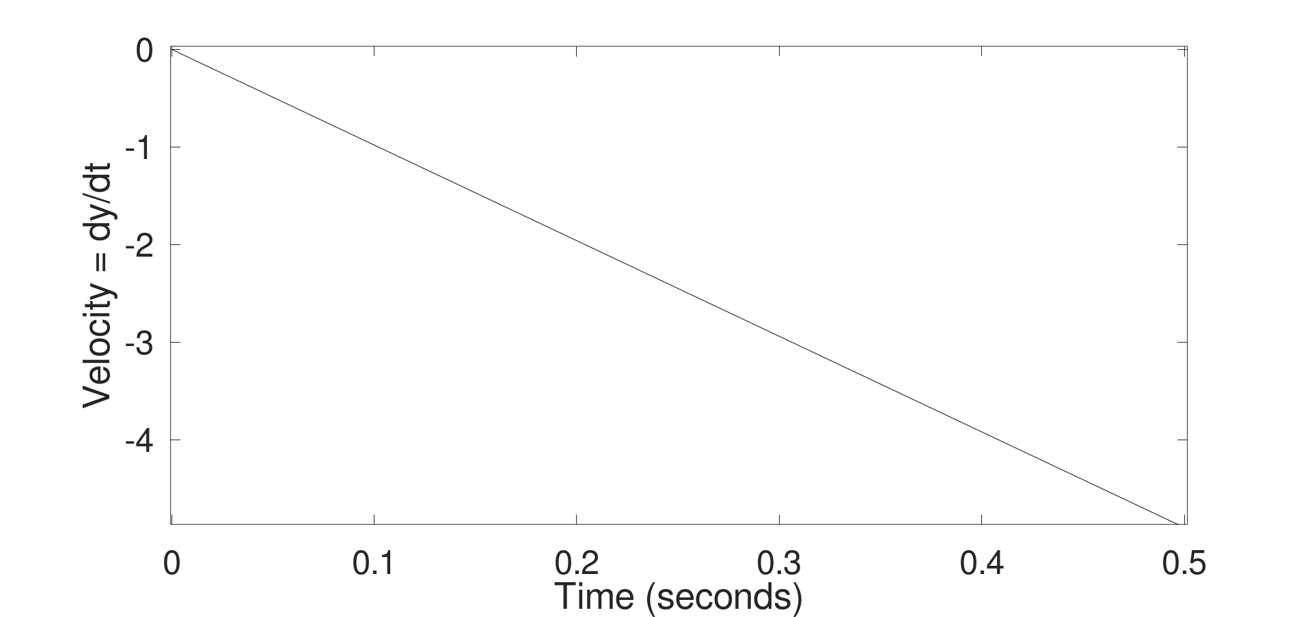

Slide 33
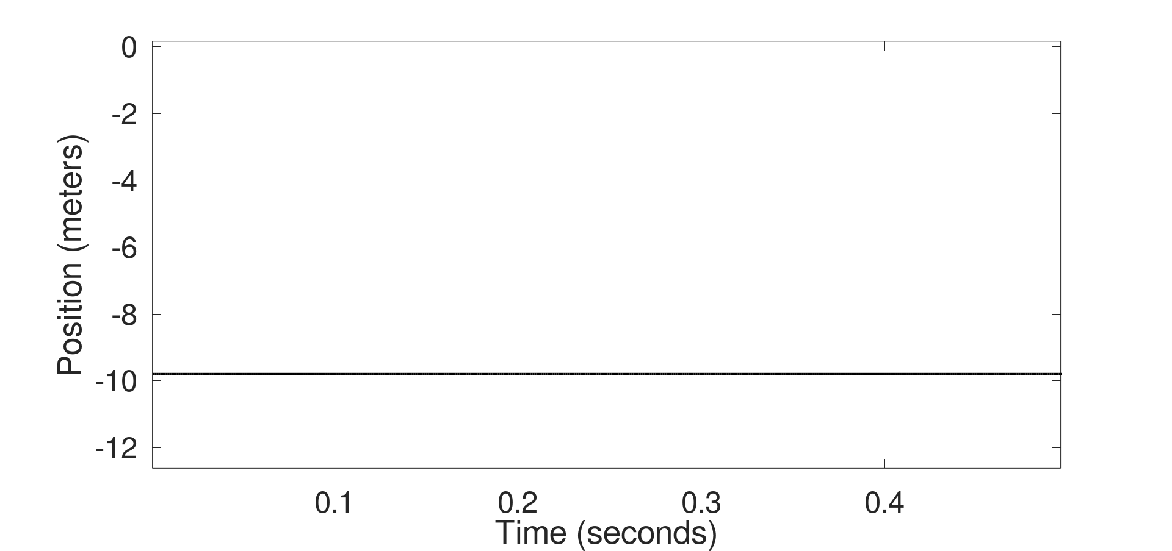
Acceleration (m/s^2)

